Slide 1



Oral Immunotherapy: Not OUtMATCH-ed Yet?
Michael Main, MD
Fellow, Allergy and Immunology
Stanford Health Care
AAIFNC Biannual Journal Club Debate, 11/1/23
Notes:
Intro

Slide 2
Introduction
IgE-mediated food allergies affect a significant proportion of the global population, estimated to be up to 8% of children and 2-3% of adults worldwide.
Moreover, food allergy is the leading cause of anaphylaxis in the pediatric population.
The standard of care for food allergy has primarily been avoidance, epinephrine use for severe allergic reactions, and periodic testing.
Over the last decade, oral immunotherapy (OIT) has been the most-studied active intervention for food allergy.
Notes:
Food allergy. Everyone here has SOME exposure to this; some may have even been inspired to go into this field because their personal experiences with food allergy! ood allergy represents a big problem: it affects a significant portion of children with increasing prevalence and is also the leading cause of anaphylaxis in children. The standard of care for food allergy has long been one of avoidance and quick reaction, in the event of an accidental exposure leading to a severe reaction. Living in fear of an accidental exposure somewhere in your, or your food allergic child’s, life is rather inconvenient, and left a need for a therapy that could potentially decrease reactivity or attenuate the response entirely. Oral immunotherapy has taken up a great deal of space in this void, moving from the question of “can this work?“ to “how can we roll this out into clinics?” over the span of the last ten years. This is, in part, because OIT is a good treatment.

Slide 3
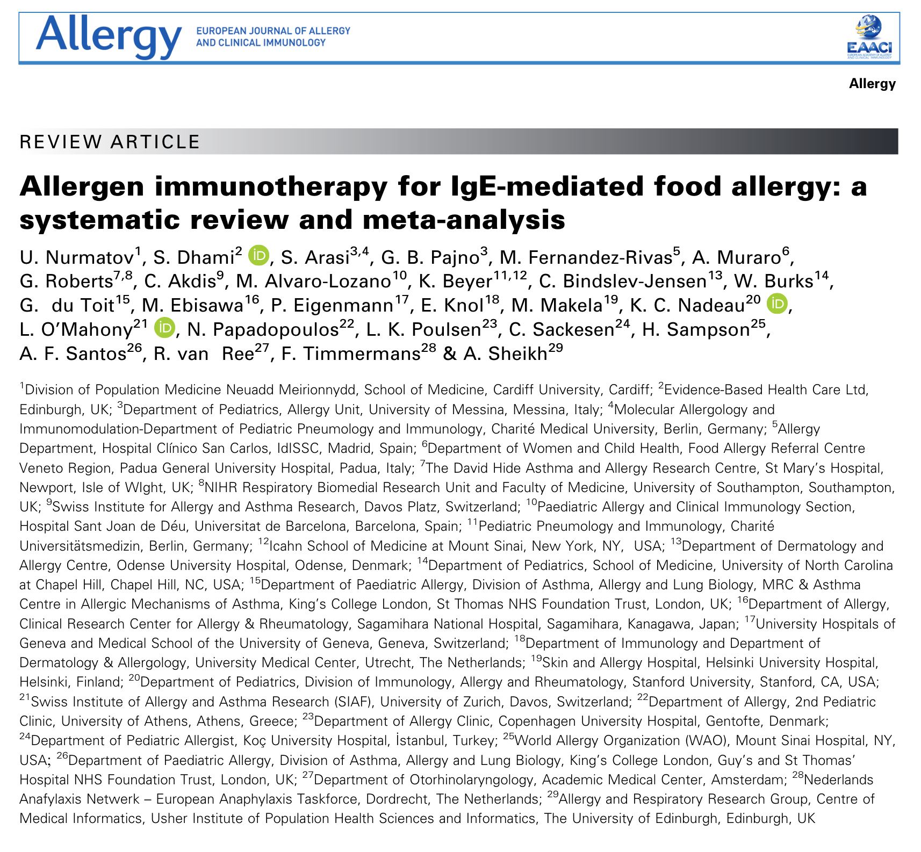
Desensitization, Remission, and Disease Modification
OIT is effective at inducing desensitization, or an induction of an increased allergic reaction threshold, in a variety of foods.
OIT to peanut, milk and egg have been widely studied and found to induce desensitization in most patients.
OIT has also been demonstrated to, in some studies, induce sustained unresponsiveness, or remission, a state of non-responsiveness following discontinuation of oral immunotherapy.
Nurmatov, et al, 2017: conducted a systematic review and meta-analysis of 31 studies (mostly RCTs) to help develop guidelines for the EAACI for allergen immunotherapy for IgE-mediated food allergy.
Notes:
So let’s talk about one of the biggest strengths of oral immunotherapy compared to biologics as we currently understand their role today; namely, that it is an immunomodulatory and disease-modifying therapy that can induce desensitization (so increasing the allergic reaction threshold) as well as lead to long-term, sustained unresponsiveness (or remission, as some groups prefer to call it now) in which OIT can be discontinued and the food in question can be ad libbed in the diet, which is more or less the dream for food allergy patients.
So there is a good deal of data on the ability of OIT to induce desensitization with varying data on sustained unresponsiveness; in a systematic review and meta-analysis that was done in 2017 as part of developing the EAACI guidelines for allergen immunotherapy for food allergy; Nurmatov and group evaluated 31 allergen immunotherapy studies, most of which were RCTs.

Slide 4
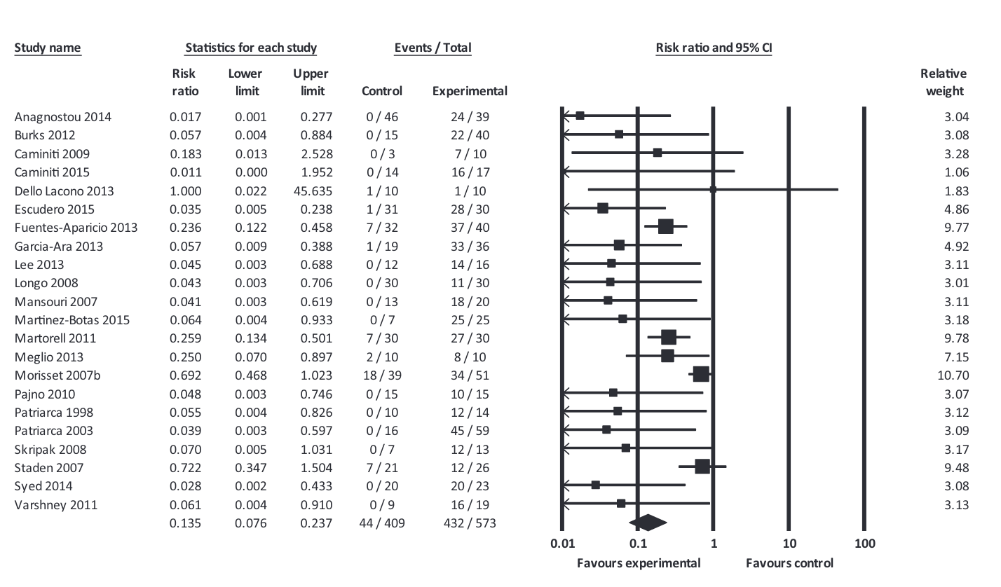
RR = 0.14, 95% CI 0.08, 0.24)
Notes:
Here is the subgroup analysis for OIT specifically from this paper, which found well-defined evidence of efficacy of OIT to desensitize patients to milk, egg and peanut as well as sustained unresponsiveness in about 30% of patients following OIT. Generally speaking, a great deal of the data has focused on milk, egg and peanut, and one of the weaknesses leveraged against OIT previously has been a paucity of evidence for other food allergens.

Slide 5
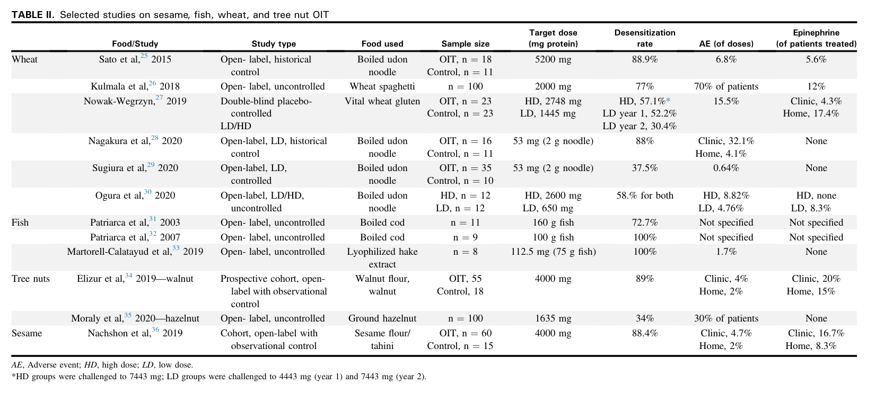
Perret et al, 2021
Notes:
Following up on that, I just wanted to note that other common food allergens have undergone various trials in the last few years with mostly good desensitization rates.

Slide 6
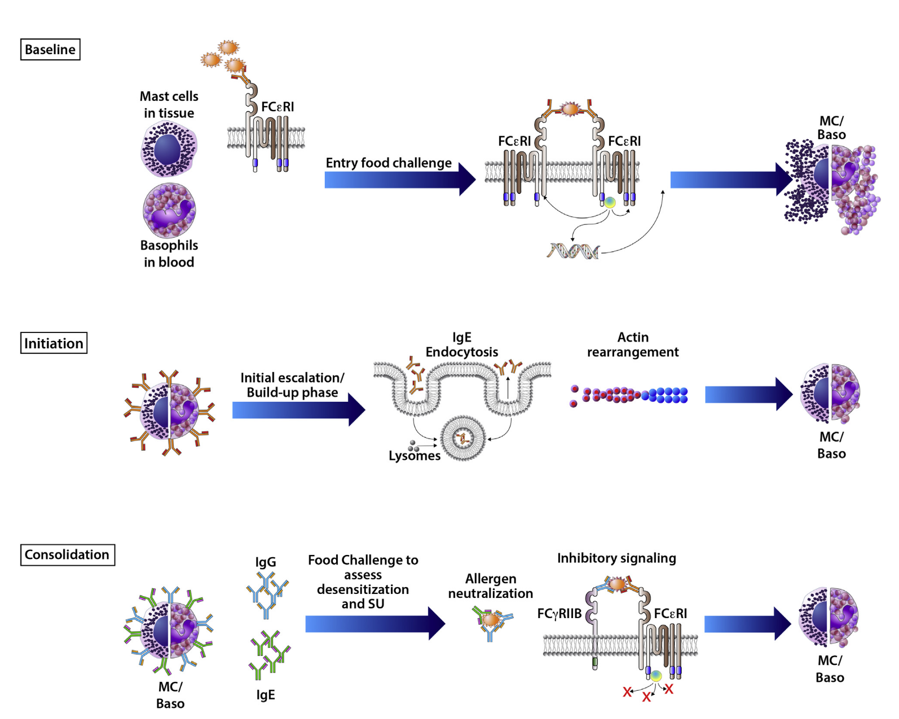
Desensitization, Remission, and Disease Modification
Oral immunotherapy is an immunomodulatory and disease-modifying intervention.
Repeated exposure to low dose antigen leads to IgE endocytosis and actin rearrangement.
Subsequent increasing doses of allergen are associated with a decrease in T_{H}2 activity, increased frequency of IL-10 producing CD4+ T cells, and production of allergen-specific IgG₄ antibody.
Kulis et al., “Immune Mechanisms of Oral Immunotherapy.”
Notes:
So what is the mechanism behind desensitization and, more importantly, sustained unresponsiveness? With initiation of OIT and repeated exposure to low doses of allergenic food protein, IgE endocytosis and actin rearrangement may occur and reduce reactivity of mast cells and basophils; subsequent dosing and continuation of maintenance is associated with a decrease in Th2 activity, increased frequency of IL-10 producing CD4+ T cells, and production of allergen-specific IgG4 which can compete with sIgE for allergen binding.
Circulating allergen-specific IgG can neutralize allergen (such as IgEs not cross-linked on effector cells, and allergen specific IgG can bind to Fc gamma Receptor IIb to induce inhibnitory signaling with IgE and IgG cross-linking, preventing degranulation).

Slide 7
Desensitization, Remission, and Disease Modification
While evaluation of remission/sustained unresponsiveness has generally shown a limited duration of benefit, there is evidence that taking advantage of intervention with OIT in early life may be beneficial given its immunomodulatory nature.
Consider the LEAP trial and the LEAP-ON study:
  Du Toit, et al, 2015: RCT using 4 mo-11 mo olds with pre-existing sensitivity to peanut→significantly reduced frequency of peanut allergy along with significant increases in peanut-specific IgG, IgG₄, IgG₄:IgE ratio when given peanut protein daily
  Du Toit, et al, 2016: In patients from the LEAP trial, avoidance of peanut for 12 months was not associated with an increased incidence of peanut allergy; also continued to have higher levels of peanut-specific IgG₄ and peanut-specific IgG₄:IgE ratio
Notes:
One perceived drawback of oral immunotherapy is that, while there is evidence that some patients CAN get to a state of sustained unresponsiveness, that clearly does not happen for ALL patients, and the strength of OIT as an intervention in food allergy would be made that much stronger if, perhaps, there was a potential window in which this disease-modifying effect of OIT was more efficacious...
And it appears that there is, particularly in early childhood. Thinking back to the LEAP trial, we saw patients from ages 4 mo to 11 mo with pre-existing sensitivity to peanut have significantly reduced amounts of peanut allergy along with evidence of immune modulation in the sense that peanut-specific IgG levels were increased in the peanut consumption groups; in LEAP-ON, these patients could then avoid peanut intake for 12 months with no significant increase in peanut allergy while maintaining these immunomodulatory benefits.

Slide 8
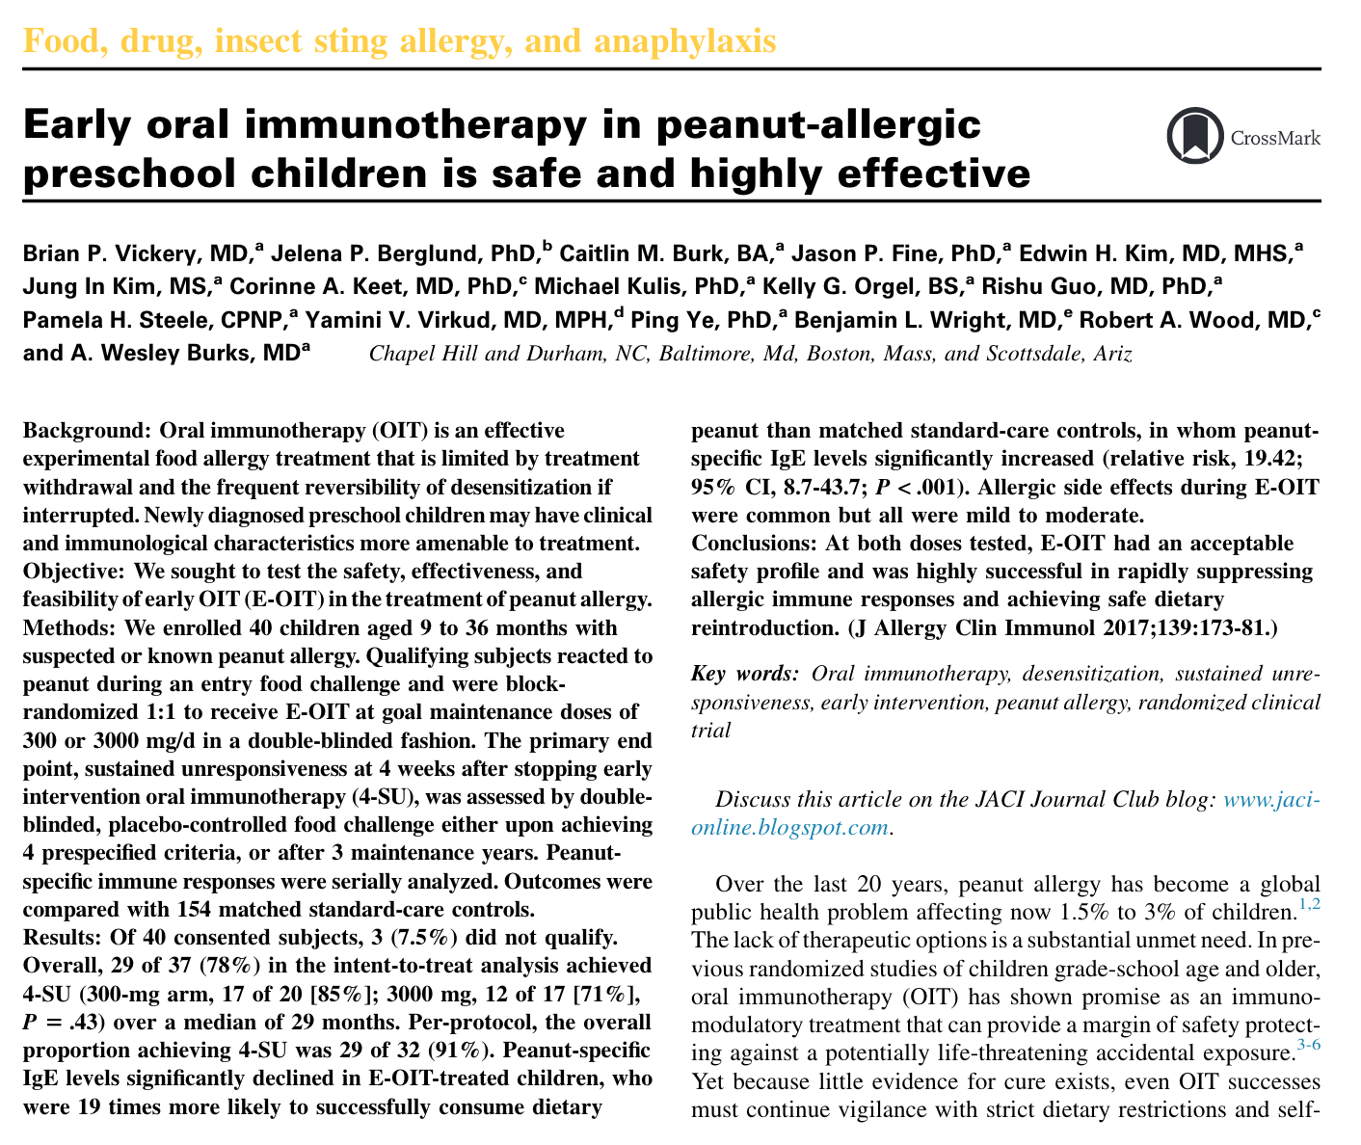
Desensitization, Remission, and Disease Modification
Vickery et al, 2017: conducted a single-center, double-blinded clinical trial to evaluate the effectiveness of early intervention oral immunotherapy.
Evaluated:
  Rates of desensitization and sustained unresponsiveness in both low and high dose peanut OIT
  Effect of baseline peanut specific IgE levels on outcome
  Effect of peanut exposure on the allergic immune response
Notes:
Vickery et al, 2017:
Interested in studying the clinical effectiveness of early OIT as an immunomodulatory and disease-modifying treatment, postulating that this could interrupt allergic priming before full maturation, as 1) food specific IgE production begins in infancy, and 2) Th2 cytokine expression further drives food specific IgE production over the first two years of life.
Devised a randomized, double blinded clinical trial of both low and high dose peanut E-OIT in children aged 9 to 36 months, compared to a control group of untreated peanut-allergic patients; primary outcome was sustained unresponsiveness after stopping OIT for four weeks after three maintenance years. Low dose was 300mg/d, high dose was 3000mg/d.
ITT pop: 37 patients; 3 of these withdrew for treatment related AEs, two withdrew for nonadherence.
Fig 2A: in the ITT analysis, 30 of 37 overall were desensitized at the end of treatment. A total of 29/37 achieved 4-SU; in the per protocol analysis, rate of desensitization was 30/32 with 29/32 achieving 4-SU.
Also noted that the median psIgE level significantly declined in OIT subjects while in controls, it increased (Fig 2B).

Slide 9
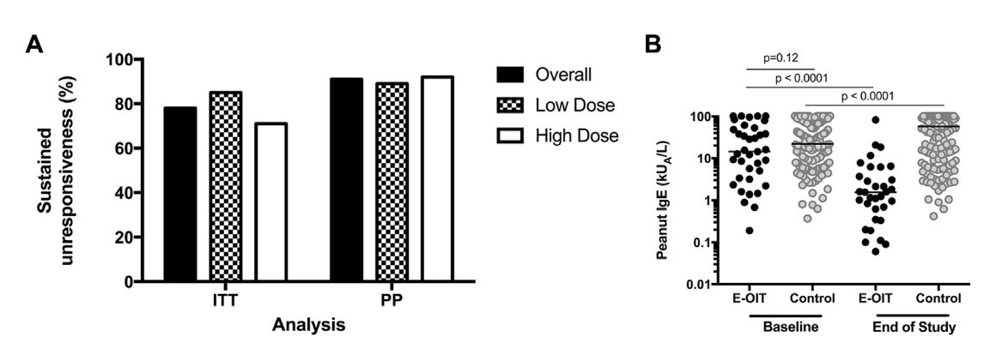
Notes:
So looking at the results, on the left we see the primary outcome in the intention to treat and per protocol analyses for early OIT. In the per protocol analysis, rate of desensitization was 94% with 91% achieving sustained unresponsiveness. In the intention to treat analysis, 81% were desensitized and 78% achieved sustained unresponsiveness. On the right, we see that median psIgE levels significantly declined in OIT subjects while increasing in controls.
Fig 2A: shows proportion of all subjects, in both low and high dose treatment arms, achieving sustained unresponsiveness for both intent to treat and per protocol analyses. In the ITT analysis, a total of 29/37 achieved 4-SU; in the per protocol analysis, 29/32 achieved 4-SU.
Fig 2B: shows distribution of psIgE between participants receiving early-OIT and matched controls. Median psIgE level significantly declined in OIT subjects to 1.6kUa/L while in controls, it increased to 57.4 kUa/L.

Slide 10
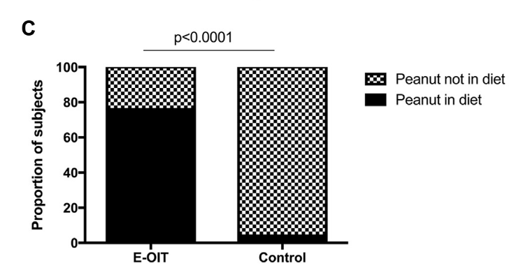
Notes:
Fig 2C: Proportions of E-OIT and control participants able to reintroduce peanut-containing foods in the diet at the end of the study period (median 43 months), evaluated by OFC after a period of avoidance (for the control group) and maintenance E-OIT in both the low dose and high dose treatment arms. Overall proportion of controls successfully introducing peanut was 4%, compared to 78% in the OIT group.

Slide 11
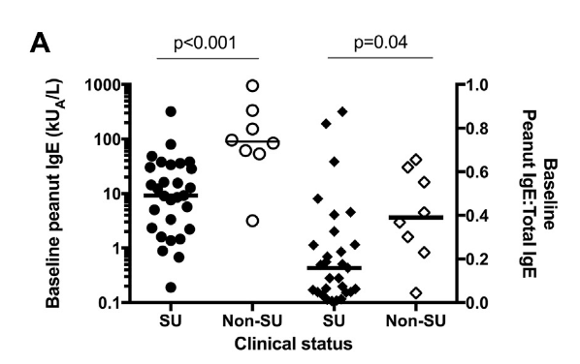
Notes:
Fig 3: In their association of baseline psIgE characteristics and outcomes, they noted that both baseline psIgE and the ratio peanut-specific IgE to total IgE are significantly lower in successes than among failures in the intention to treat population.

Slide 12
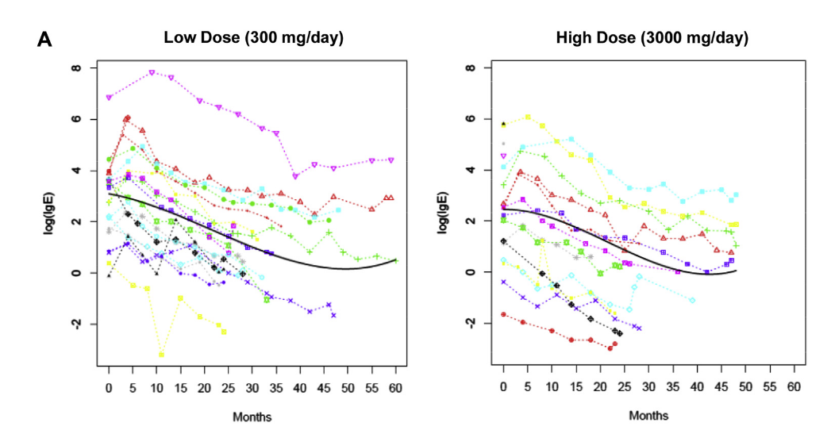
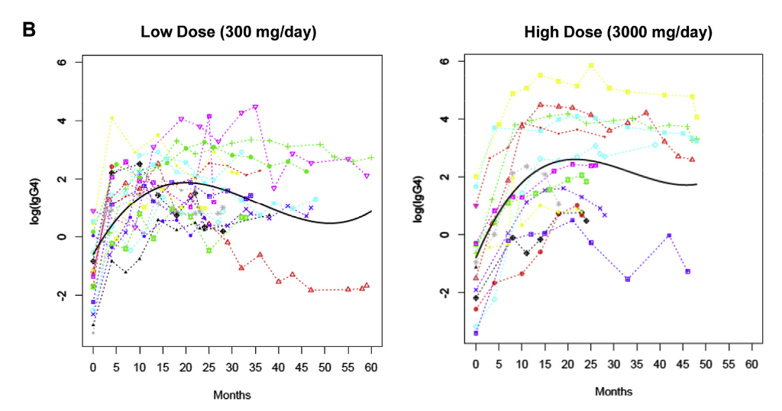
Notes:
Here, the group analyzed changes in immunological outcomes Fig 4A: log transformed psIgE for both doses of E-OIT; shows downward trend in psIgE levels. Fig 4B shows an inverse trend, in which peanut-specific IgG4 levels increase over time. No statistically significant difference in change from baseline between the two groups.
So the major takeaways from this study, which was the the first to target peanut-allergic children younger than 3 years old for OIT treatment (and the first to study two peanut OIT doses prospectively!), was that a fairly high percentage of food allergic patients receiving early OIT 1) displayed sustained unresponsiveness, 2) demonstrated immunomodulatory effects and 3) most were able to incorporate the allergenic food in question.

Slide 13
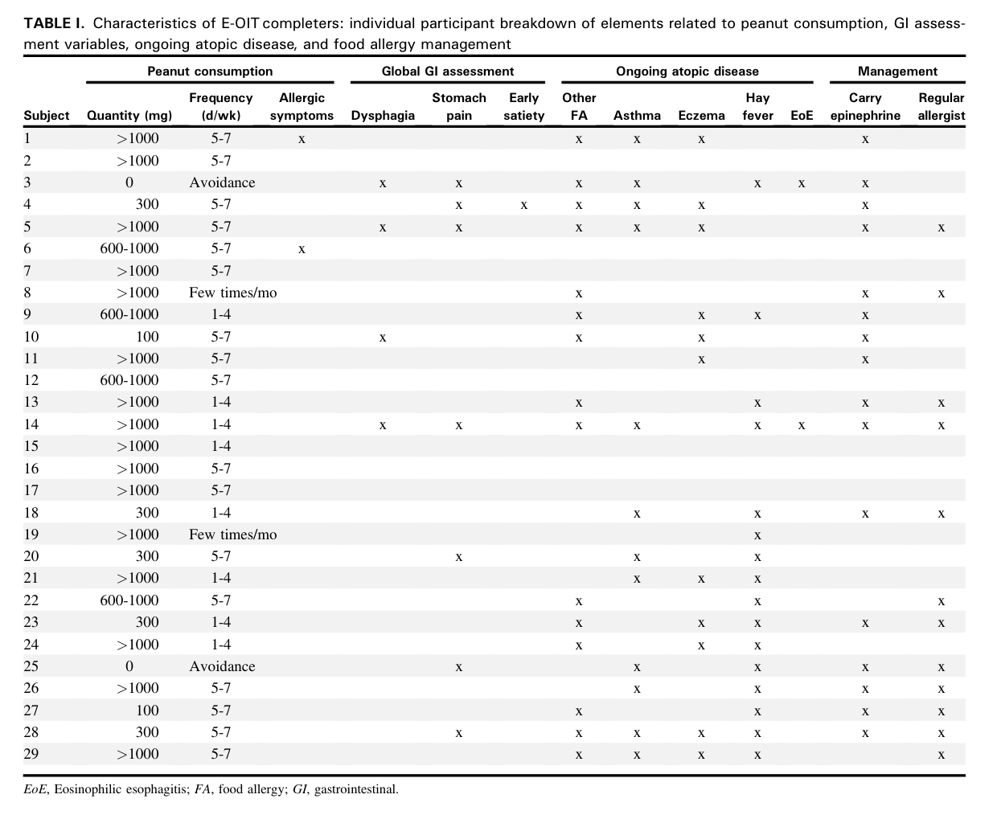
Herlihy, et al, 2021
Notes:
Designed a 21 item follow up telephone survey to administer to completers of the early-OIT study (Vickery 2017); wanted to gather info about quantity, frequency, safety, tolerability and lifestyle impact.
39 participants from the parent E-OIT study were completers; survey response rate was 74% with mean follow up interval being 65 months.
27 of the 29 responders reported continuing dietary peanut consumption; over half of these patients were eating >1000mg of peanut protein in a single serving.

Slide 14
Herlihy, et al, 2021
Notes:
Designed a 21 item follow up telephone survey to administer to completers of the early-OIT study (Vickery 2017); wanted to gather info about quantity, frequency, safety, tolerability and lifestyle impact.
39 participants from the parent E-OIT study were completers; survey response rate was 74% with mean follow up interval being 65 months.
27 of the 29 responders reported continuing dietary peanut consumption; over half of these patients were eating >1000mg of peanut protein in a single serving. Additionally, most were eating peanut 5-7 days per week!

Slide 15
Herlihy, et al, 2021
Notes:
Designed a 21 item follow up telephone survey to administer to completers of the early-OIT study (Vickery 2017); wanted to gather info about quantity, frequency, safety, tolerability and lifestyle impact.
39 participants from the parent E-OIT study were completers; survey response rate was 74% with mean follow up interval being 65 months.
27 of the 29 responders reported continuing dietary peanut consumption; over half of these patients were eating >1000mg of peanut protein in a single serving. Additionally, most were eating peanut 5-7 days per week! Two stopped; one was diagnosed with biopsy-proven EoE and the other had an extreme taste aversion to peanut.

Slide 16
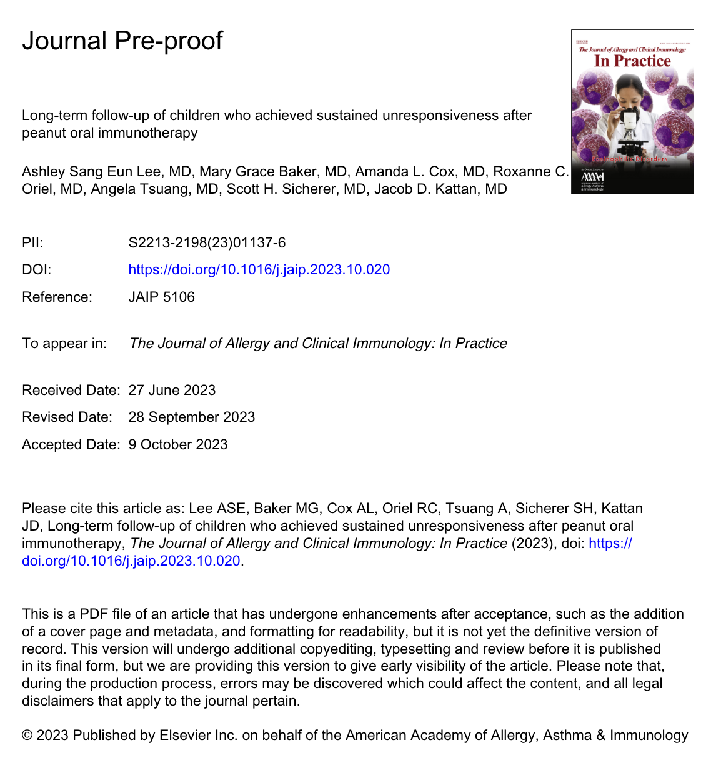
Desensitization, Remission, and Disease Modification
San Eun Lee, et al, 2023: wanted to evaluate longer-term outcomes in patients who underwent peanut OIT at Mount Sinai.
Performed clinical follow-up chart review of 44 children (median age 6.5 years old) who:
  Successfully completed OIT build up to maintenance dosing (median 1-1.5g peanut protein) at Jaffe and had shown a decrease in peanut sIgE, Ara h 2 sIgE and peanut SPT.
  Successfully underwent a desensitization OFC with ~6g peanut protein after a median 18.4 months of maintenance dosing.
  Successfully proved sustained unresponsiveness after discontinuing daily peanut dosing for 4-6 weeks then repeating the desensitization OFC.
Notes:
Sang Eun Lee, et al, 2023: a (very) recent study that evaluated longer-term outcomes in patients who underwent peanut OIT at Mount Sinai; interesting in part due to their having the largest pediatric cohort after achieving SU to peanut (44 children).
Each of these patients (median age was 6.5 years old) had successfully completed OIT build up at Jaffe; these patients had shown a decrease in testing parameters (peanut sIgE, Ara h 2 sIgE and peanut SPT) during a period of OIT maintenance (median duration of maintenance OIT with 1.15g of peanut was 18.4 months); then underwent a desensitization OFC to a full serving of peanut butter (about 6g of peanut protein).
These 44 patients were then instructed to discontinue daily peanut dosing for 4-6 weeks before repeating the full serving peanut OFC to assess for SU (median length of time for dosing discontinuation was 35 days). Then the patients were encouraged to ad lib peanut without specifying ingestion frequency and precise amounts.
After a median of 552 days after passing the SU OFC, all 44 patients continued to consume peanut; 57% reported consuming more than 3g of peanut protein, 73% continued to have peanut at least weekly, and no parent reported adverse reactions to peanut.
So while it was a relatively small sample size, it interestingly showed 100% of their cohort continuing to consume peanut at varying quantites and frequencies after a significant amount of time following sustained unresponsiveness achievement, and given the lack of regimented feeding schedules and protein amounts, this is as close a reflection to real life patient behaviors as any.

Slide 17
Desensitization, Remission, and Disease Modification
Then instructed to ad lib peanut without specifying 1) ingestion frequency or 2) protein amount.
After median of 552 days following passing the SU OFC:
  All 44 patients continued to consume peanut
  57% consuming more than 3g of peanut protein
  73% continued to consume peanut at least weekly
  No parent reported any adverse reaction to peanut (!)
Notes:
Sang Eun Lee, et al, 2023: a (very) recent study that evaluated longer-term outcomes in patients who underwent peanut OIT at Mount Sinai; interesting in part due to their having the largest pediatric cohort after achieving SU to peanut (44 children).
Each of these patients (median age was 6.5 years old) had successfully completed OIT build up at Jaffe; these patients had shown a decrease in testing parameters (peanut sIgE, Ara h 2 sIgE and peanut SPT) during a period of OIT maintenance (median duration of maintenance OIT with 1.15g of peanut was 18.4 months); then underwent a desensitization OFC to a full serving of peanut butter (about 6g of peanut protein).
These 44 patients were then instructed to discontinue daily peanut dosing for 4-6 weeks before repeating the full serving peanut OFC to assess for SU (median length of time for dosing discontinuation was 35 days). Then the patients were encouraged to ad lib peanut without specifying ingestion frequency and precise amounts.
After a median of 552 days after passing the SU OFC, all 44 patients continued to consume peanut; 57% reported consuming more than 3g of peanut protein, 73% continued to have peanut at least weekly, and no parent reported adverse reactions to peanut.
So while it was a relatively small sample size, it interestingly showed 100% of their cohort continuing to consume peanut at varying quantites and frequencies after a significant amount of time following sustained unresponsiveness achievement, and given the lack of regimented feeding schedules and protein amounts, this is as close a reflection to real life patient behaviors as any.

Slide 18
Desensitization, Remission, and Disease Modification
In comparison...
Omalizumab: demonstrated to cause decreases in free IgE levels, and downregulation of FcεRI on basophils and mast cells.
  Slavin et al, 2009: found that these effects waned and symptoms returned following av. 52 weeks of treatment followed by 8 weeks cessation in asthma patients.
Dupilumab: Guttman-Yassky, et al, 2018: demonstrated ability to reduce expression of genes involved in type 2 inflammation and serum biomarkers (including total, allergen-specific IgE) when treated for 16 weeks.
Notes:
Fc epsilon R1: high affinity IgE receptor
While this may not particularly hold true for

Slide 19
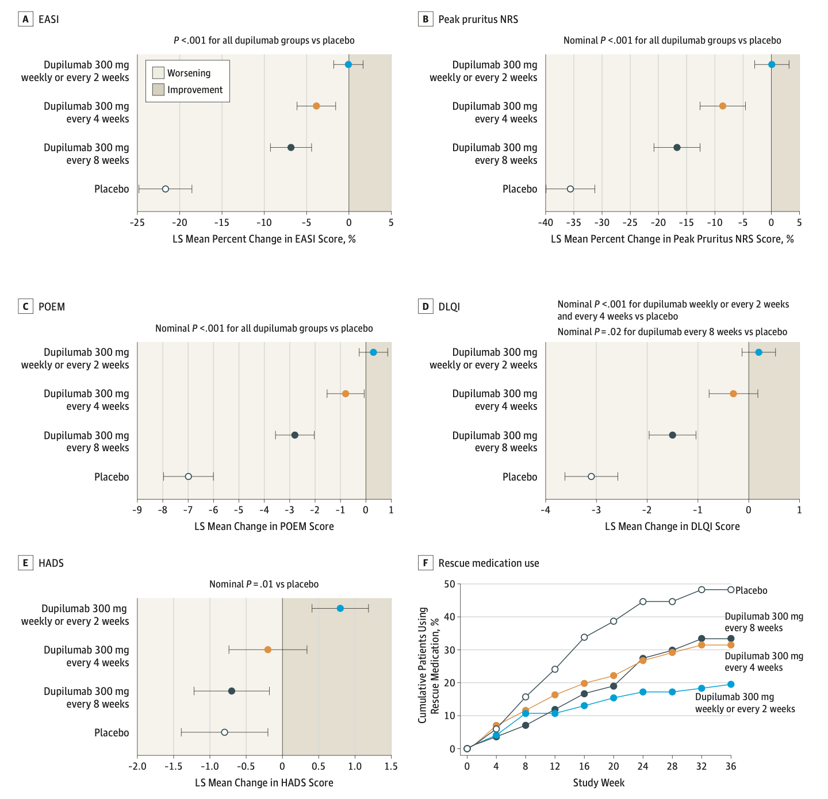
Worm et al, 2016
Notes:
The SOLO-CONTINUE trial: In 2016, Worm et al published their randomized clinical trial which had taken patients from two previous dupilumab monotherapy clinical trials who had achieved a 75% improvement in Eczema Area and Severity Index scores (EASI-75), and randomized them to either weekly/every two week treatment, every 4 week treatment, 8 week treatment, or placebo (effectively withdrawal). Found that trying to wean the dose resulted in recurrence of symptoms, and note that placebo (withdrawal) was significantly affected. These patients were also treated with dupilumab for 16 weeks in their prior trials, so they should have (theoretically) had some of the immunomodulatory effects of dupilumab.

Slide 20
Quality of Life
Food allergy and strict avoidance can lead to food-related anxiety, fear of accidental exposures, and consequent social and dietary limitations.
Effect of OIT on quality of life is an ongoing area of interest.
  Chu, et al, 2017: in the PACE systemic review and meta-analysis, assessed four studies, which had used the Food Allergy Quality of Life Questionnaire-Parent Form (FAQLQ-PF); did not improve quality of life by the minimally important difference compared with no oral immunotherapy.
  However, various other trials since then, and using more patients, have shown improvement in QOL in both patients and caregivers.

Slide 21
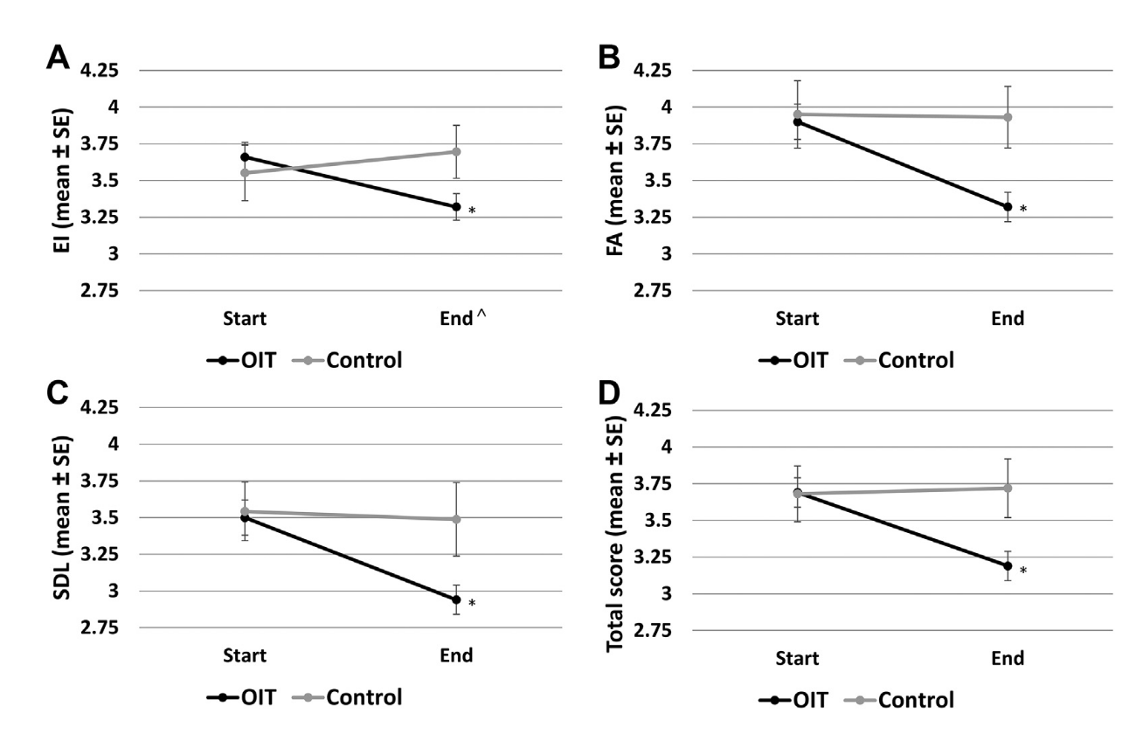
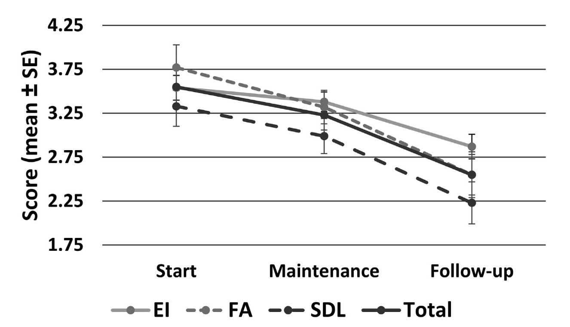
Quality of Life
Epstein-Rigbi, et al, 2018: conducted a prospective cohort study on 175 patients starting OIT to characterize changes in QOL during initiation, updosing, and maintenance.
Found significant change in OIT-treated groups compared to control in the three domains of the FAQLQ-PF (emotional impact, food anxiety and social/dietary limitation).
Additional improvement in QOL was noted in a 6 month follow up period; significant differences seen for FA and SDL.
Notes:
In this study from 2019, a group evaluated changes in QOL through the process of OIT (initiation, updosing, at achieving maintenance and then 6 months after maintenance), evaluating emotional impact, food anxiety, and social and dietary limitation. They used the Food Allergy Quality of Life Questionaire-Parent Form.
EI: emotional impact
FA: food anxiety
Social and dietary limitation: SDL

Slide 22
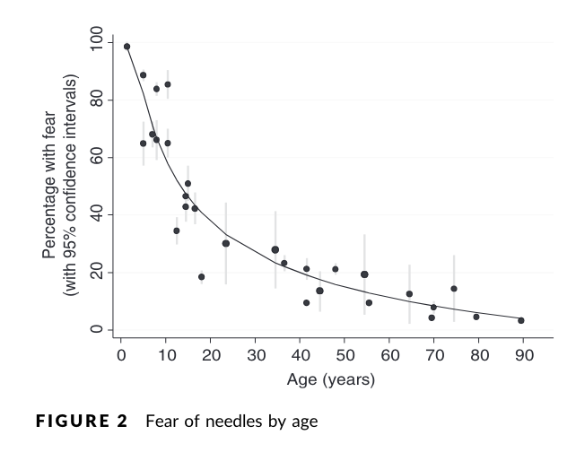
Quality of Life Considerations
OIT allows for some degree of incorporation of food into the diet, which may be important to the patient/caregiver based on their values.
OIT also offers an intervention for patients that are needlephobic, a particularly important concern in children.
  McLenon and Rogers, 2018: conducted a systematic review and meta-analysis (35 articles selected) to better characterize needle fear.
  Found that the majority of children exhibit needle fear.
Notes:
Additionally, OIT makes incorporation of the allergenic food in question part of the diet, which may be an important consideration for caregivers. Food is inherently important from multiple standpoints, not just for living and because it is tasty like Donato Enoteca, but also could be important from a cultural perspective.

Slide 23
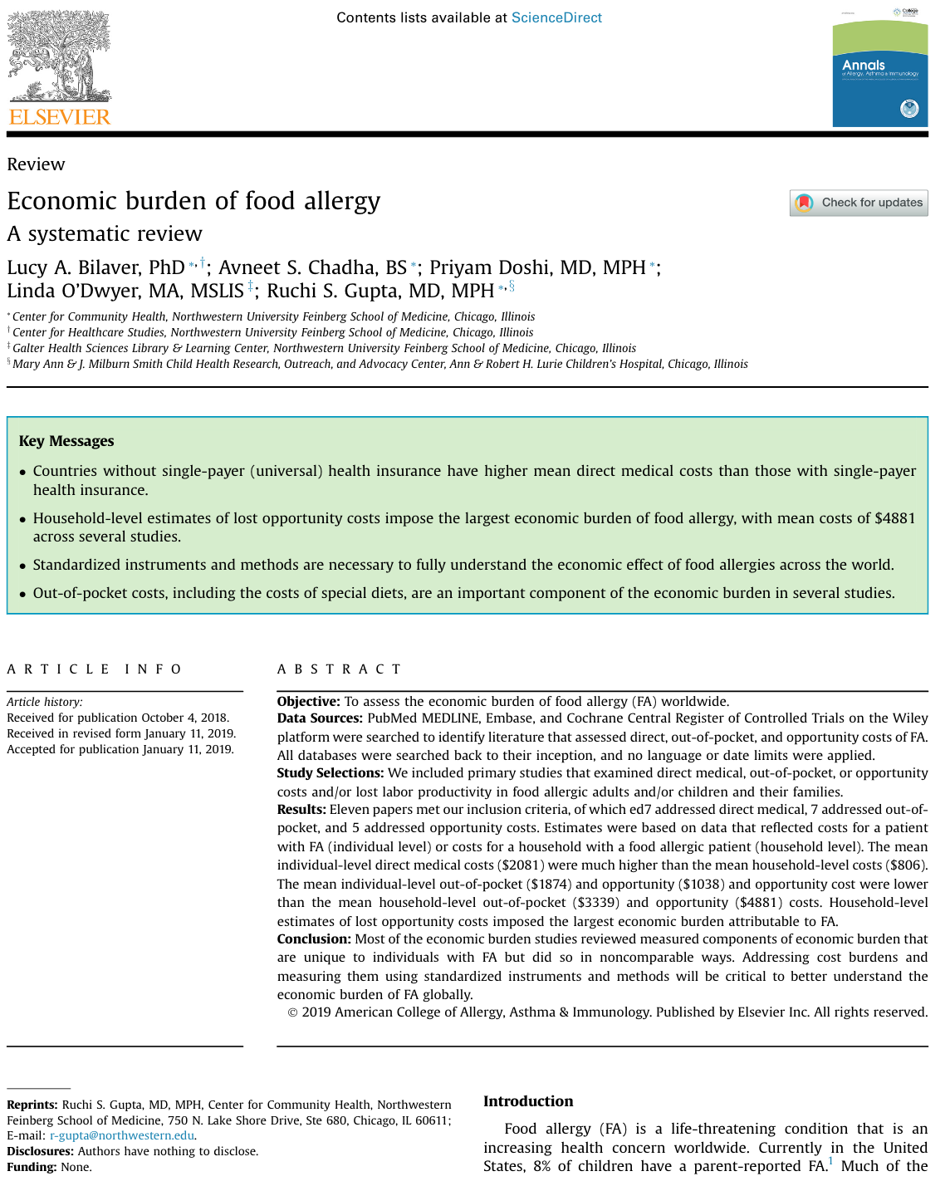
Cost Considerations
Bilaver et al, 2019: conducted a systematic review of 11 papers addressing direct medical, out-of-pocket, and lost labor productivity in food-allergic patients and caregivers.
Found that in the US:
  Average direct medical cost was approximately $800-$1100 per patient per year
  Average out of pocket cost was approximately $1400 per patient per year
  Average opportunity cost was approximately $2800 per patient per year
Notes:
Another factor to consider is the cost-effectiveness of oral immunotherapy. Already, we know that food allergy imposes a significant cost to the healthcare system as well as to families.
A systematic review of 11 papers assessing direct medical, out-of-pocket, and lost labor productivity in food-allergic patients found that...

Slide 24
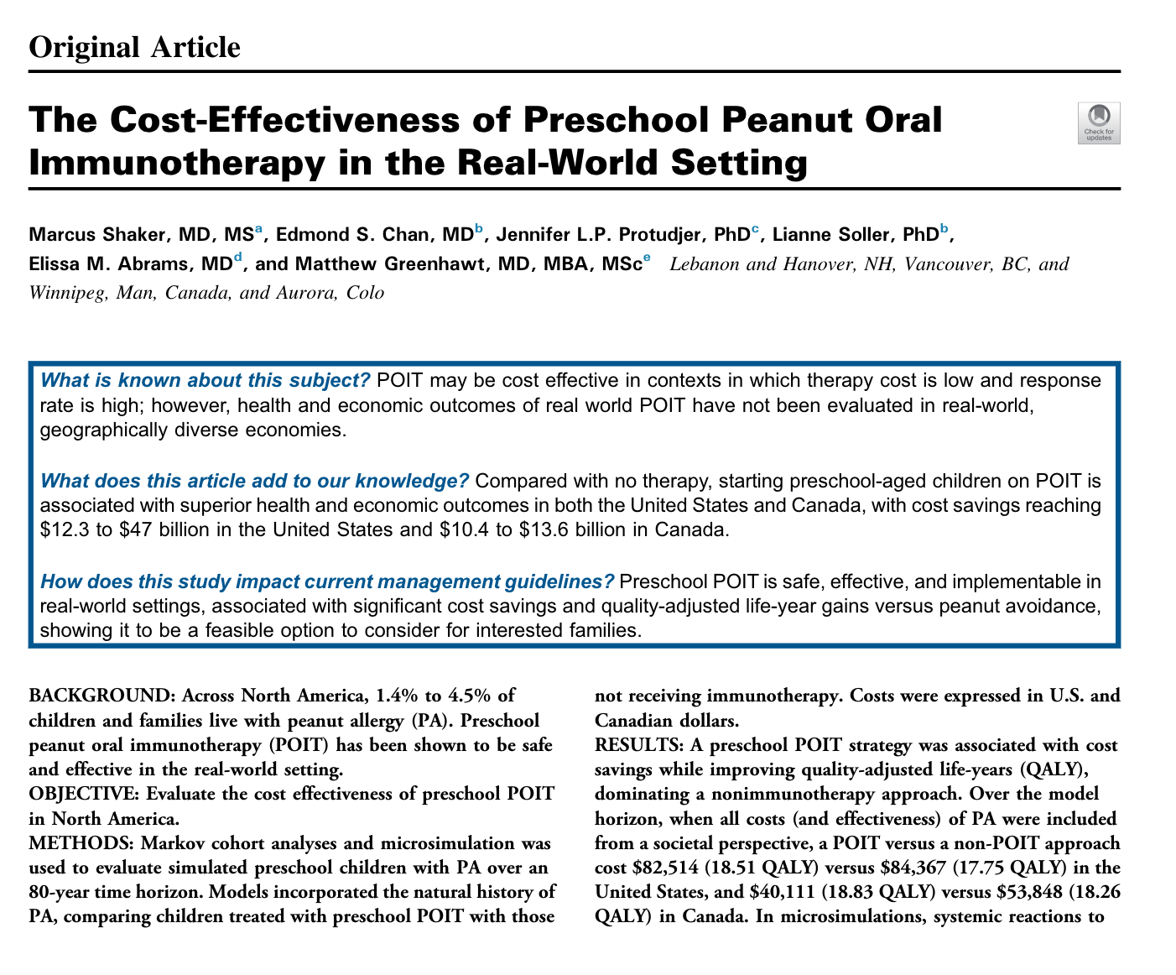
Cost Considerations
Biologics tend to be $$$...
  Wholesale acquisition cost of 150 mg of omalizumab is ~$1100
  While prices can often be brought down by copay programs, these may be subject to change.
Is OIT cost-effective?
  Shaker, et al, 2021: wanted to provide a cost-effectiveness model exploring the health and economic benefits of real-world peanut OIT implementation in US and Canadian preschool-aged children.
  Used modeling software to simulate preschool children in US and Canadian contexts.
Notes:
Shaker et al, 2021: sought to provide a cost-effectiveness model exploring the health and economic benefits of real-world OIT implementation in preschool aged children in the US and Canada.
They used software to model Markov cohorts, with a model cycle length of 1 year and an 80 year time horizon to evaluate the downstream societal costs of implementing peanut OIT. Primary outcome was incremental cost-effectiveness ratio (ICER) expressed in cost per quality-adjusted life years (QALYs) and net monetary benefit (NMB) of peanut OIT compared to peanut avoidance.

Slide 25
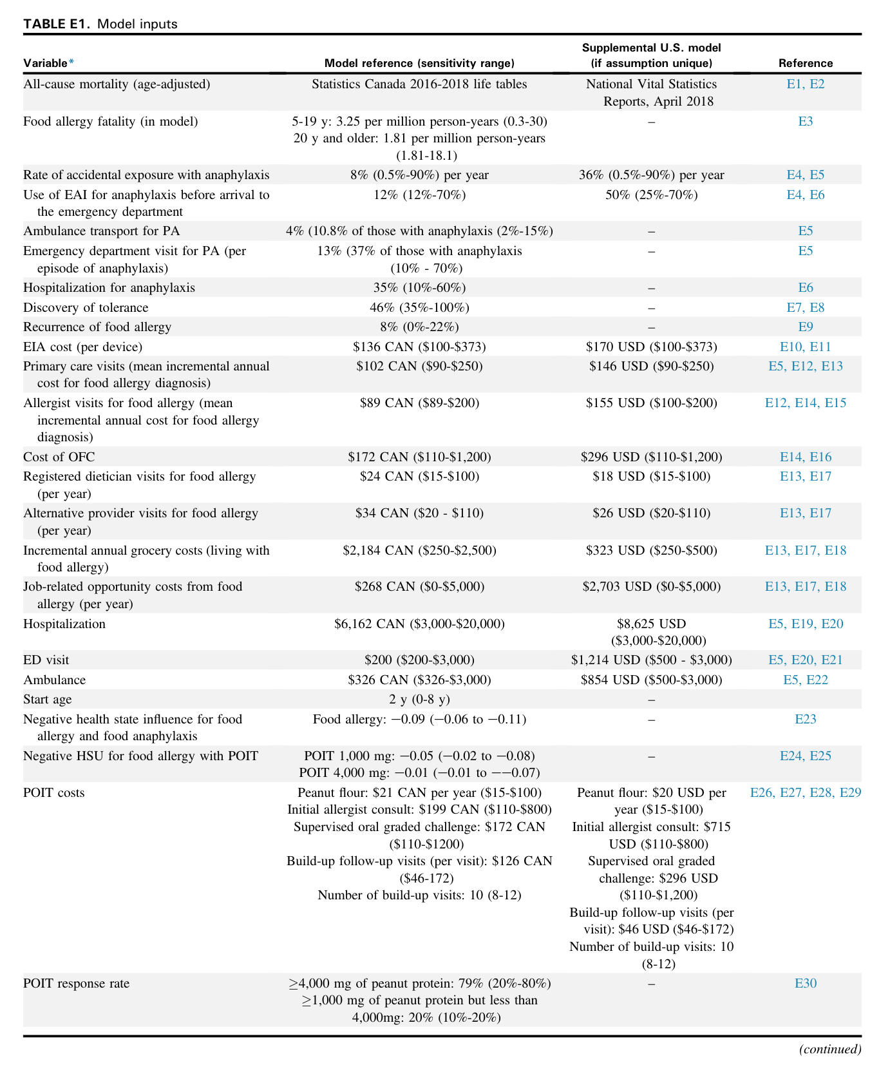
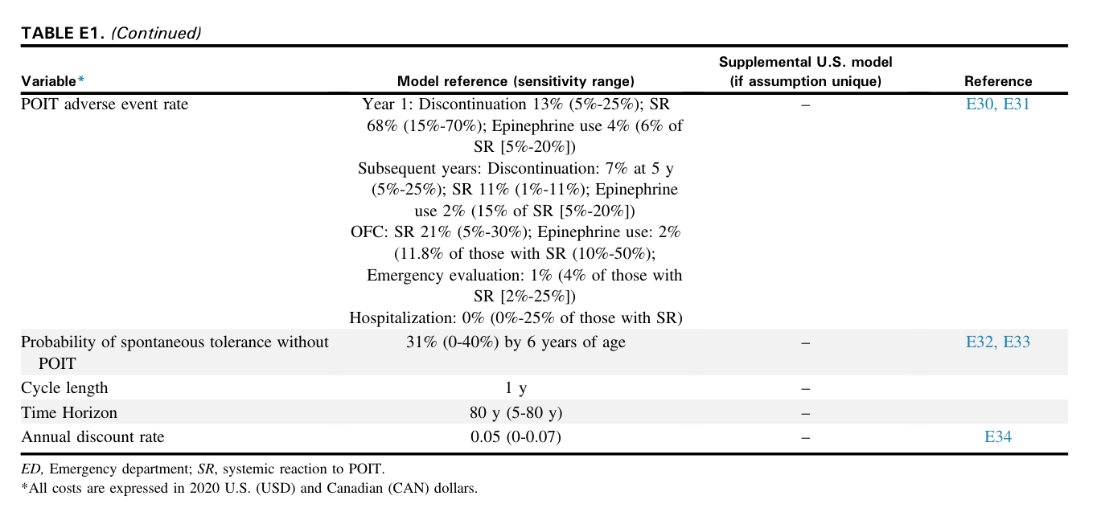
Used a “base case” represented by a 2-year-old with peanut allergy, incorporating multiple inputs relevant to costs associated with food allergy (such as epinephrine costs, OFCs to assess for tolerance, acute visits for accidental reactions, etc).

Slide 26
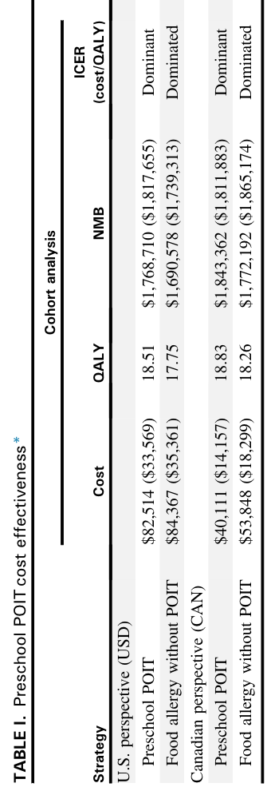
Cost Considerations
Primary outcome measure was cost effectiveness ratio (expressed in cost per quality-adjusted life year) and net monetary benefit.
Appeared that in their simulation, OIT provided a cost savings per preschooler of $1,853 to $7,104 in the US; $13,737 to $17,947 in Canada.
Societal perspective showed significant cost savings compared to avoidance.
Notes:
Net monetary benefit: represents the value of an intervention in monetary terms.

Slide 27
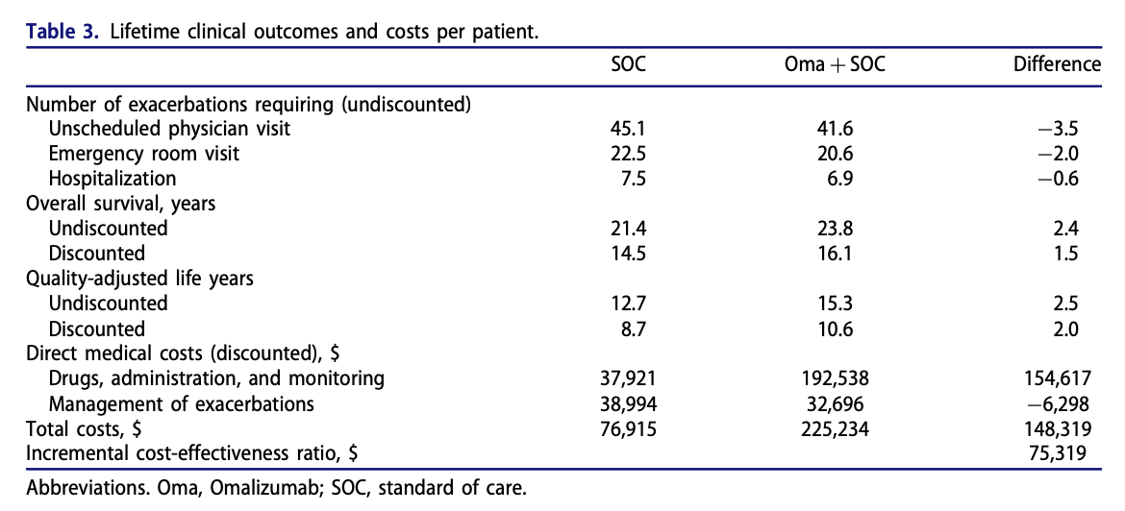
Cost Considerations
Sullivan et al, 2020: sought to evaluate the cost-effectiveness of omalizumab in patients with uncontrolled mod-severe asthma.
Lifetime benefit of 2 QALY for $148,319 = $74,159/QALY
Comparatively, lifetime benefit of 18.51 QALY for OIT in food allergy = $4,460/QALY
Notes:
Over a similar lifetime horizon, noted that the total cost of omalizumab in these patients was approximately $148,000 for a 2 QALY benefit.

Slide 28

Moral Hazard
People may be more inclined to take risks as they do not completely bear the burden of said risk.
Could this be applicable to our interventions for food allergy?
  Consider the behaviors and habits involved in OIT..
  ...and consider how this might lead to more risk-taking behavior in those getting biologic treatment.
Notes:
So I’d like to put forward the concept of moral hazard and how this might relate to our differing interventions for food allergy. Moral hazard is, essentially, when someone becomes more inclined to take risks because they have insurance, or some reason to not completely bear the burden of that risk. Kind of like how I use my iPhone without a case because I have AppleCare.
Similarly, it is worth considering this may apply to oral immunotherapy and biologics. Because that is what desensitization sort of is, right? Insurance. In OIT, even just considering a patient who is desensitized and taking maintenance dosing, there is a lot of clinical education given to patients and caregivers around the amount of food protein to be consumed; and patients receiving oral immunotherapy have to incorporate the food into their daily routine and be familiar with the taste of the food, and bring their epipens in when they are getting updosed and such. When it comes time for widespread prescription of biologics (that’s when, not if) for food allergy, one could argue that this patient population may engage in riskier behavior comparatively.

Slide 29
In Summary...
Oral immunotherapy, compared to biologics, is a disease-modifying intervention that can induce sustained unresponsiveness/remission, likely with greater effect earlier in life.
OIT can improve quality of life and provides a degree of patient/caregiver flexibility.
OIT may be more cost-effective compared to biologic therapy.

Slide 30
1. Bilaver, Lucy A., Avneet S. Chadha, Priyam Doshi, Linda O’Dwyer, and Ruchi S. Gupta. “Economic Burden of Food Allergy.” Annals of Allergy, Asthma & Immunology 122, no. 4 (April 2019): 373-380.e1. https://doi.org/10.1016/j.anai.2019.01.014.
2. Chu, Derek K, Robert A Wood, Shannon French, Alessandro Fiocchi, Manel Jordana, Susan Waserman, Jan L Brożek, and Holger J Schünemann. “Oral Immunotherapy for Peanut Allergy (PACE): A Systematic Review and Meta-Analysis of Efficacy and Safety.” The Lancet 393, no. 10187 (June 2019): 2222–32. https://doi.org/10.1016/S0140-6736(19)30420-9.
3. Du Toit, George, Graham Roberts, Peter H. Sayre, Henry T. Bahnson, Suzana Radulovic, Alexandra F. Santos, Helen A. Brough, et al. “Randomized Trial of Peanut Consumption in Infants at Risk for Peanut Allergy.” New England Journal of Medicine 372, no. 9 (February 26, 2015): 803–13. https://doi.org/10.1056/NEJMoa1414850.
4. Du Toit, George, Peter H. Sayre, Graham Roberts, Michelle L. Sever, Kaitie Lawson, Henry T. Bahnson, Helen A. Brough, et al. “Effect of Avoidance on Peanut Allergy after Early Peanut Consumption.” New England Journal of Medicine 374, no. 15 (April 14, 2016): 1435–43. https://doi.org/10.1056/NEJMoa1514209.
5. Epstein-Rigbi, Na’ama, Michael R. Goldberg, Michael B. Levy, Liat Nachshon, and Arnon Elizur. “Quality of Life of Food-Allergic Patients Before, During, and After Oral Immunotherapy.” The Journal of Allergy and Clinical Immunology: In Practice 7, no. 2 (February 2019): 429-436.e2. https://doi.org/10.1016/j.jaip.2018.06.016.
6. Greenhawt, Matthew, Rebekah Marsh, Hannah Gilbert, Scott Sicherer, Audrey DunnGalvin, and Dan Matlock. “Understanding Caregiver Goals, Benefits, and Acceptable Risks of Peanut Allergy Therapies.” Annals of Allergy, Asthma & Immunology 121, no. 5 (November 2018): 575–79. https://doi.org/10.1016/j.anai.2018.06.018.
7. Herlihy, Lauren, Edwin H. Kim, A. Wesley Burks, Holly Barber, Quindelyn Cook, Luanna Yang, Deanna Hamilton, and Brian P. Vickery. “Five-Year Follow-up of Early Intervention Peanut Oral Immunotherapy.” The Journal of Allergy and Clinical Immunology: In Practice 9, no. 1 (January 2021): 514–17. https://doi.org/10.1016/j.jaip.2020.07.009.
8. Hill, David A., Jesse W. Dudley, and Jonathan M. Spergel. “The Prevalence of Eosinophilic Esophagitis in Pediatric Patients with IgE-Mediated Food Allergy.” The Journal of Allergy and Clinical Immunology: In Practice 5, no. 2 (March 2017): 369–75. https://doi.org/10.1016/j.jaip.2016.11.020.
9. Kulis, Michael D., Sarita U. Patil, Erik Wambre, and Brian P. Vickery. “Immune Mechanisms of Oral Immunotherapy.” Journal of Allergy and Clinical Immunology 141, no. 2 (February 2018): 491–98. https://doi.org/10.1016/j.jaci.2017.12.979.
10. Lee, Ashley Sang Eun, Mary Grace Baker, Amanda L. Cox, Roxanne C. Oriel, Angela Tsuang, Scott H. Sicherer, and Jacob D. Kattan. “Long-Term Follow-up of Children Who Achieved Sustained Unresponsiveness after Peanut Oral Immunotherapy.” The Journal of Allergy and Clinical Immunology: In Practice, October 2023, S2213219823011376. https://doi.org/10.1016/j.jaip.2023.10.020.
11. McLenon, Jennifer, and Mary A.M. Rogers. “The Fear of Needles: A Systematic Review and Meta‐analysis.” Journal of Advanced Nursing 75, no. 1 (January 2019): 30–42. https://doi.org/10.1111/jan.13818.
12. Mori, Francesca, Mattia Giovannini, Simona Barni, Rodrigo Jiménez-Saiz, Daniel Munblit, Benedetta Biagioni, Giulia Liccioli, et al. “Oral Immunotherapy for Food-Allergic Children: A Pro-Con Debate.” Frontiers in Immunology 12 (September 28, 2021): 636612. https://doi.org/10.3389/fimmu.2021.636612.
13. Nurmatov, U., S. Dhami, S. Arasi, G. B. Pajno, M. Fernandez‐Rivas, A. Muraro, G. Roberts, et al. “Allergen Immunotherapy for IgE‐mediated Food Allergy: A Systematic Review and Meta‐analysis.” Allergy 72, no. 8 (August 2017): 1133–47. https://doi.org/10.1111/all.13124.
14. Perrett, Kirsten P., Sayantani B. Sindher, Philippe Begin, Josiah Shanks, and Arnon Elizur. “Advances, Practical Implementation, and Unmet Needs Regarding Oral Immunotherapy for Food Allergy.” The Journal of Allergy and Clinical Immunology: In Practice 10, no. 1 (January 2022): 19–33. https://doi.org/10.1016/j.jaip.2021.10.070.
15. Shaker, Marcus, Edmond S. Chan, Jennifer L.P. Protudjer, Lianne Soller, Elissa M. Abrams, and Matthew Greenhawt. “The Cost-Effectiveness of Preschool Peanut Oral Immunotherapy in the Real-World Setting.” The Journal of Allergy and Clinical Immunology: In Practice 9, no. 7 (July 2021): 2876-2884.e4. https://doi.org/10.1016/j.jaip.2021.02.058.
16. Slavin, Raymond G., Caterina Ferioli, Stacey J. Tannenbaum, Carmen Martin, Martin Blogg, and Philip J. Lowe. “Asthma Symptom Re-Emergence after Omalizumab Withdrawal Correlates Well with Increasing IgE and Decreasing Pharmacokinetic Concentrations.” Journal of Allergy and Clinical Immunology 123, no. 1 (January 2009): 107-113.e3. https://doi.org/10.1016/j.jaci.2008.09.050.
17. Vickery, Brian P., Jelena P. Berglund, Caitlin M. Burk, Jason P. Fine, Edwin H. Kim, Jung In Kim, Corinne A. Keet, et al. “Early Oral Immunotherapy in Peanut-Allergic Preschool Children Is Safe and Highly Effective.” Journal of Allergy and Clinical Immunology 139, no. 1 (January 2017): 173-181.e8. https://doi.org/10.1016/j.jaci.2016.05.027.
18. Worm, Margitta, Eric L. Simpson, Diamant Thaçi, Robert Bissonnette, Jean-Philippe Lacour, Stefan Beissert, Makoto Kawashima, et al. “Efficacy and Safety of Multiple Dupilumab Dose Regimens After Initial Successful Treatment in Patients With Atopic Dermatitis: A Randomized Clinical Trial.” JAMA Dermatology 156, no. 2 (February 1, 2020): 131. https://doi.org/10.1001/jamadermatol.2019.3617.

Slide 31
Rebuttal: Adverse Reactions
OIT is commonly known to be associated with adverse reactions.
  For example: 96.4% of patients in the PALISADE trial experienced “1 or more adverse reaction” during dose increases and 87.1% experienced adverse reactions during maintenance.
  Chu et al, 2019: In the Peanut Allergen immunotherapy, Clarifying the Evidence (PACE) systematic review and meta-analysis, concluded that OIT increased anaphylaxis risk, frequency and epinephrine use...
However!
  Most adverse reactions are either subjective or mild.
  Adverse events are more likely to occur during updosing, which is done in a supervised environment.
Biologics are not without adverse reactions or long-term risks, either.
Notes:
Most adverse reactions tend to be either subjective (ex pruritis, throat itching) or mild (lip swelling, rhinorrhea, sneezing).
Also, in the PACE review, median age across the trials they reviewed was 8.7 years of age.
Biologic adverse reactions in question:
Omalizumab is associated with a risk of anaphylaxis (about 0.1%); In a letter to JACI by Lieberman et al in 2017, they reported on the characteristics of 132 patients with potential anaphylaxis associated with omalizumab; episodes of anaphylacxis tended to involve the respiratory tract (95%) and about 17% of cases required hospitalization.
Thinking about dupilumab,

Slide 32
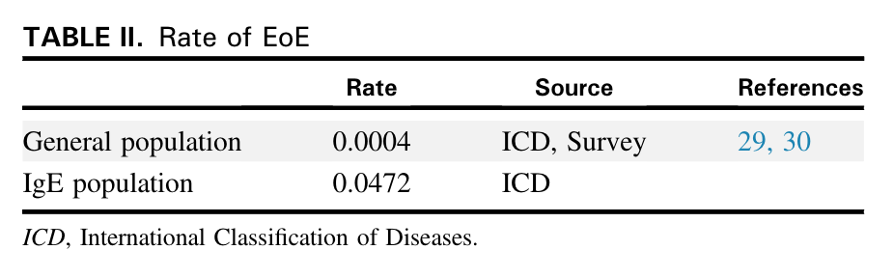
Rebuttal: Eosinophilic Gastrointestinal Reactions
Important to consider that food-allergic patients are at higher risk to develop EoE regardless of OIT.
Hill et al, 2016: evaluated the prevalence of EoE in patients with IgE-mediated food allergy through the CHOP EMR in a retrospective cohort study.
  12,083 patients identified; 570 of those patients had a diagnosis of EoE.
Additionally, as gastroscopy is not routinely done prior to starting OIT, may be difficult to know if EoE or esophageal eosinophilia was present before treatment started.

Slide 33
Rebuttal: Compliance Issues
Oral immunotherapy can be hard and compliance with treatment is a major concern.
Howe et al, 2019: conducted a randomized, blinded, controlled phase II study in which children were split into two groups for symptom management training:
  One group was told symptoms were an unfortunate side effect
  Other group told that non-life threatening symptoms could signal desensitization.
  Second group: significantly less anxious, experienced fewer non life-threatening symptoms, and were less likely to skip/reduce doses.
Points to possibility that issues with compliance can be helped with reframing.
Not featured: medical clowns!
Notes:
If your patient is NOT highly needlephobic, oral immunotherapy can be a more difficult treatment compared to a relatively infrequent injection. Concerns can definitely pop up, such as anxiety related to foods that these patients fear and avoid (for good reason), food aversion, and fear of adverse reactions, which can lead to issues with compliance.
Howe et al, 2019, conducted a randomized, blinded, controlled phase II study in which 50 children and caregivers were split into two groups and received slightly different symptom management training; one group was informed that non-life threatening symptoms were an unfortunate side effect of treatment, while the other group was informed that non-life threatening symptoms could signal desensitization. The group that was informed that symptoms can signal desensitization were less anxious, experienced fewer non-life threatening symptoms as doses increased and were less likely to skip or reduce doses.
So some of the issues with compliance may be helped

