Slide 1

Antihistamines are a significant clinical risk factor for dementia - Pro
Matthew MacDougall, MD PhD
Stanford University

Slide 2
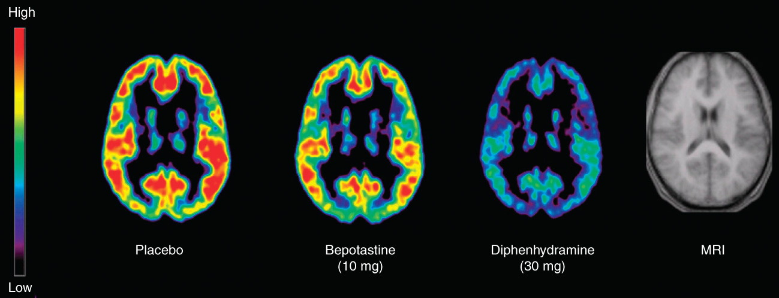
Outline
Brief Review of Histamine
Antihistamines
Memory
Arguments for Dementia Risk of Antihistamines

Slide 3
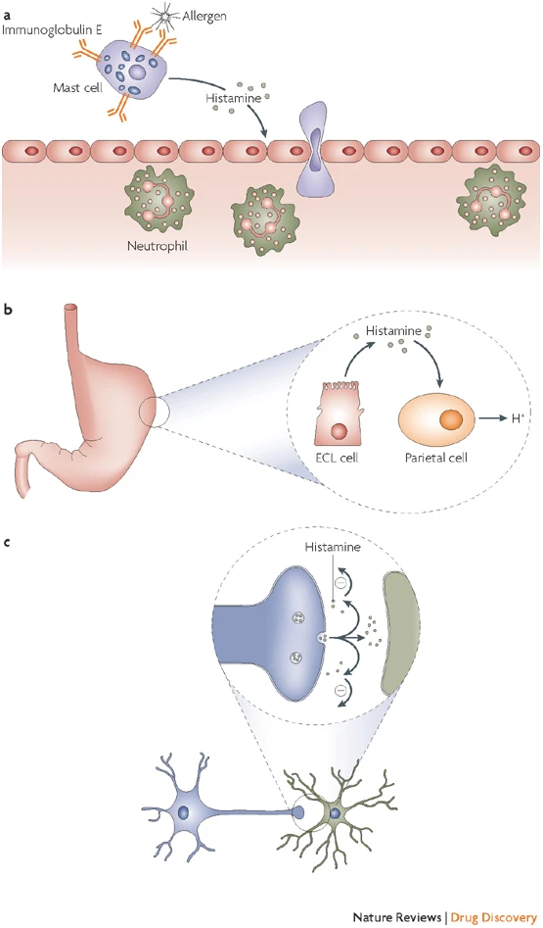
Histamine
Histamine sits at the interface of the immune system and nervous system
Made by:
Mast Cells/Basophils/Platelets
Enterochromaffin-like cells
Neurons of the Tuberomammillary nucleus of the hypothalamus
3 main physiologic actions:
Inflammation: action on smooth muscle cells and endothelium leading to vasodilation and vascular permeability
Gastric Acid Secretion: Action on Parietal Cells to drive gastric acidification
Neurotransmitter: CNS role in sleep-wake, appetite, learning and memory
Notes:
Thurmond, R., Gelfand, E. & Dunford, P. The role of histamine H₁ and H₄ receptors in allergic inflammation: the search for new antihistamines. Nat Rev Drug Discov 7, 41–53 (2008)

Slide 4
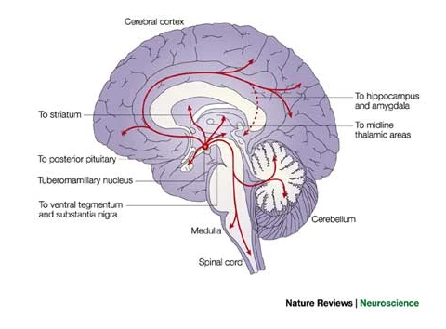
Histamine and The Brain
The CNS histaminergic neurons(Tuberomamillary Nucleus of Hypothalamus) modulate many neuronal circuits
More than 50% of the Histamine in the brain is derived from Mast Cells
3 of the 4 Histamine Receptors, including H1 and H2 are expressed in distinctive patterns in the brain

Slide 5
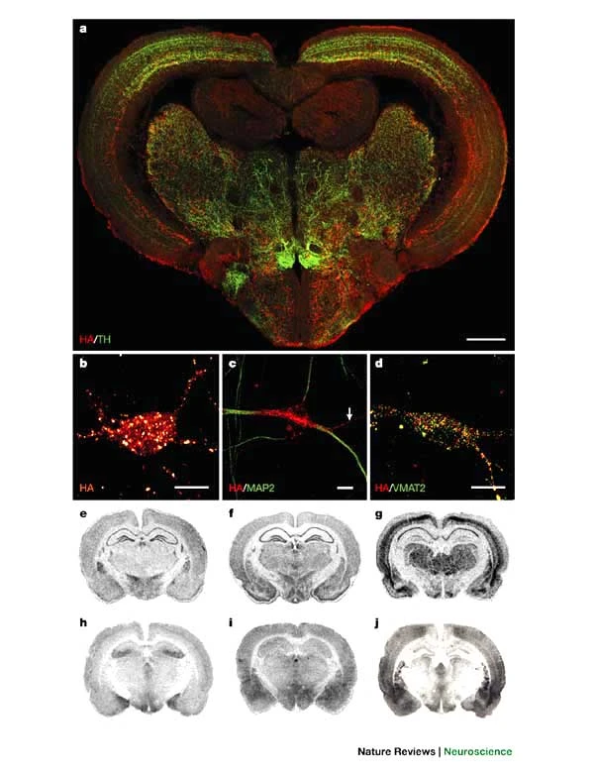
Histamine in the Brain
Histamine is broadly expressed by neurons throughout the brain
Histamine receptors H1, H2, H3 have differential expression throughout the brain
Notes:
Top image – Zebrafish brain cross section with Histamine in Red and Tyrosine hydroxylase in Green
Panels e–j show coronal sections of rat brain at the level of the medial hypothalamus. For each receptor, in situ hybridization (e, H₁; f, H₂; g, H₃), and binding of specific radioactive ligands (h, H₁; i, H₂; j, H₃), are shown. All receptors are expressed abundantly in the cerebral cortex, hippocampus, amygdala and hypothalamus.

Slide 6
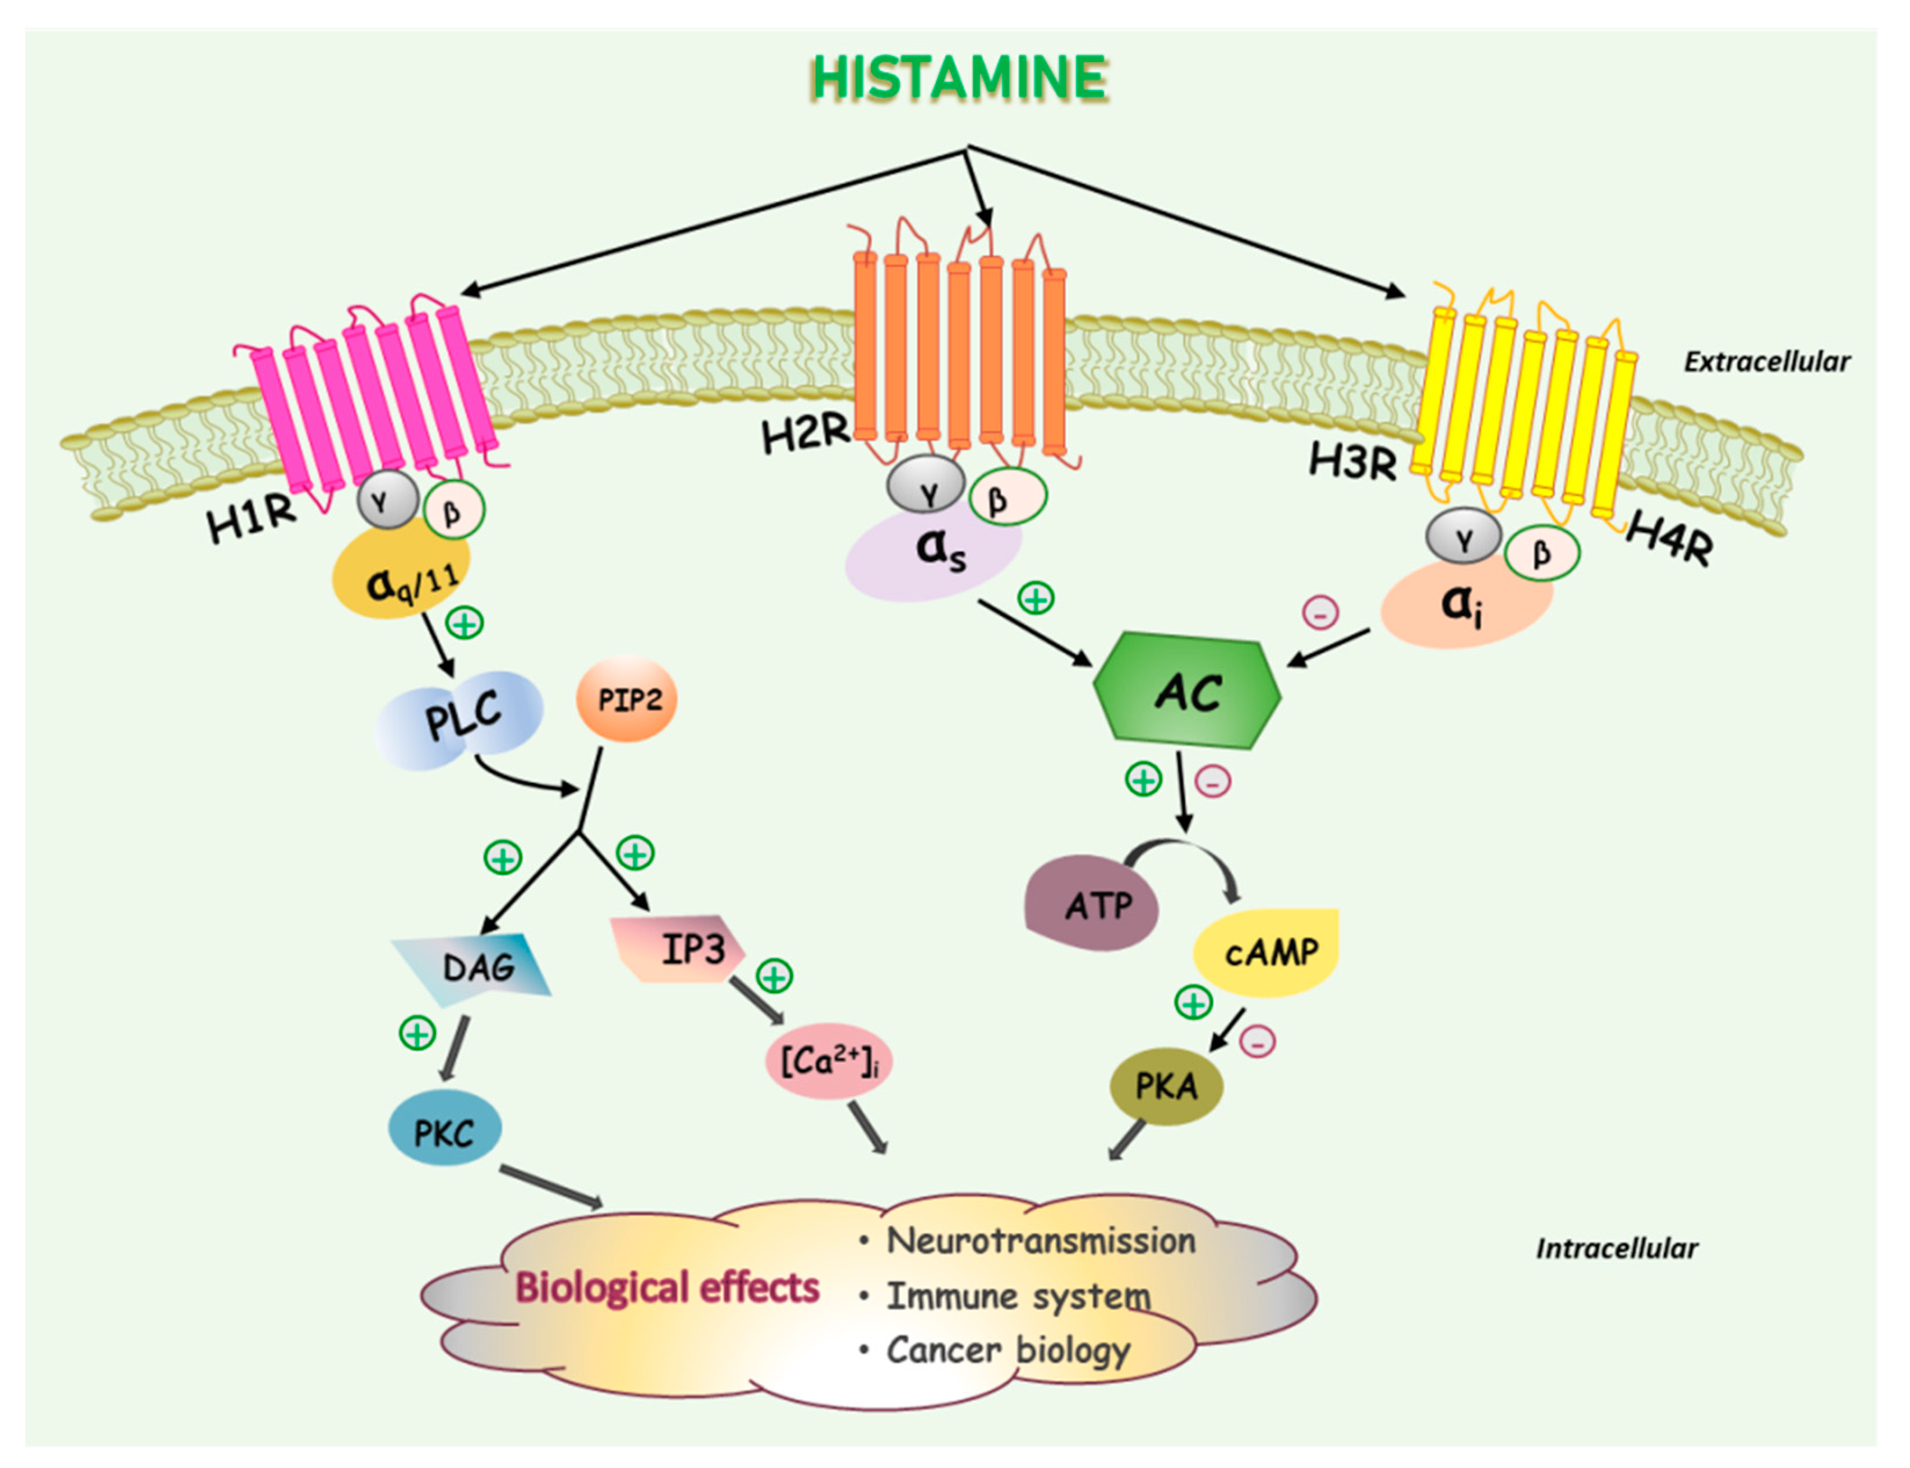
Histamine Receptors
G protein-coupled receptors
H1-H3 are expressed broadly including the brain
H4 is mostly expressed in bone marrow/leukocytes
Biologic effects depend heavily on cell type localization
Notes:
Nguyen PL, Cho J. Pathophysiological Roles of Histamine Receptors in Cancer Progression: Implications and Perspectives as Potential Molecular Targets. Biomolecules. 2021; 11(8):1232. https://doi.org/10.3390/biom11081232

Slide 7
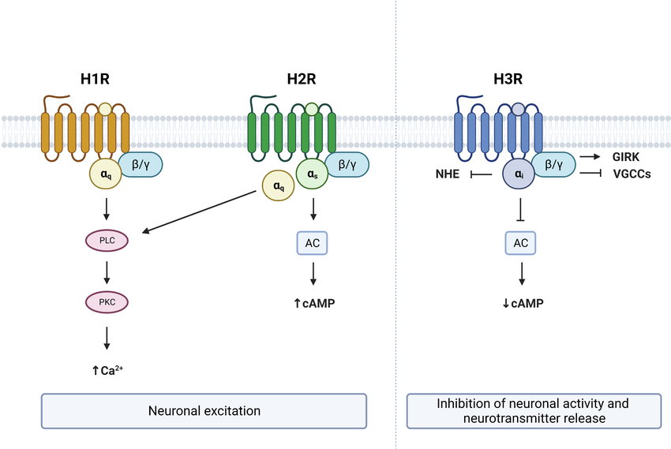
Neuronal Actions of Histamine Receptors
Notes:
Khouma A, Moeini MM, Plamondon J, Richard D, Caron A, Michael NJ. Histaminergic regulation of food intake. Front Endocrinol (Lausanne). 2023 Jun 27;14:1202089. doi: 10.3389/fendo.2023.1202089. PMID: 37448468; PMCID: PMC10338010.

Slide 8
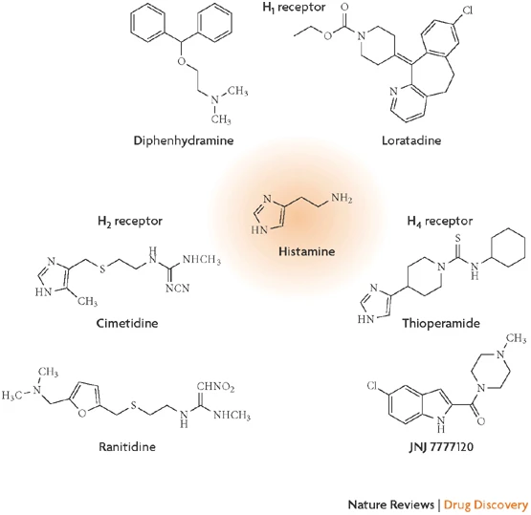
Antihistamines
Small molecules that bind to and inhibit Histamine receptors
First Generation H1:
Diphenhydramine, hydroxyzine, promethazine, chlorpheniramine, doxylamine
Second Generation H1:
Cetirizine, Loratadine, Fexofenadine, desloratadine, levocetirizine
H2:
Famotidine, Cimetidine, Ranitidine

Slide 9
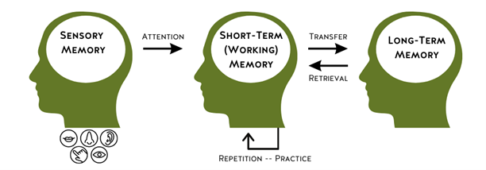
Memory aND Dementia
There are many ways to assess memory:
Dementia can be defined as memory loss due to poor new memory formation or memory retrieval; especially for recent events leading to difficulty with problem-solving and decision making
Notes:
Cholinergic effect or not?
Blood Brain Barrier or not?
Do any medications in the drug class of antihistamines increase risk?
Does inhibiting histamine itself increase risk of dementia?

Slide 10
Three Main Arguments In Favor of Anti-Histamines Causing Dementia
Antihistamine Memory Impact Mechanisms
Rodent Exemplar Studies – Short Term and Long-Term Memory
Human Study – Short Term Memory Recall
Positive Effects of Histamine on Memory
Rodent and Human Study of Inverse Agonist of H3R – Long-term Memory Recall
Epidemiologic Studies:
Off target: Anti-cholinergic activity
On target: Anti-histamine activity in absence of anti-cholinergic activity

Slide 11
Three Main Arguments In Favor of Anti-Histamines Causing Dementia
Antihistamine Memory Impact Mechanisms
Rodent Exemplar Studies – Short Term and Long-Term Memory
Human Study – Short Term Memory Recall
Positive Effects of Histamine on Memory
Rodent and Human Study of Inverse Agonist of H3R – Long-term Memory Recall
Epidemiologic Studies:
Off target: Anti-cholinergic activity
On target: Anti-histamine activity in absence of anti-cholinergic activity

Slide 12
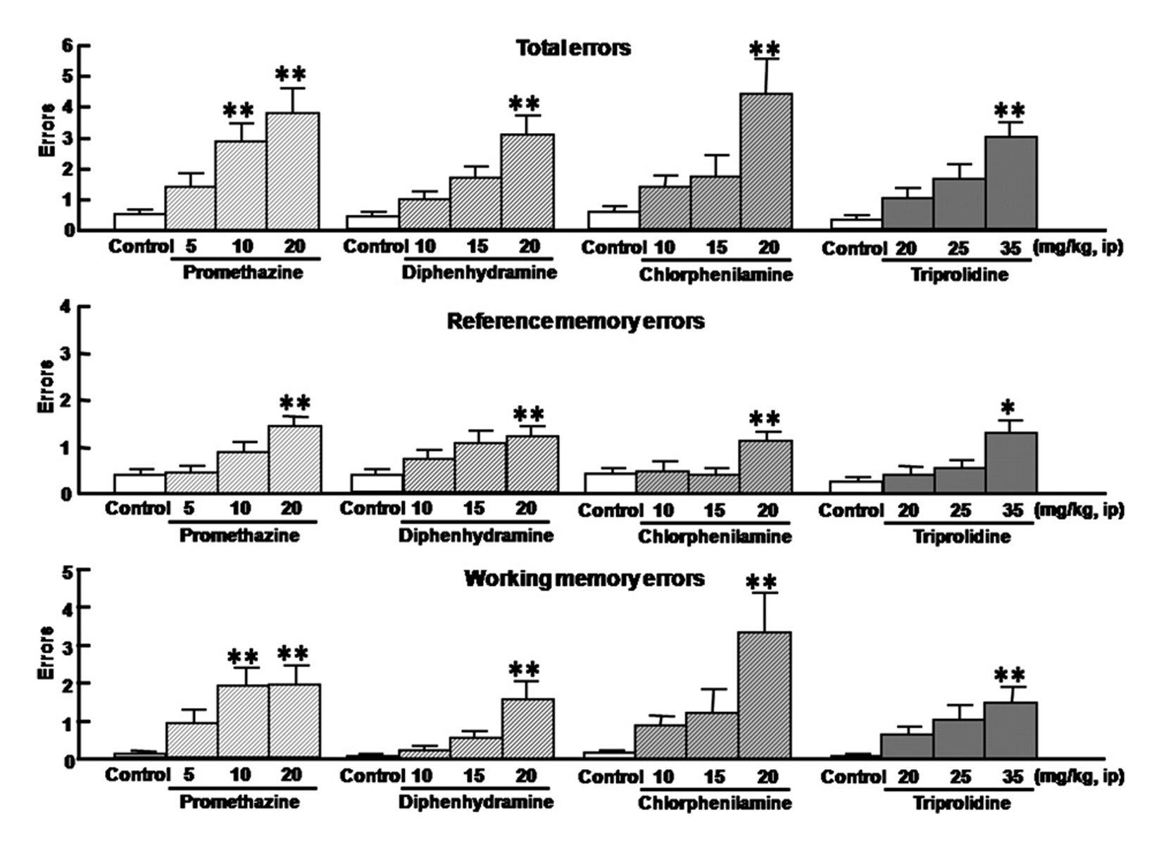
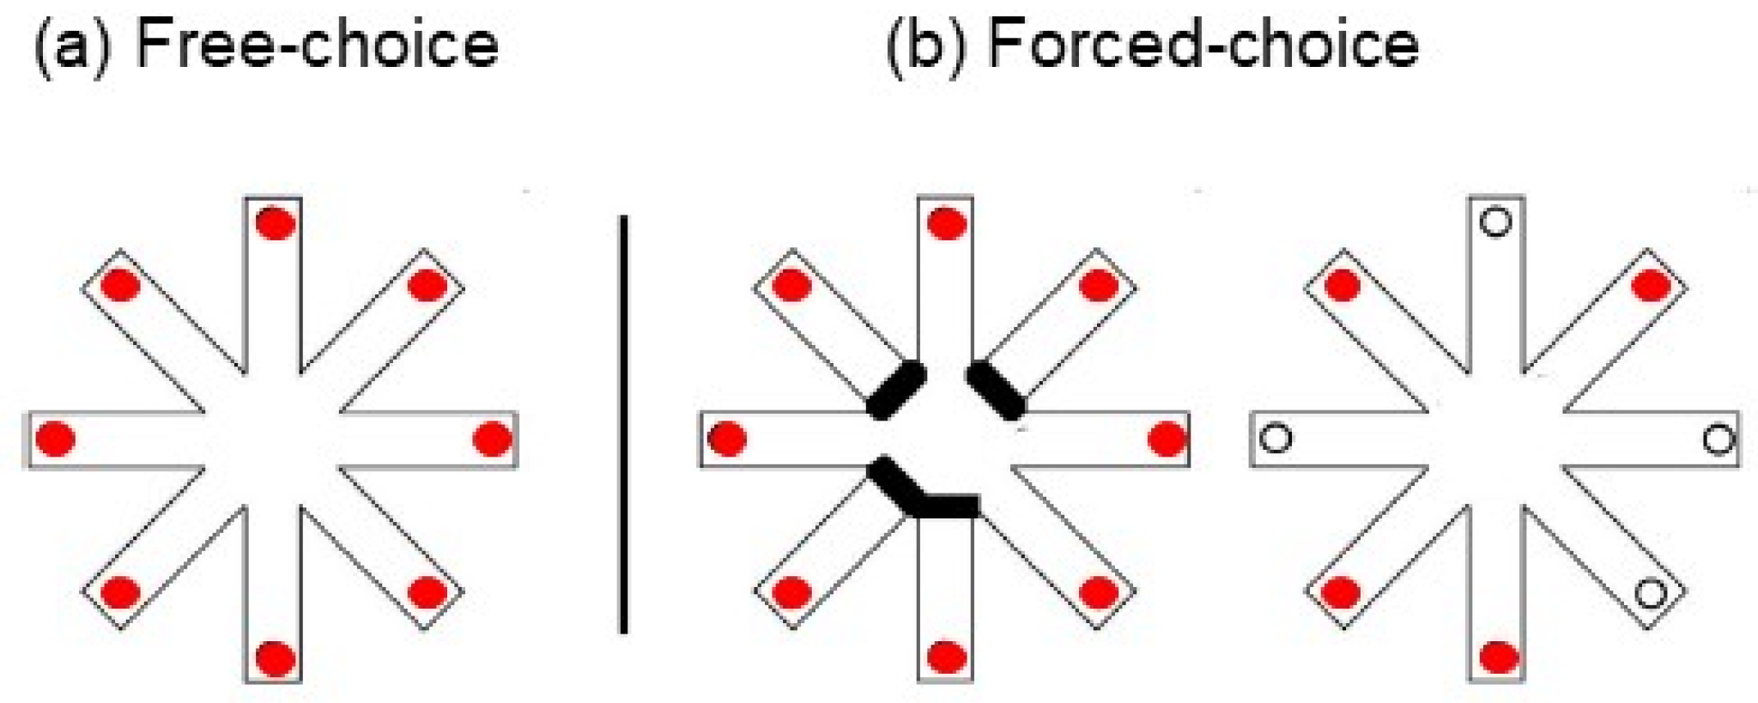
Rats given First Generation H1 Inhibitors make more Memory Errors
Increasing doses of First Generation H1 blockers increase reference memory and working memory errors in Radial Arm Maze Test
Notes:
Masuoka T, Mikami A, Yasuda M, Shinomiya K, Kamei C. Effects of histamine H(1) receptor antagonists on hippocampal theta rhythm during spatial memory performance in rats. Eur J Pharmacol. 2007 Dec 8;576(1-3):77-82. doi: 10.1016/j.ejphar.2007.08.020. Epub 2007 Aug 23. PMID: 17884040.

Slide 13
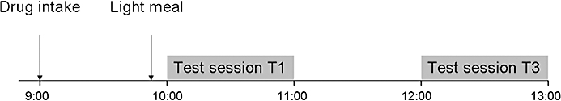
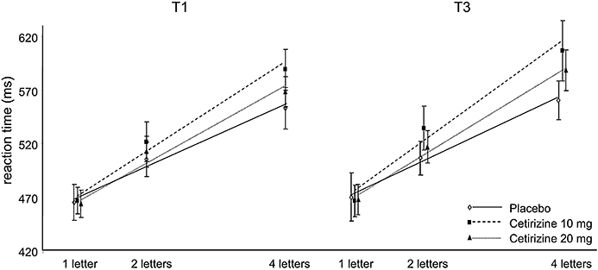
Cetirizine Slows Memory Scanning Task
vanRuitenbeek et al recruited 17 people to undergo memory testing after cetirizine
Timing after dose based on prior studies showing no effect on driving at 1 hr, but impairment at 3-4 hrs
Word learning (recall) was unchanged but memory scanning speed (short term memory retrieval) was slower after a single dose of cetirizine
Notes:
van Ruitenbeek P, Vermeeren A, Riedel WJ. Histamine H1 receptor antagonist cetirizine impairs working memory processing speed, but not episodic memory. Br J Pharmacol. 2010 Sep;161(2):456-66. doi: 10.1111/j.1476-5381.2010.00907.x. PMID: 20735428; PMCID: PMC2989595.

Slide 14
Three Main Arguments In Favor of Anti-Histamines Causing Dementia
Antihistamine Memory Impact Mechanisms
Rodent Exemplar Studies – Short Term and Long-Term Memory
Human Study – Short Term Memory Recall
Positive Effects of Histamine on Memory
Rodent and Human Study of Inverse Agonist of H3R – Long-term Memory Recall
Epidemiologic Studies:
Off target: Anti-cholinergic activity
On target: Anti-histamine activity in absence of anti-cholinergic activity

Slide 15
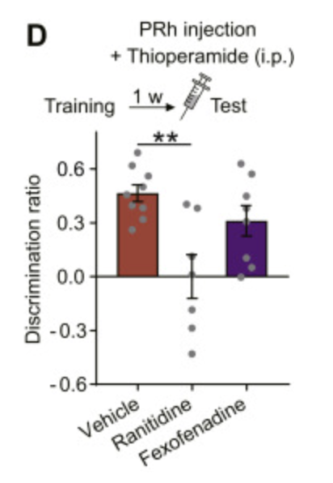
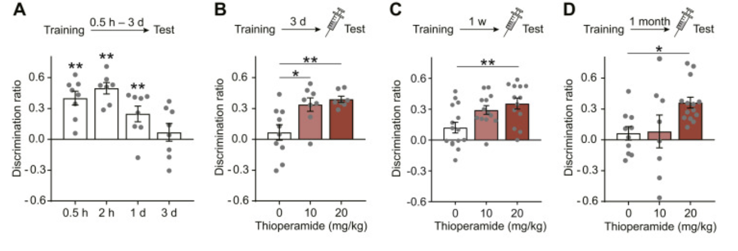
Inverse Agonism of H3R Increases Brain Histamine to Improve Memory Performance in Mice and Human
H3R are constitutively active and prevent release of histamine at axon terminals, so inverse agonism of H3R promotes release of histamine
thioperamide and betahistine
Question: Does inverse agonism of H3R promote retrieval of long-term forgotten object memory in mice and humans?
Notes:
Nomura H, Mizuta H, Norimoto H, Masuda F, Miura Y, Kubo A, Kojima H, Ashizuka A, Matsukawa N, Baraki Z, Hitora-Imamura N, Nakayama D, Ishikawa T, Okada M, Orita K, Saito R, Yamauchi N, Sano Y, Kusuhara H, Minami M, Takahashi H, Ikegaya Y. Central Histamine Boosts Perirhinal Cortex Activity and Restores Forgotten Object Memories. Biol Psychiatry. 2019 Aug 1;86(3):230-239. doi: 10.1016/j.biopsych.2018.11.009. Epub 2019 Jan 8. PMID: 30635130.
Mice novel object recognition, introduce novel object during training and then offer familiar and novel object. Will prefer novel object

Slide 16
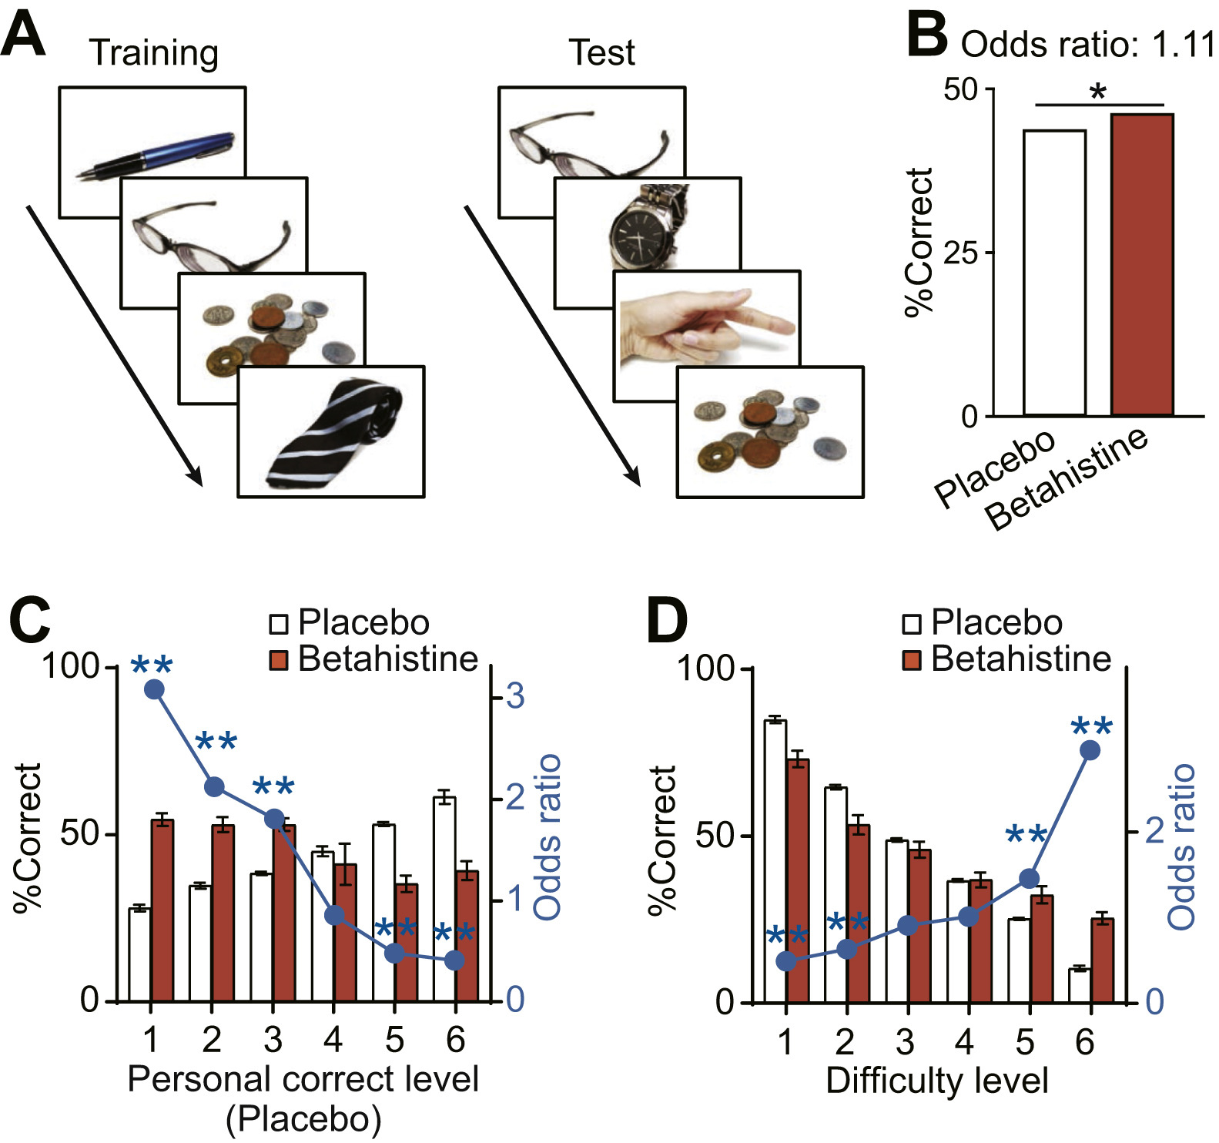
Inverse Agonism of H3R Increases Brain Histamine to Improve Memory Performance in Mice and Human
H3R are constitutively active and prevent release of histamine at axon terminals, so inverse agonism of H3R promotes release of histamine
thioperamide and betahistine
Question: Does inverse agonism of H3R promote retrieval of long-term forgotten object memory in mice and humans?
38 participants incidentally studied serial images of 128 objects
Recognition performance was tested 7 and 9 days after the training (days 8 and 10, respectively)
They were administered 108 mg betahistine or placebo orally 30 minutes before the tests started.
Cross over design – half randomized to to placebo first or betahistine first
Notes:
Nomura H, Mizuta H, Norimoto H, Masuda F, Miura Y, Kubo A, Kojima H, Ashizuka A, Matsukawa N, Baraki Z, Hitora-Imamura N, Nakayama D, Ishikawa T, Okada M, Orita K, Saito R, Yamauchi N, Sano Y, Kusuhara H, Minami M, Takahashi H, Ikegaya Y. Central Histamine Boosts Perirhinal Cortex Activity and Restores Forgotten Object Memories. Biol Psychiatry. 2019 Aug 1;86(3):230-239. doi: 10.1016/j.biopsych.2018.11.009. Epub 2019 Jan 8. PMID: 30635130.
Mice novel object recognition, introduce novel object during training and then offer familiar and novel object. Will prefer novel object
Betahistine improved memory recall especially for more difficult items., but did actually worsen recall at less difficulty. Also worked better in individuals with worse performance on placebo.

Slide 17
Three Main Arguments In Favor of Anti-Histamines Causing Dementia
Antihistamine Memory Impact Mechanisms
Rodent Exemplar Studies – Short Term and Long-Term Memory
Human Study – Short Term Memory Recall
Positive Effects of Histamine on Memory
Rodent and Human Study of Inverse Agonist of H3R – Long-term Memory Recall
Epidemiologic Studies:
Off target: Anti-cholinergic activity
On target: Anti-histamine activity in absence of anti-cholinergic activity

Slide 18
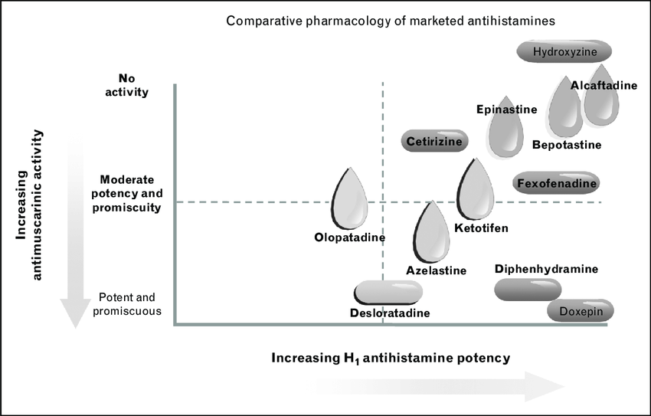
Anticholinergic Activity Inherent to Antihistamines
High similarity of histamine with acetylcholine leading to inherent anti-muscarinic cross-reactivity
Increasing selectivity for H1R generally leads to less cholinergic activity
Notes:
Wade, Laurie & Bielory, Leonard & Rudner, Shara. (2012). Ophthalmic antihistamines and H 1-H 4 receptors. Current opinion in allergy and clinical immunology. 12. 510-6. 10.1097/ACI.0b013e328357d3ba.

Slide 19
First-Generation Anti-Histamines Increase Dementia Risk
Primarily through blood brain barrier penetration and anti-cholinergic off target effects
Study 1: Prospective Cohort Study from Gray et al, JAMA Internal Medicine 2015
Study 2: Umbrella Review from Belessiotis-Richards et el, Mol Psychiatry 2025

Slide 20
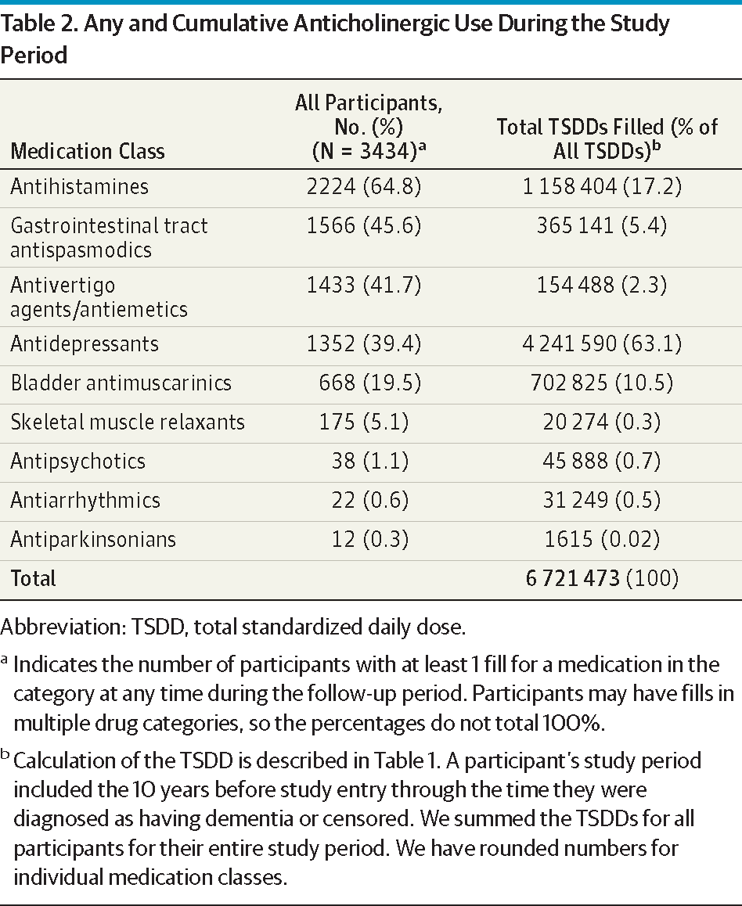
High Cumulative Anti-cholinergic use is associated with higher risk of dementia
Examined anticholinergic classes – tricyclic antidepressants, first-generation antihistamines (65% of participants), and bladder antimuscarinic
Cumulative use over 10 years excluding the prior 12 months
797 of 3434 (65 years or older with no dementia at entry) developed dementia
HR 1.54 for Dementia and 1.63 for Alzheimer’s Disease for highest Total Standardized Daily Dose
Additionally, found on post-hoc analysis that the timing within the 10-year exposure window was not important
Notes:
Gray SL, Anderson ML, Dublin S, et al. Cumulative Use of Strong Anticholinergics and Incident Dementia: A Prospective Cohort Study. JAMA Intern Med. 2015;175(3):401–407. doi:10.1001/jamainternmed.2014.7663
Confidence

Slide 21
Meta-Analyses associate Anticholinergics with dementia
3 total meta-analyses each with 6-14 studies; participant numbers ranging from 0.5 to 1.5M patients
Pooled relative risks ranged from 1.2(95% CI 1.15-1.26) to 1.46 (95% CI 1.17-1.81)
Possible dose-dependent relation with stronger association when anticholinergic use for at least 1 year
Moderate certainty evidence
Notes:
Belessiotis-Richards C, Hayes J, Feng Yap Y, Talwar S, Eskinazi M, Li W, Ward H, Letrondo PA, Morelli-Batters M, Bruun A, Lin R, Wright T, Mukadam N. Systemic medications and dementia risk: a systematic umbrella review. Mol Psychiatry. 2025 Jul 24. doi: 10.1038/s41380-025-03129-3. Epub ahead of print. PMID: 40707785.

Slide 22
Second Generation Antihistamines Safer, but may have underappreciated Increase Dementia Risk
Overall Safer Design with less anti-cholinergic activity and less/absent blood brain barrier penetration
Study 1: Recent Pharmacovigilance Study, Kan et al, Expert Opinion on Drug Safety, 2025
Study 2: Retrospective Taiwanese Study, Su et al, JACI In Practice, 2024
Notes:
What are the confounders, specifically indication? Timeline?
Sleep disturbance as indication?
Nasal congestion?
Clear outline of arguments:
1. Epi
2. Mechanistic
3.
H3R affinity?

Slide 23
High Cumulative Anti-histamine Use is associated with Higher Risk of Dementia
Kan et al, Expert Opinion on Drug Safety, 2025
Pharmacovigilance Study of USA, Japan, Canada – assessed first-generation, second-generation H1 receptor antagonists (as well as benzodiazepines)
Evaluated adverse event reporting databases for broad dementia events
Found OR for 1st Generation H1RAs 3.33 (95% CI 3.22-3.44)
Found OR for 2nd Generation H1RAs 2.03 (95% CI 1.98-2.07)
Notes:
For comparison Benzos OR 2.74

Slide 24
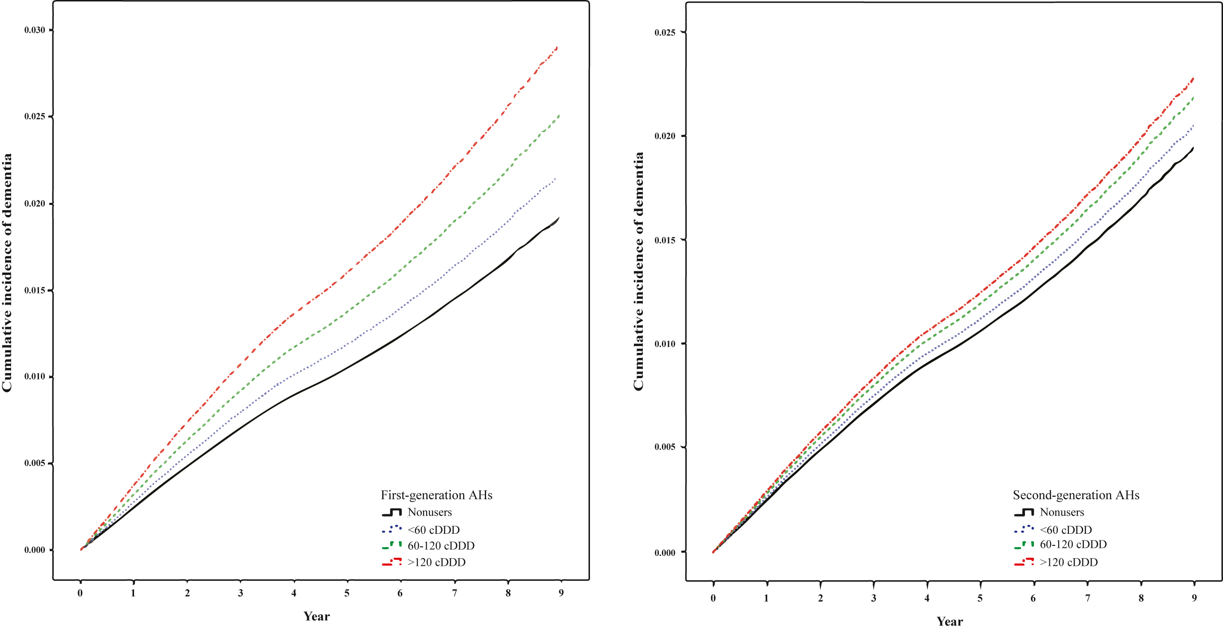
Second Generation Antihistamines increase Dementia risk as well
Retrospective Taiwanese Study, Su et al, JACI In Practice, 2024
Higher dose users of either first or second generation (including fexofenadine) antihistamines had an increased incidence of dementia
Interestingly, First Generation increased HR for alzheimers, vascular, and other dementia while second generation only increased HR for alzheimers and other dementia

Slide 25
Conclusions
Anti-histamines in rodent and human models tested in single doses impact short term and long-term memory tasks
Neuronal histamine stimulation drives long term memory recall
Antihistamines are a significant clinical risk factor for dementia due to their inherent anti-cholinergic effects
Even in the absence of anti-cholinergic effects, there is lower, but present signal of risk of dementia even in more selective anti-histamines

Slide 26
Thank you

Slide 27
Rebuttal

Slide 28
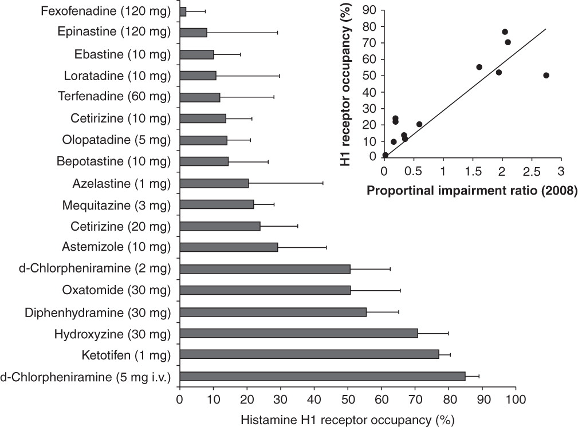
Second Generation Antihistamines Still Cross Blood Brain Barrier
Examine human PET imaging of [¹¹C]-doxepin after pretreatment with antihistamines to measure occupancy
All antihistamines cross BBB to some extent
Notes:
Yanai, K., Zhang, D., Tashiro, M., Yoshikawa, T., Naganuma, F., Harada, R., … Okamura, N. (2011). Positron emission tomography evaluation of sedative properties of antihistamines. Expert Opinion on Drug Safety, 10(4), 613–622. https://doi-org.laneproxy.stanford.edu/10.1517/14740338.2011.562889

Slide 29
Age as an Important Co-Variate, but does not mean antihistamines are Not a risk Factor
Age >65 underlies positive signal in most studies, whereas the studies looking younger(ie >= 50yo) yield mixed results
This is best exemplified by a Taiwanese study in Front Aging Neurosci 2022
H1RA aged ≥50 years - subdistribution hazard ratio [SHR] = 1.025, 95% confidence interval [CI] = 0.883-1.297, p = 0.274
H1RA aged ≥65 years - adjusted SHR: 1.782, 95% CI = 1.368-2.168, p < 0.001
Increased age increases the pretest probability and therefore the sensitivity of examining the effects of antihistamines
Notes:
Yang CC, Chien WC, Chung CH, Lai CY, Tzeng NS. The Usage of Histamine Type 1 Receptor Antagonist and Risk of Dementia in the Elderly: A Nationwide Cohort Study. Front Aging Neurosci. 2022 Mar 18;14:811494. doi: 10.3389/fnagi.2022.811494. PMID: 35370616; PMCID: PMC8972197.

Slide 30
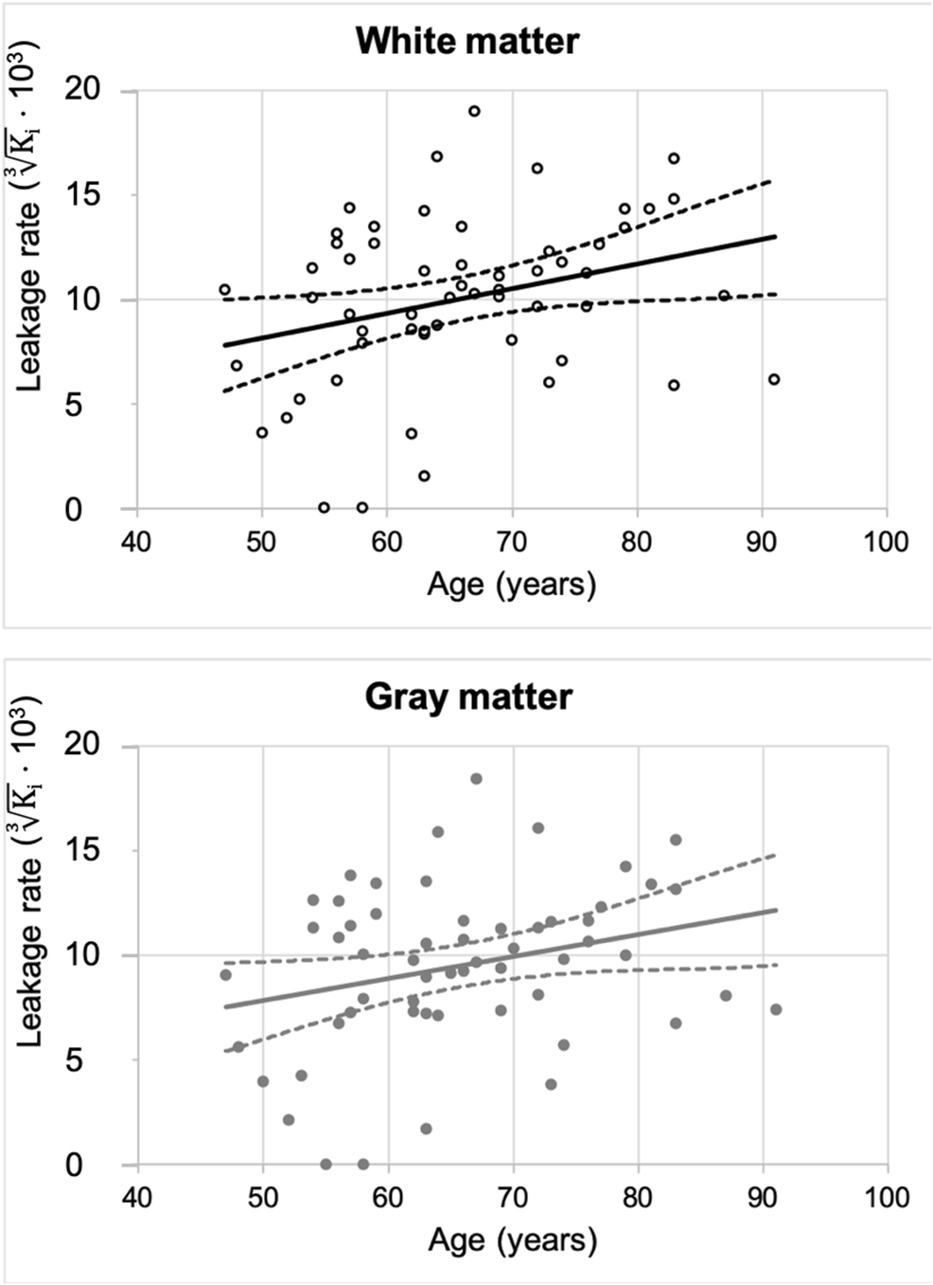
Antihistamine Brain penetration may increase with Age
57 participants, mean age of 66 years ranging from 47-91 with normal MMSE and no substance abuse or signs of aging
Used Dual-time Dynamic Contrast Enhanced MRI – to measure contrast leak fast and slow phases
This could explain the more pronounced effect of antihistamines in older individuals even 2nd generation
Notes:
Verheggen, I.C.M., de Jong, J.J.A., van Boxtel, M.P.J. et al. Increase in blood–brain barrier leakage in healthy, older adults. GeroScience 42, 1183–1193 (2020). https://doi-org.laneproxy.stanford.edu/10.1007/s11357-020-00211-2

Slide 31
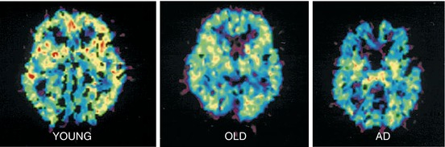
Histamine receptor Expression is decreased in Alzheimers Disease
[11C]-Doxepin PET as a proxy for H1 recapture expression is decreases with age and further in AD
As we’ve seen previously, antihistamines create a similar effect on signal
Notes:
Higuchi et al. 2000Figure 2

Slide 32
Anti-Histamines SUmmary
Antihistamine Name | Generation | Anticholinergic Burden | Dementia Risk Evidence | Safer Alternatives
Diphenhydramine | First | High (AE=1) | Strong association | Fexofenadine, Loratadine
Hydroxyzine | First | High | Strong association | Fexofenadine, Loratadine
Promethazine | First | High | Strong association | Fexofenadine, Loratadine
Chlorpheniramine | First | High | Strong association | Fexofenadine, Loratadine
Doxylamine | First | High | Strong association | Fexofenadine, Loratadine
Cetirizine | Second | Low-moderate | Minimal association | Fexofenadine, Loratadine
Loratadine | Second | Low | Minimal association | Fexofenadine
Fexofenadine | Second | Lowest | Lowest association | —
Desloratadine | Second | Low | Minimal association | Fexofenadine, Loratadine
Levocetirizine | Second | Low | Minimal association | Fexofenadine, Loratadine
If you ask OpenEvidence to summarize the dementia risk of in a table of antihistamines, it summarizes as we would expect!

Slide 33
Thank you

Slide 34
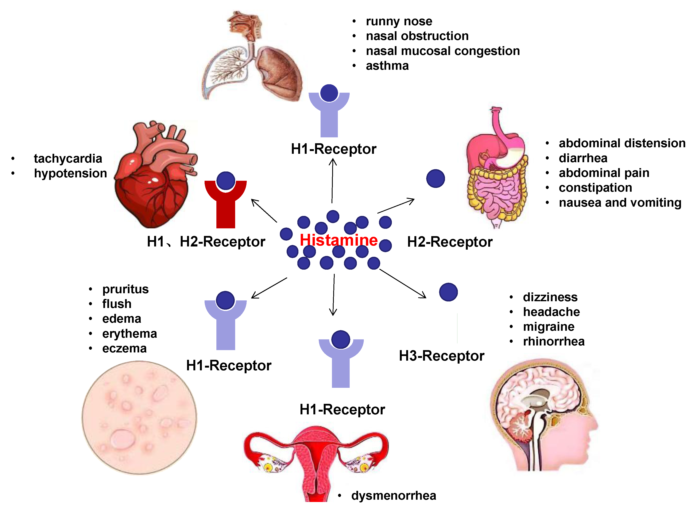
Histamine and Allergy
Crosslinking of IgE on Mast Cells leads and other triggers such as complement or MGPRX2 leads to Histamine release
Local and Systemic action of histamine through different receptors drives many of the allergic symptoms we see
Notes:
Histamine among many other pruritogenic mediatros can active itch-sensitive C-fibres or indirectly through other cells to release amines, proteases, neuokinins, cytokines, cannabinoids, and opioids
Thurmond, R., Gelfand, E. & Dunford, P. The role of histamine H₁ and H₄ receptors in allergic inflammation: the search for new antihistamines. Nat Rev Drug Discov 7, 41–53 (2008)

Slide 35
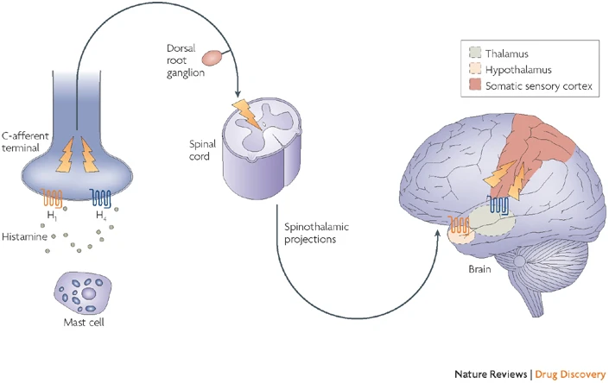
Histamine and Itch
Notes:
Histamine among many other pruritogenic mediatros can active itch-sensitive C-fibres or indirectly through other cells to release amines, proteases, neuokinins, cytokines, cannabinoids, and opioids
Thurmond, R., Gelfand, E. & Dunford, P. The role of histamine H₁ and H₄ receptors in allergic inflammation: the search for new antihistamines. Nat Rev Drug Discov 7, 41–53 (2008)

Slide 36
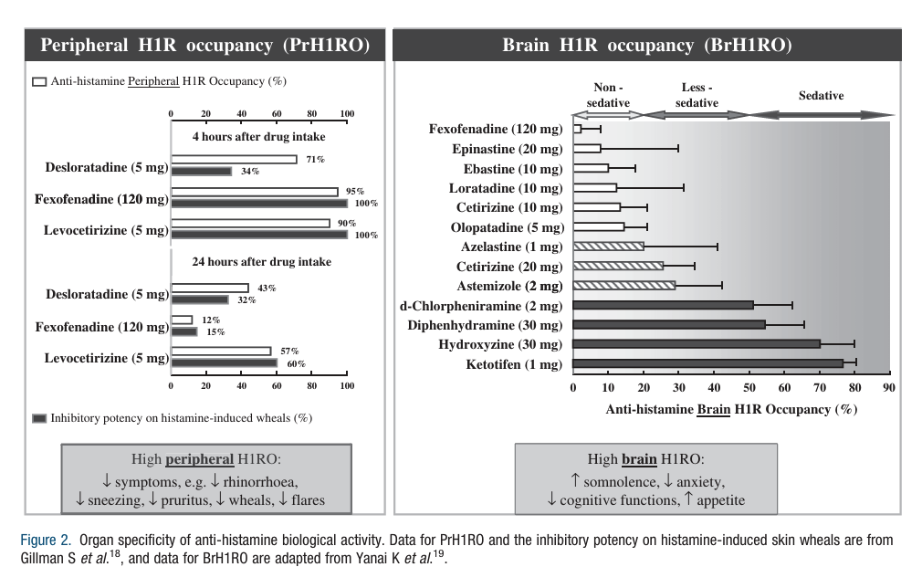
Second Generation Antihistamines do occupy Histamine Receptors in the brain
There is some inherent brain H1R occupancy of all anti-histamines even those designed to not cross the blood brain barrier (fexofenadine)
Notes:
So, what if you exclude anticholinergic effects?

Slide 37
Mixed Results For Anti-Cholinergic Anti-histamines and Dementia
Study from Coupland et al. JAMA Int Med 2019.
Pros: Large study(n=58,768), well-designed based on prior studies to attempt to determine risk of individual anti-cholinergic drugs by controlling out non-index drug effects and other co-variates
Nested Case-Control Study – found no significant increase in risk with anti-histamine however the study was probably underpowered for antihistamines since only 0.5% of patients were on the highest doses of antihistamines which was observed previously
In addition, a listed limitation is the likely under classification of dementia in the study due to the use of listed diagnosis of dementia or use of acetylecholinesterase inhibitors; this is unlike other studies that include dementia events more broadly
Notes:
Coupland CAC, Hill T, Dening T, Morriss R, Moore M, Hippisley-Cox J. Anticholinergic Drug Exposure and the Risk of Dementia: A Nested Case-Control Study. JAMA Intern Med. 2019;179(8):1084–1093. doi:10.1001/jamainternmed.2019.0677

