Slide 1


Slide 2
Antihistamines are NOT a significant clinical risk factor for dementia
Sid Aung, PGY-4
UCSF

Slide 3
Vaccines → Autism
Tylenol in pregnancy → Autism
Antihistamines → Dementia

Slide 4
Vaccines → Autism
Tylenol in pregnancy → Autism
Antihistamines → Dementia
No causal link – based only on observational studies many of which were small with significant limitations and confounding

Slide 5
Outline
First generation antihistamines and dementia — a flawed argument
Second generation antihistamines are safe and do not increase risk for dementia
Correlation does not equal causation

Slide 6
Outline
First generation antihistamines and dementia — a flawed argument
Second generation antihistamines are safe and do not increase risk for dementia
Correlation does not equal causation

Slide 7
Dementia is a chronic condition
Chronic and progressive syndrome leading to deficits in multiple cognitive domains severe enough to interfere with daily functioning
First generation antihistamines can cause short term sedation particularly in elderly
  Attributed to anticholinergic properties
Even data on anticholinergics and dementia are mixed with many studies arguing against it
Mangialasche et al. 2012

Slide 8
Many studies do not show an association between anticholinergics and dementia

Slide 9
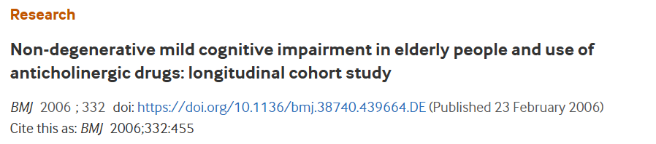
Cohort study of 372 elderly patient without dementia
Compared group of patient with continuous anticholinergic use with group of non-users in development of dementia at 8 year follow up
No difference was found between the two groups for incident dementia

Slide 10
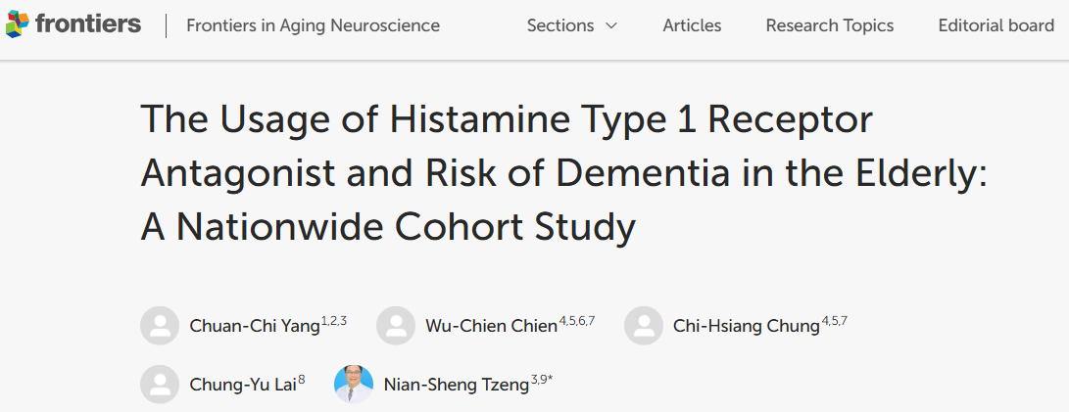
Taiwanese cohort study investigating primary outcome of incident dementia with all H1RA agents (including first- and second-generation antihistamines) in ~9000 patients
No association between H1RA use and dementia (HR 1.025, p = 0.274)

Slide 11
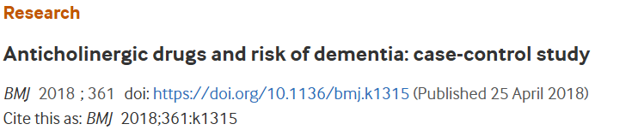
Large case-control study of over 40,000 dementia patients with over 280,000 matched controls
Evaluated association between different types of anticholinergic drug classes and incident dementia
Found increased dementia odds with several anticholinergic classes (notably antidepressants, urological, antiparkinson drugs)
NO association with antihistamines and incident dementia!
Richardson K, Fox C, Maidment I, et al

Slide 12
First generation antihistamines and dementia — a poor argument
First generation antihistamines cause short-term sedation through anticholinergic activity
Many studies show there is no association between antihistamines and dementia

Slide 13
Outline
First generation antihistamines and dementia — a flawed argument
Second generation antihistamines are safe and do not increase risk for dementia
Correlation does not equal causation

Slide 14
Antihistamines ≠ Anticholinergics
Only first-generation antihistamines (e.g. diphenhydramine, hydroxyzine) have meaningful anticholinergic effects
Second-generation antihistamines are highly selective for H1 receptors and have minimal to no clinically relevant anticholinergic activity

Slide 15
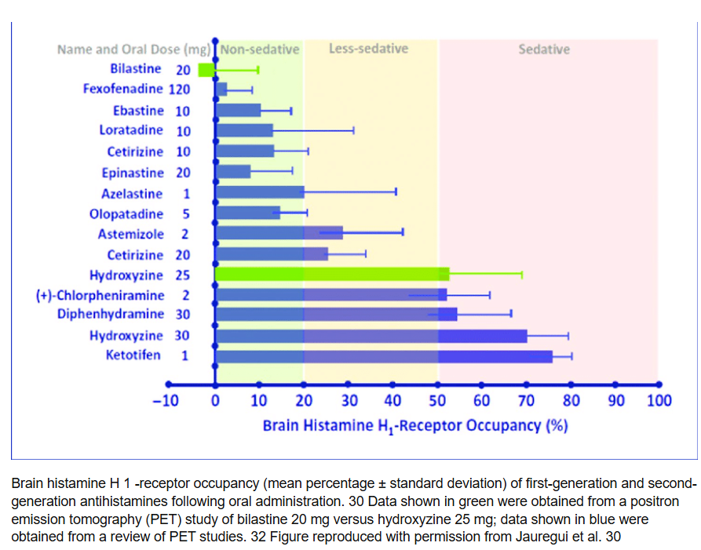
Not all antihistamines are created equal
Leceta et al. 2021

Slide 16
Antihistamines have many uses and are safe!
Allergic rhinitis
Acute urticaria
Chronic urticaria
Pruritis
Adjunct for anaphylactic reactions (cutaneous symptoms)
Anti-emetics (first-generation)
Motion sickness (first-generation)
Vertigo (first-generation)

Slide 17
Proof of concept – CSU
RCT in 2010 showing updosing up to 4x conventional doing of levocetirizine was effective for refractory urticaria without increased somnolence or serious adverse events at the higher doses during the study period
On the strength of this and related evidence, major guidelines endorsed up-dosing second-generation H1 antihistamines to as much as 4× before moving to biologics or immunosuppressants.
Would we be routinely doing this if concern for antihistamines and dementia?
Staevska et al. 2010

Slide 18
Second generation antihistamines are safe and do not increase risk of dementia
Pharmacologic distinctions are crucial
First-generation antihistamines cross the blood brain barrier and are known to cause short-term cognitive impairment as opposed to neurodegeneration
Second-generation antihistamines do not cross the BBB and have not been associated with dementia
Anticholinergics are implicated in dementia risk
Second generation antihistamines do not have significant anticholinergic activity
It would be premature to extrapolate dementia risk to the entire drug class of antihistamines

Slide 19
Outline
First generation antihistamines and dementia — a flawed argument
Second generation antihistamines are safe and do not increase risk for dementia
Correlation does not equal causation

Slide 20
Anti-histamines
Dementia

Slide 21
Alcohol
FGA and alcohol are both commonly used self-medications for insomnia.
Confounding = associated with both the predictor and outcome but NOT in the causal pathway between the two; can create a spurious relationship
Elderly patients have much more chronic disease and polypharmacy
Advanced age
Insomnia
More likely to use FGA if you have
insomnia
Anti-histamines
Dementia
More likely to use antihistamine for anxiety/somatic symptoms
Depression/
Mood disorder
Sedentary, poor diet,
metabolic syndrome
Allergies/Atopy negatively impacts exercise
tolerance
Notes:
Re-include this diagram at the end and go through each point in rebuttal

Slide 22
Many known risk factors for dementia confounded antihistamines
Advanced age
Medical comorbidities
  Hypertension, diabetes, high cholesterol, obesity (particularly mid-life)
Lifestyle
  Sedentary lifestyle, poor diet/nutrition, smoking, excessive alcohol consumption
Sleep
  Insomnia, sleep disturbances
Neuropsychiatric
  Depression, low cognitive engagement, low social engagement
Peters et al. 2019 | Shi et al. 2017

Slide 23
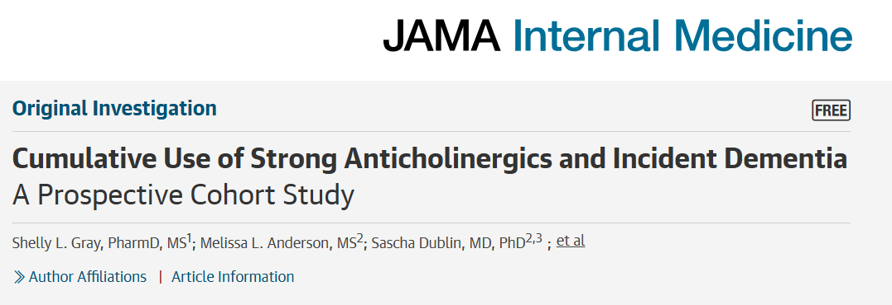
Exposure: Cumulative use of strong anticholinergics (including FGA) over 10 years prior to baseline and during follow-up (using pharmacy dispensing data), measured as total standardized daily doses (TSDD) in patients >65
Primary outcome: incident all-cause dementia (ascertained from medical records diagnostic codes or cognitive testing). Secondary outcome looking only at Alzheimer’s Dementia
Result: Compared with no exposure (0 TSDD), increasing categories of cumulative anticholinergic use were associated with increasing hazard ratios (HRs) for dementia with a peak of HR 1.54 for TSDD 1095 (~3 years).

Slide 24
Confounding
Covariates included in the adjusted model: age, education (at least some college versus none), BMI, self-report of smoking, self-report exercise, self-reported CAD, HTN and DM2 inferred from pharmacy data on medications, self-report of depressive symptoms, use of benzodiazepines as a proxy for sleep or anxiety
These are imperfect ways to measure potential confounders (self report, proxies), pharmacy dispensing does not mean they were taken
Missing many potential confounders - alcohol, diet, lipids
Notes:
Garbage in garbage out

Slide 25
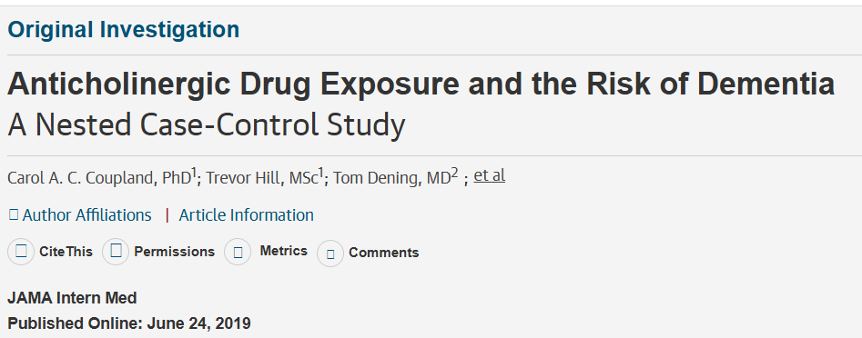
Nested case-control study in primary care setting in England, with patients > 55 years old with new dementia diagnosis between 2005-2015 with matched controls without dementia by age, sex, practice setting, and time
Exposure: Strong anticholinergic drugs across multiple drug classes in the 1 to 11 years prior to dementia diagnosis by TSDD
Outcome: Dementia diagnosis as recorded in primary care or hospital records or death certificate data. Also included patients with prescription of donepezil, rivastigmine, memantine.
Result: Increased odds of dementia with high anticholinergic exposure by increasing TSDD class, compared to nonuse, with peak adjusted OR ~1.29 at highest TSDD (>1095 TSDDs)

Slide 26
Confounding
Covariates included in the adjusted model: BMI, smoking and alcohol use by report in medical record, comorbidities in the record (HTN, DM2, CAD, HLD, depression)
Relies on self-report, and on the assumption of correct labeling in the chart
Did not include confounders including sleep patterns/insomnia, sedentary behavior, diet, exercise, education, etc.

Slide 27
Summary
Many studies do not demonstrate an association between antihistamines and dementia
The subset of studies that do show an association are limited to first generation antihistamines in context of anticholinergic effect
Even those few studies are observational in scope and are limited by significant confounding
Second generation antihistamines have minimal anticholinergic activity and do not cross the blood brain barrier – they are safe and do not increase dementia risk

Slide 28
Rebuttal
Sid Aung, PGY-4
UCSF

Slide 29
Alcohol
FGA and alcohol are both commonly use self-medications for insomnia.
Confounding = associated with both the predictor and outcome but NOT in the causal pathway between the two; can create a spurious relationship
Elderly patients have much more chronic disease and polypharmacy
Advanced age
Insomnia
More likely to use FGA if you have
insomnia
Anti-histamines
Dementia
More likely to use antihistamine for anxiety/somatic symptoms
Depression/
Mood disorder
Sedentary, poor diet,
metabolic syndrome
Allergies/Atopy negatively impacts exercise
tolerance
Notes:
Re-include this diagram at the end and go through each point in rebuttal

Slide 30
What about antihistamines alone?
Drugs grouped into classes, one of which was first generation antihistamines
Sub analyses by drug classes only looked at whether a difference existed between antidepressants and “other anticholinergic classes”
They did not explore antihistamines as an independent predictor.

Slide 31
Outcome ascertainment:
We know that anticholinergics cause acute cognitive impairment and sedation
They ascertained outcome of dementia by cognitive testing. They did not instruct patients to hold anticholinergics prior to testing!
How do you know what you’re measuring is chronic neurodegeneration versus acute/reversible cognitive impairment?
Notes:
Long half lives
Huge flaw
Not included in limitations

Slide 32
What about antihistamines as an independent predictor?
In the highest >1095 TSDD, after adjusting for all other anticholinergic drug classes and confounders, antihistamines had lowest point estimate (OR 1.14) and was NOT statistically significant (95% CI 0.98 – 1.34)
In lower TSDD groups, odds ratios were basically null (1-1.03) for antihistamines.

Slide 33
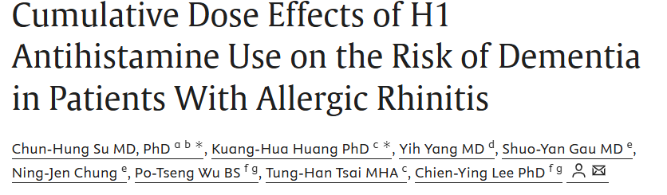
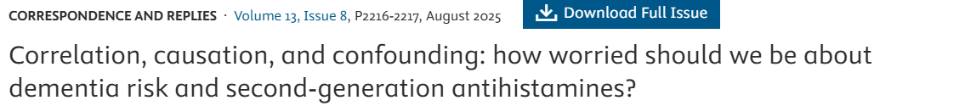
Only paper showing association between second generation antihistamine and dementia
Garnered reply letters calling into question validity
Highlight concern about significant confounding
Reasonable chance those not using SGA used ICS which is more effective at treating nasal obstruction/sleep apnea associated with dementia

Slide 34
Reverse causation
Outcome of interest (dementia) precedes and causes the exposure (anticholinergics)
Urinary symptoms, depression, and insomnia can occur years prior to memory and cognitive defects in dementia
What do people use for these symptoms? Anticholinergics (anti-depressants, bladder relaxants, sleep aids)
Studies attempted to control for this (e.g. Gray et al did sensitivity analysis that excluded prescriptions fills in the most recent 1 year period)

Slide 35
References
Ancelin ML, Artero S, Portet F, Dupuy AM, Touchon J, Ritchie K. Non-degenerative mild cognitive impairment in elderly people and use of anticholinergic drugs: longitudinal cohort study. BMJ. 2006;332(7539):455-459. doi:10.1136/bmj.38740.439664.DE
Richardson K, Fox C, Maidment I, et al. Anticholinergic drugs and risk of dementia: case-control study. BMJ. 2018;361:k1315. Published 2018 Apr 25. doi:10.1136/bmj.k1315
Yang CC, Chien WC, Chung CH, Lai CY, Tzeng NS. The Usage of Histamine Type 1 Receptor Antagonist and Risk of Dementia in the Elderly: A Nationwide Cohort Study. Front Aging Neurosci. 2022;14:811494. Published 2022 Mar 18. doi:10.3389/fnagi.2022.811494
Mangialasche F, Kivipelto M, Solomon A, Fratiglioni L. Dementia prevention: current epidemiological evidence and future perspective. Alzheimers Res Ther. 2012;4(1):6.. doi:10.1186/alzrt104
Shi L, Chen SJ, Ma MY, et al. Sleep disturbances increase the risk of dementia: A systematic review and meta-analysis. Sleep Med Rev. 2018;40:4-16. doi:10.1016/j.smrv.2017.06.010
Peters R, Booth A, Rockwood K, Peters J, D'Este C, Anstey KJ. Combining modifiable risk factors and risk of dementia: a systematic review and meta-analysis. BMJ Open. 2019;9(1):e022846. doi:10.1136/bmjopen-2018-022846
Zheng YB, Shi L, Zhu XM, et al. Anticholinergic drugs and the risk of dementia: A systematic review and meta-analysis. Neurosci Biobehav Rev. 2021;127:296-306. doi:10.1016/j.neubiorev.2021.04.031
Leceta A, García A, Sologuren A, Campo C. Bilastine 10 and 20 mg in paediatric and adult patients: an updated practical approach to treatment decisions. Drugs Context. 2021;10:2021-5-1. Published 2021 Aug 10. doi:10.7573/dic.2021-5-1
Staevska M, Popov TA, Kralimarkova T, et al. “The effectiveness of levocetirizine and desloratadine in up to 4 times conventional doses in difficult-to-treat urticaria.” J Allergy Clin Immunol. 2010;125(3):676–682. doi:10.1016/j.jaci.2009.11.047.
Coupland CAC, Hill T, Dening T, Morriss R, Moore M, Hippisley-Cox J. Anticholinergic Drug Exposure and the Risk of Dementia: A Nested Case-Control Study. JAMA Intern Med. 2019;179(8):1084–1093. doi:10.1001/jamainternmed.2019.0677
Gray SL, Anderson ML, Dublin S, et al. Cumulative Use of Strong Anticholinergics and Incident Dementia: A Prospective Cohort Study. JAMA Intern Med. 2015;175(3):401–407. doi:10.1001/jamainternmed.2014.7663
Joh HK, Kwon H, Son KY, et al. Allergic Diseases and Risk of Incident Dementia and Alzheimer's Disease. Ann Neurol. 2023;93(2):384-397. doi:10.1002/ana.26506
Guay-Gagnon M, Vat S, Forget MF, et al. Sleep apnea and the risk of dementia: A systematic review and meta-analysis. J Sleep Res. 2022;31(5):e13589. doi:10.1111/jsr.13589

