Slide 1


Slide 2

Immunotherapy is Indicated for the Management of Atopic Dermatitis
AAIFNC Debate
Conny Lu
10/16/2024

Slide 3
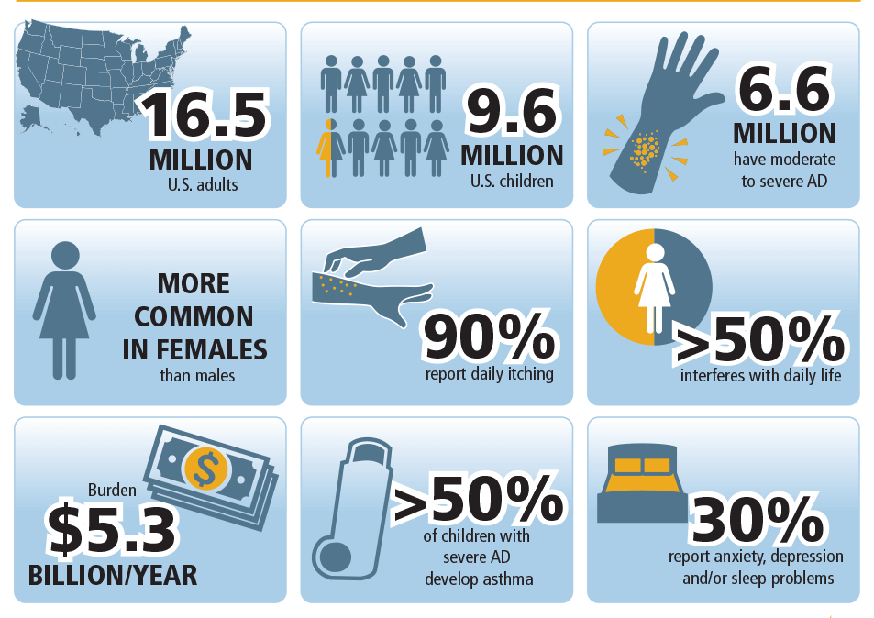

Atopic Dermatitis
AllergyAsthmaNetwork.org
Notes:
Globally, ~20% of children have atopic dermatitis
In the United States, almost 10 million children, or 15.1% have AD
16.5 million adults of adults in the United States have AD (7.3%) – so it does persistent in some cases
6.6 million people have moderate-severe AD
>50% of people with severe AD develop comorbid conditions such as asthma
We know it negatively impacts quality of life (QoL), emotional health, and socialization
Direct costs of AD in the United States are estimated to be $5.3 billion per year.

Slide 4
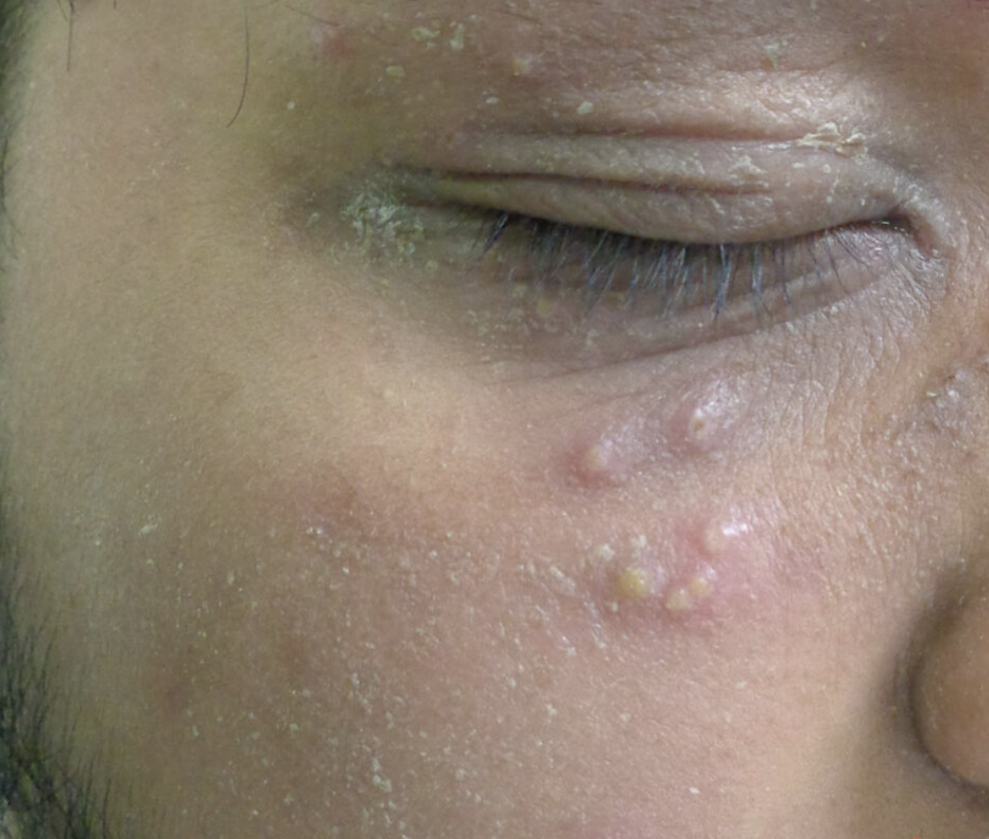
Case Presentation
7-year-old M presented to urgent care for recurrent eczema herpeticum.
This is his 4th flare in the past year.
His eczema has been hard to control with topicals. He was put on Dupixent but had to stop it due to severe conjunctivitis.
He is currently being treated with both low dose methotrexate and cyclosporine.
Patient also suffers from allergic rhinitis.
Would you make any changes to his treatment regimen?.
dftbskindeep.com
Notes:
Secondary im-petigi-ni-zation

Slide 5
AIT Can Be Extremely Helpful for Select Patients with AD
Effective | Safe | Disease-Modifying
Can Treat Co-morbid Allergic Conditions | Assessable | Low Cost
Notes:
It is effective, safe, can be disease-modifying.
It can treat co-morbid conditions such as allergic rhinitis and asthma.
It is assessable and low cost.

Slide 6
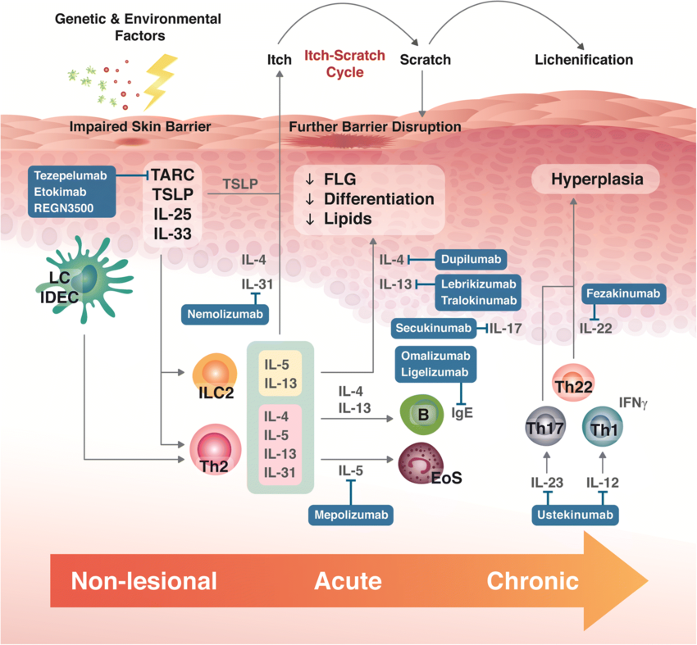
The Pathophysiology of Atopic Dermatitis is Multifactorial –
Treatment should also be Multimodal!
Frontiers in Pediatrics Nov 2022 DOI 10.3389/fped.2022.1050560
Notes:
The pathophysiology of AD is multifactorial and involves impaired epidermal barrier function, skin microbiome abnormalities, genetic factors, and environmental triggers, and immune dysregulation. There are several endotypes characterized by discrete immunological and molecular mechanisms, which is relevant for disease treatment, which should be multimodal. I think we’re seeing a more personalized approach in AD management now.
-----
AIT’s multiple anti-inflammatory, immunomodulatory, and pro-tolerogenic mechanisms including induction of IL-10 production by innate cells, epithelial repair, and modulation of the JAK-STAT pathway might explain the clinical benefits described in the previous study.
genetic, neuroendocrine, immune, and environmental factors
https://www.frontiersin.org/journals/pediatrics/articles/10.3389/fped.2022.1050560/full

Slide 7
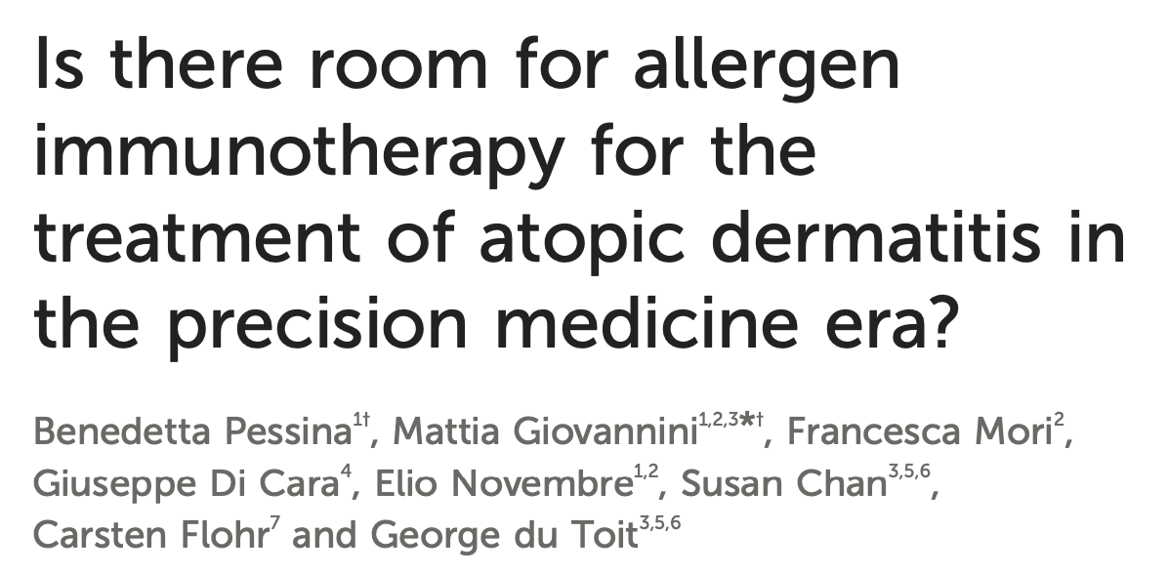
YES!
Characteristics of Patients More Likely to Respond
Patients with a proven sensitization to aeroallergens, particularly house dust mites, grass, and birch allergies
Patients who have AD flare-ups induced by aeroallergens
Concomitant allergic rhinitis or asthma.
Frontiers in Pediatrics Nov 2022 DOI 10.3389/fped.2022.1050560
Notes:
This is an opinion article published in 2022 in Frontiers in Pediatrics
We’re in the Era of Precision Medicine – such a buzzword in multiple fields
https://www.frontiersin.org/journals/pediatrics/articles/10.3389/fped.2022.1050560/full

Slide 8
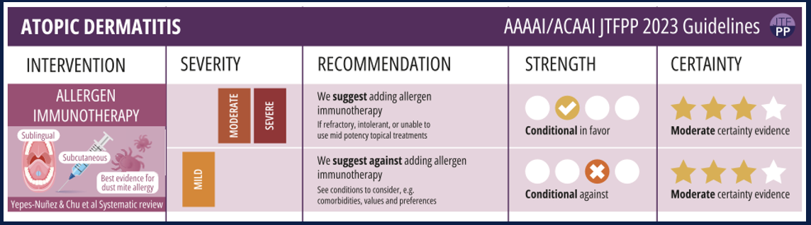
Both the AAAAI and ACAAI Recommend the Use of AIT in Moderate to Severe Atopic Dermatitis
Chu, Derek K. et al. Annals of Allergy, Asthma & Immunology (2023) DOI: 10.1016/j.anai.2023.11.009
Notes:
This is the Updated 2023 Atopic Dermatitis Practice Parameter guidelines, which recommends ADDING allergen immunotherapy for moderate and severe eczema that is refractory, intolerant, or unable to use mid potency topical treatments with moderate certainty evidence
Moderate certainty of evidence taken from a systematic review by Yepes-Nunez and Chu – next slide

Slide 9
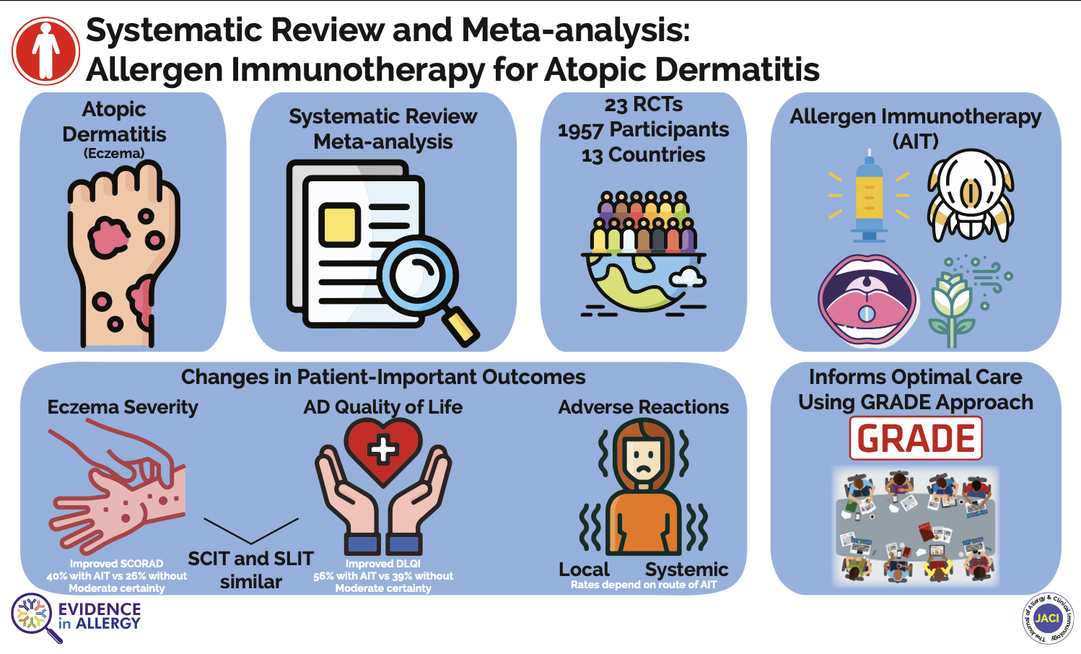
Juan José Yepes-Nuñez et al. Journal of Allergy and Clinical Immunology 2023 151147-158 DOI: (10.1016/j.jaci.2022.09.020)
Notes:
This was published in JACI in 2023 – it is a systemic review and meta-analysis of allergen immunotherapy for Atopic dermatitis
Included 23 randomized controlled trials from 13 countries comparing SCIT, SLIT, and/or no AIT/placebo on top of standard care with topical treatments and found that AIT imprnoved SCORAD (severity of atopic dermatitis) and QOL measures
Improved SCORAD defined as a 50% reduction from baseline in Clinician-reported severity (SCORAD and EASI prioritized over investigator global assessment)
patient-reported severity (eg, patient-oriented eczema measure)
QoL defined as an improvement in Dermatology Life Quality Index by 4 points or more

Slide 10
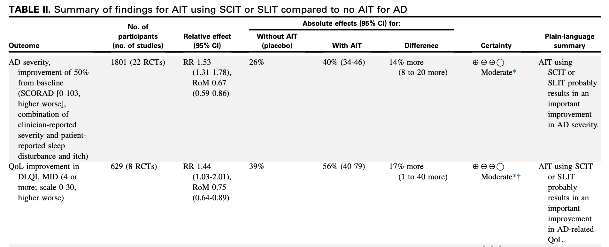
Both SCORAD and AD-QoL Improved with AIT
Journal of Allergy and Clinical Immunology 2023 151147-158 DOI: (10.1016/j.jaci.2022.09.020)
Notes:
Both SCORAD and AD-QoL Improved with AIT Compared to Placebo
In terms of eczema severity, SCORAD improved in 40% of patients with AIT vs 26% in patients without
AD-related quality of life improved 56% with AIT vs 39% without.

Slide 11
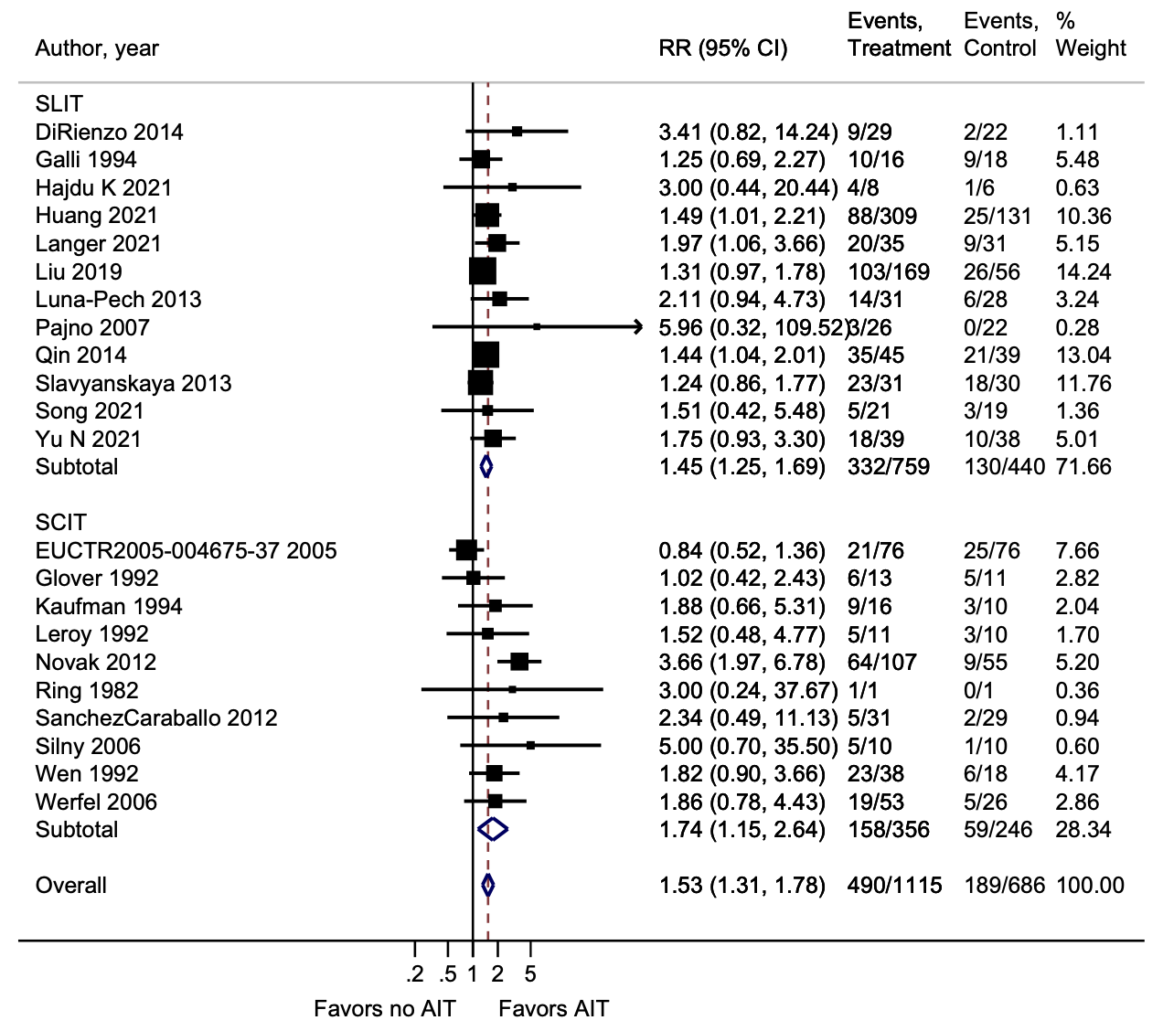
Both SCIT and SLIT Demonstrated a Positive Impact on Eczema Severity
Journal of Allergy and Clinical Immunology 2023 151147-158 DOI: (10.1016/j.jaci.2022.09.020)
Notes:
Shows the impact of AIT on eczema severity from each individual study, from 1982-2021
Most studies desensitized patients to HDM and 4 RCTs either addressed pollens or did not specify the allergen or allergens used. The reports described the doses used to be based on efficacy in allergic rhinitis. AIT was provided for a median (range) of mean duration among studies of 12 (3-36) months.
Probability to improve SCORAD score by 50% from baseline – majority of them favor AIT
relative risk (RR)

Slide 12
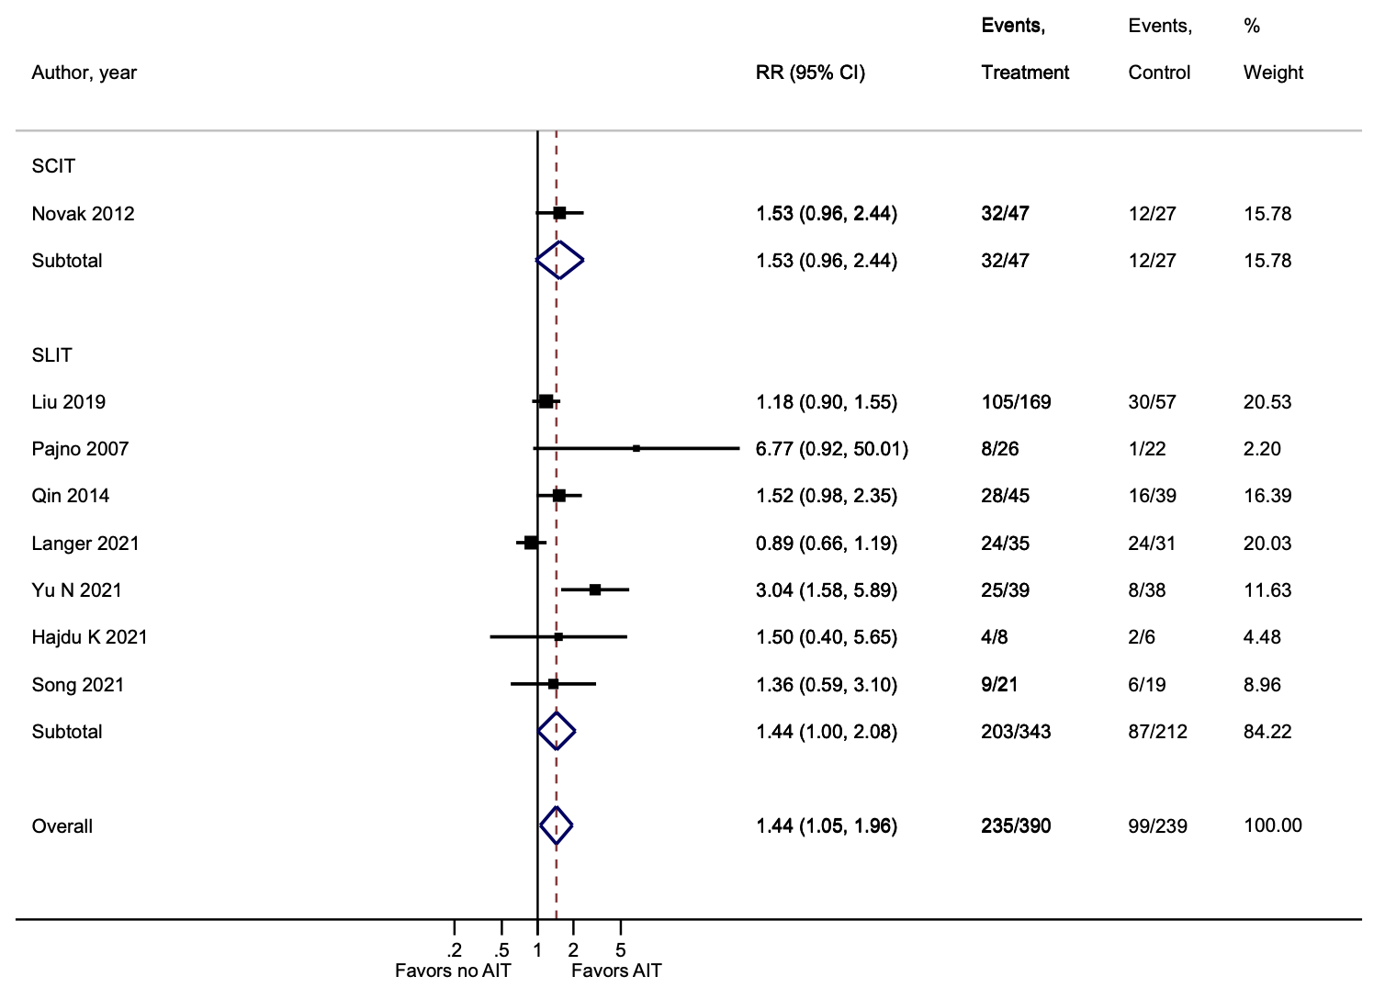
Both SCIT and SLIT Demonstrated a Positive Impact on Eczema-Related Dermatology Life Quality Index (DLQI)
Journal of Allergy and Clinical Immunology 2023 151147-158 DOI: (10.1016/j.jaci.2022.09.020)
Notes:
Similar figure for QoL - Improvement measured by DLQI by minimally important difference of 4.

Slide 13
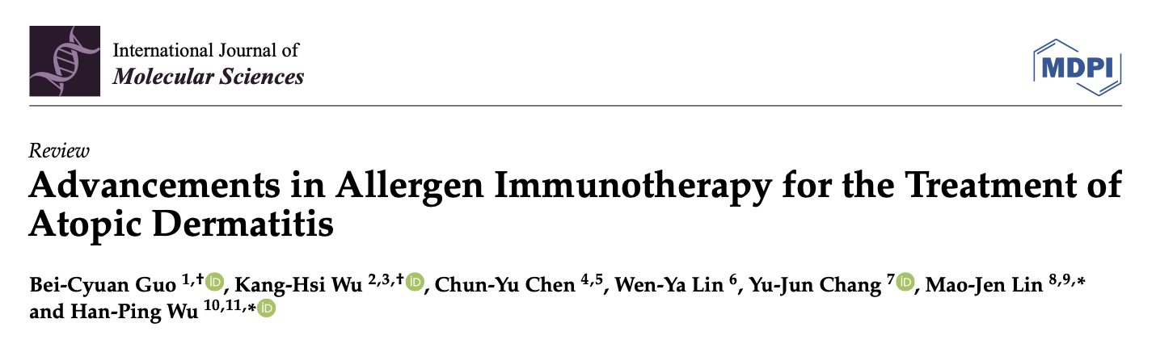
AIT Shows Promising Outcomes in Reducing the Severity of AD
Bei-Cyuan Guo et al., International Journal of Molecular Sciences (2024) doi.org/10.3390/ijms25021316
Notes:
This 2024 Review also supports the use of AIT for the Management of AD
https://www.ncbi.nlm.nih.gov/pmc/articles/PMC10816003/pdf/ijms-25-01316.pdf

Slide 14
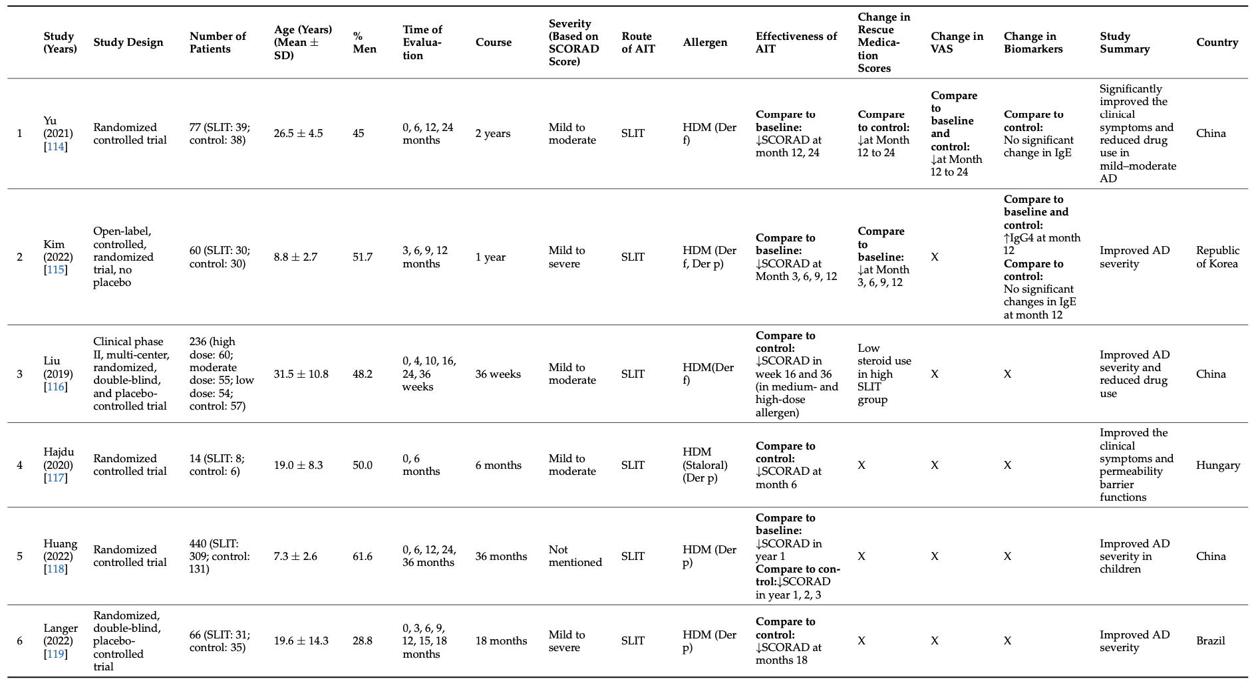
Studies Show a Reduction in SCORAD Scores and Rescue Medication Use with SLIT
Bei-Cyuan Guo et al., International Journal of Molecular Sciences (2024) doi.org/10.3390/ijms25021316
Notes:
Includes a few new studies on SLIT that were not included in the last paper (Kim 2022)
Included patients with a spectrum of eczema severity ranging from mild to severe
Some studies are compared to baseline, some compared to control
All of them showed an improvement in SCORAD with SLIT
Some also showed reduced rescue medication use

Slide 15
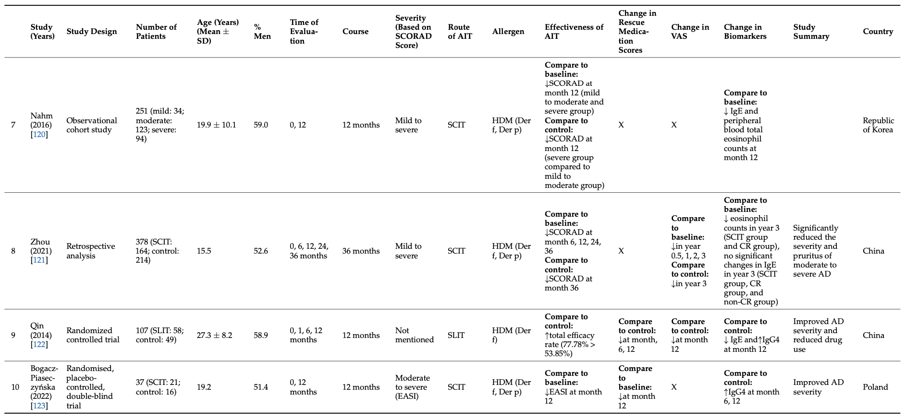
Similar Reduction in SCORAD, EASI, and Rescue Medication Use with SCIT
Bei-Cyuan Guo et al., International Journal of Molecular Sciences (2024) doi.org/10.3390/ijms25021316
Notes:
Nahm 2016, Zhou 2021, Bogacz 2022 are new SCIT studies that weren’t included in the previous systematic review
Nahm and Zhou papers showed an improvement in SCORAD with SCIT
Bogacz showed an improvement in Eczema Area and Severity Index with SCIT

Slide 16
Multiple European Guidelines also Support the Use of AIT for Atopic Dermatitis
2019 European Academy of Allergy and Clinical Immunology (EAACI) Consensus-based European Guidelines for the Treatment of AD
European Task Force on Atopic Dermatitis (ETFAD) of the European Academy of Dermatology and Venerology (EADV) 2020 position paper
2022 European Dermatology Forum in the European Guidelines on Atopic Eczema Treatment
Wollenberg et al. J Eur Acad Dermatol Venereol (2022) doi: 10.1111/jdv.18429
Notes:
Not only American guidelines, but multiple European Guidelines also support the use of AIT for Atopic Dermatitis

Slide 17
Multiple European Guidelines also support the use of AIT for Atopic Dermatitis
Recent literature being more favorable towards AIT, which may have positive effects in chosen, highly sensitized patients
AIT suggested in patients with house dust mite, birch or grass pollen sensitization, and with a history of clinical exacerbation after exposure to the causative allergen.
Wollenberg et al. J Eur Acad Dermatol Venereol (2022) doi: 10.1111/jdv.18429
Notes:
Summarized the main points here

Slide 18
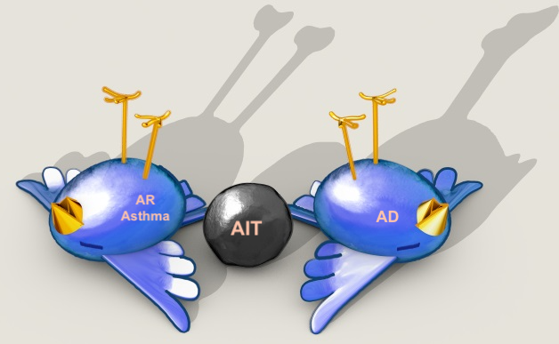
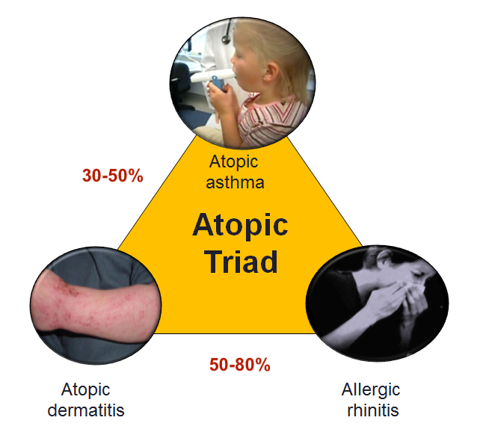
You Are Killing Two Birds With One Stone!
https://commons.wikimedia.org/wiki/File:Atopic_triad_2.PNG
Notes:
A significant percentage of patients with atopic dermatitis also experience comorbid conditions such as allergic rhinitis (AR) and asthma.
Allergic Rhinitis (AR): Approximately 50-80% of patients with atopic dermatitis are reported to also have allergic rhinitis.
Asthma: Around 30-50% of atopic dermatitis patients also suffer from asthma.
AIT may treat atopic dermatitis, allergic rhinitis, and asthma.
Topical steroids won’t address this

Slide 19
Allergen immunotherapy is currently the only disease-modifying treatment available for allergic rhinitis and allergic asthma.
AIT can potentially modify the course of atopic dermatitis!
Notes:
Can AIT also modify the course of atopic dermatitis and induce long-term remission?

Slide 20
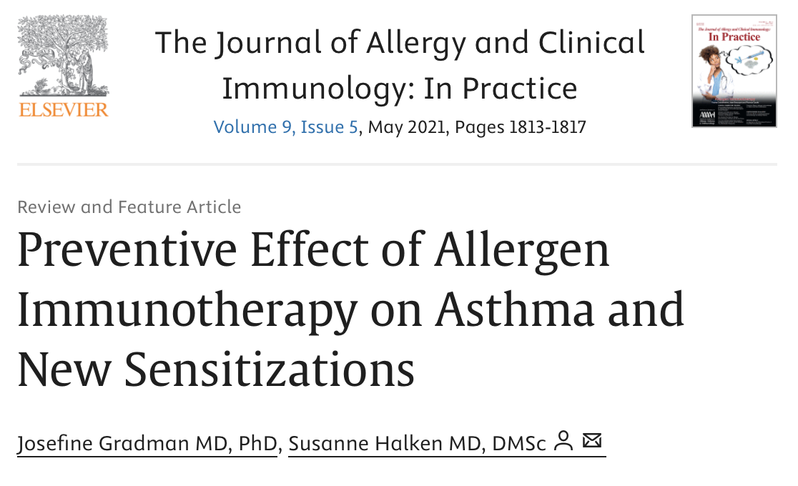
AIT has a Preventative Effect on the Development of Other Atopic Diseases
Gradman et al, JACI (2021) doi.org/10.1016/j.jaip.2021.03.010
Notes:
AIT has a preventative effect on the development of other atopic diseases, such as asthma and allergic rhinitis, both of which frequently co-exist with eczema.
Based off a systematic review from 2017 that concluded a 3-year course of AIT significantly reduced the risk of onset of asthma in patients with AR, with the greatest effect in children, those receiving (SCIT) or (SLIT), and for pollen AIT.

Slide 21
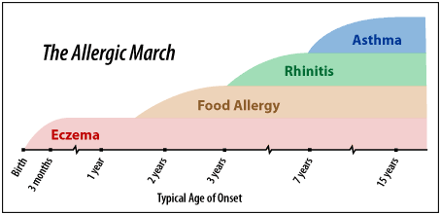
AIT can Prevent the Onset of New Allergen Sensitizations
Gradman et al, JACI (2021) doi.org/10.1016/j.jaip.2021.03.010
Notes:
Here is a diagram depicting the concept of the allergic march: atopic individuals usually start of with eczema in infancy, and can go on to develop food allergy, rhinitis, and asthma
Not only can AIT prevent the development of worsening rhinitis and asthma, there is data that AIT may also prevent the development of new sensitizations.
So for patients with atopic dermatitis and allergic sensitization, AIT may help prevent progression of their disease to more severe allergic manifestations.

Slide 22
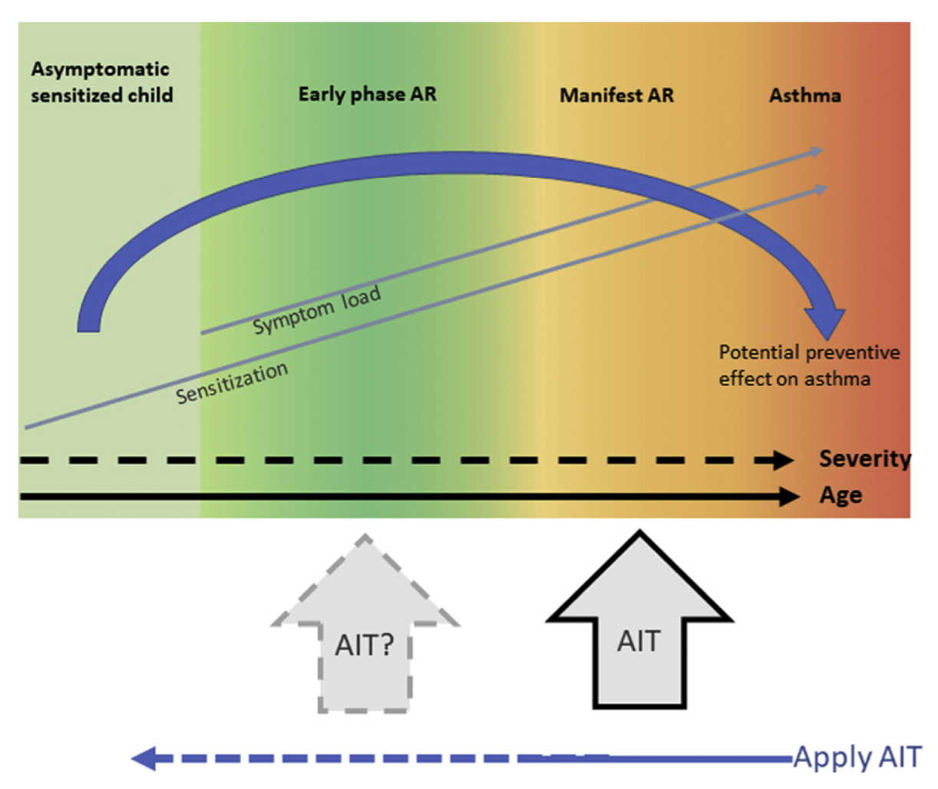
AIT should be applied early in the phase of increasing sensitizations and allergic symptoms to achieve the greatest potential of a disease-modifying effect.
Gradman et al, JACI (2021) doi.org/10.1016/j.jaip.2021.03.010

Slide 23


AIT Offers a “Natural Approach” to Atopic Dermatitis
Patients are increasingly seeking natural, less invasive treatment options.
The allergens used in AIT are derived from natural sources.
Notes:
There is a lot of hesitancy around topical steroids.
Immunosuppressants have serious potential side effects and requires routine blood tests to monitor organ function.
Biologics

Slide 24
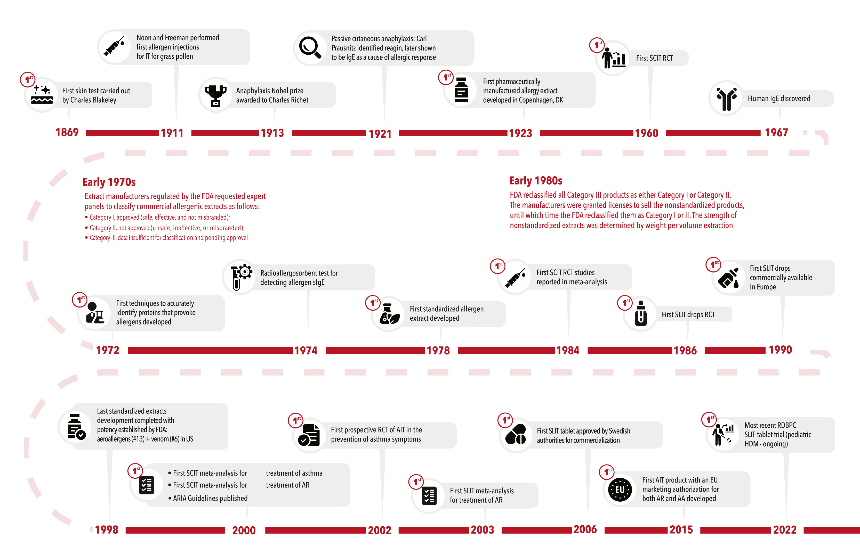
AIT has a long track record with a favorable safety profile
Moisés A. Calderon et al, JACI (2021) https://doi.org/10.1016/j.jaip.2022.10.033
Notes:
Allergen immunotherapy has been used to treat allergic diseases for over a century.
Based on numerous studies done over the years, we know that AIT is a safe and effective therapy.
AAAAI: AIT can be safely continued during pregnancy if patient is already on AIT.
SLIT has an even better safety profile.

Slide 25
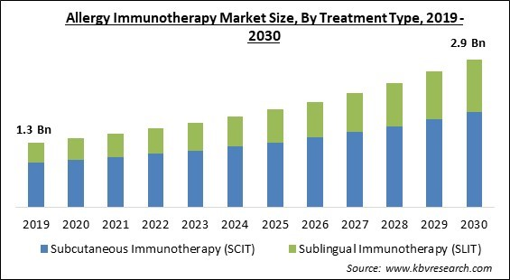
AIT is Widely Available
https://www.kbvresearch.com/allergy-immunotherapy-market/
Notes:
Compound annual growth rate of 8.4%

Slide 26
Both SCIT and SLIT are More Cost-Effective than Dupixent!
AIT is Relatively Low Cost Compared to Other Treatments
 | Price | Dosing | Yearly Cost
SCIT | $600 per vial $29 injection visit | 6-month buildup 6-month maintenance | $4,132 (for 2 vials)
SLIT | Odactra $300 per month Grastek $312 per month | Daily dosing | $3,600
Dupixent | $1,154 for 300 mg | 300 mg q2 weeks | $30,000
https://www.ncbi.nlm.nih.gov/books/NBK539194/
Notes:
Cost without insurance
AIT: taken from AllerVie where each vial costs $600 and each injection visit costs $24-29 calculations based on needing 2 vials, generous with 6 months of q2w maintenance – subsequent years would be even cheaper as you space out injection visits.
Cost-friendly to patients, hopefully also profitable for the practice

Slide 27
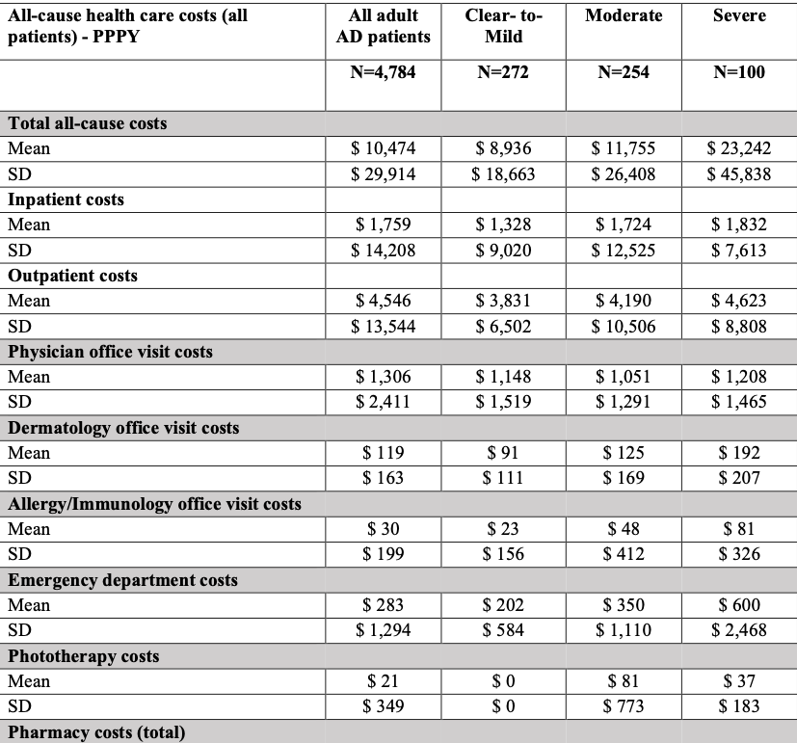
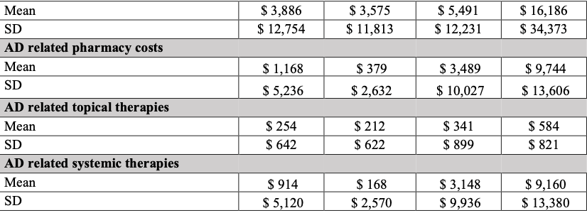
U.S. healthcare costs for adult patients with atopic dermatitis significantly increase with the severity of the disease.
Inpatient, outpatient, subspecialty, and ER visits show relatively similar costs across mild, moderate, and severe AD.
The major driver of cost: Pharmacy Expenses! Particularly AD-related medications and systemic therapies (e.g., biologics)
AIT is a cost-efficient treatment for AD and can reduce the need for expensive AD-related medications and systemic therapies!
Wang et al, J Manag Care Spec Pharm. (2022) doi: 10.18553/jmcp.2022.28.1.69
Notes:
Retrospective chart review looking at the Annual US Healthcare Costs for Adult Patients with Atopic Dermatitis, Classified by Disease Severity
Point out the increasing healthcare cost with increasing eczema severity – but when you break it down to see where this discrepancy comes from – its from pharmacy costs. The inpatient costs, outpatient costs, subspecialty visits, even ED costs are relatively similar regardless of eczema severity.
And when you break down the pharmacy costs, it’s the AD related pharmacy costs and AD related systemic therapies that account for most of the difference.
_____________________
study identified adults aged at least 18 years who received a clinical diagnosis of AD in a dermatology electronic medical record (EMR) database between 2016 and 2018 (first record = index date), which was linked to an administrative claims database.

Slide 28
Pros of AIT for Treating Atopic Dermatitis
It has demonstrated significant therapeutic efficacy for the treatment of AD.
It can treat co-morbid conditions such as allergic rhinitis and asthma.
It may induce long term remission and modify the disease course.
Some patients prefer a more natural and personalized approach to AD.
It is safe, including in pregnancy.
It is widely available.
It is low cost and can lead to significant healthcare savings.
Notes:
It can be really helpful for a select group of patients

Slide 29
Case Revisited
7-year-old M with allergic rhinitis and severe atopic dermatitis presents to urgent care for recurrent flare of eczema herpeticum. He was not able to tolerate Dupixent, so his AD is being treated with low dose methotrexate and cyclosporine. Would you make any changes to his treatment?
Consider allergy testing.
If sensitized to HDM or birch, he would be an excellent candidate for AIT, which could help him wean off dual immunosuppressant therapy.
dftbskindeep.com

Slide 30
Rebuttal

Slide 31
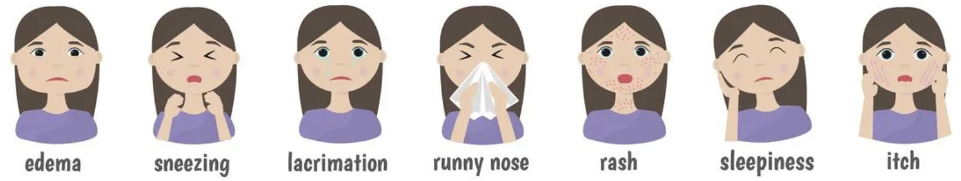
The time invested in AIT now can lead to less time managing symptoms in the future, saving time and improving quality of life long-term.
Less time spent suffering from symptoms.
SLIT can be offered to patients who are unable to come in for SCIT injections.
https://www.iowaallergyclinic.com/

Slide 32
AIT Side Effects are Mild and Manageable
Twelve RCTs in AD and 87 RCTs in rhinitis and asthma addressed adverse events from AIT and were described as primarily local reactions; not that many systemic reactions.
You’re in control of the build up phase: can adjust protocols as needed to minimize side effects
You can treat through side effects: reactions are temporary and reversible. Even when more noticeable side effects occur, they usually do not require discontinuation of therapy.
Adverse events estimated from the AD trials alone were often insufficient to meaningfully inform decision making and were therefore pooled with systematic reviews of AIT used similarly for allergic rhinitis and asthma – is this generalizable?

Slide 33
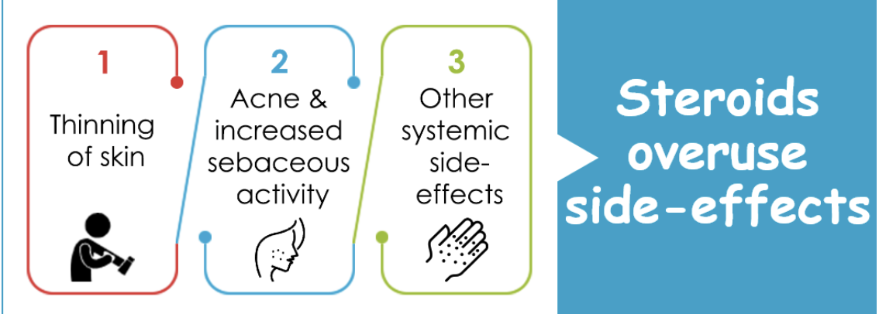
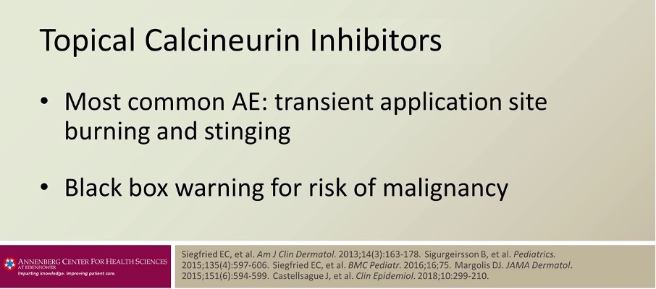
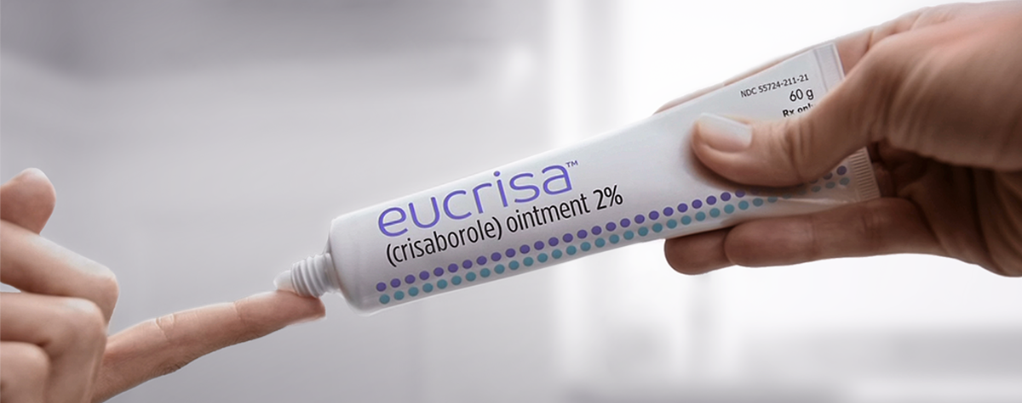
Topical Treatments Also Have Adverse Effects!
https://eczemaless.com/treating-eczema-using-topical-creams/#sideeffects
Notes:
We all know those parents that are extremely hesitant to use any topical steroids on their child
Topical calcineurin inhibitors can burn and sting
Black box warning – I know this comes from from high doses of systemic calcineurin inhibitors in animal studies and shouldn’t be generalized to the topical form, but patients can still see this warning and freak out

Slide 34
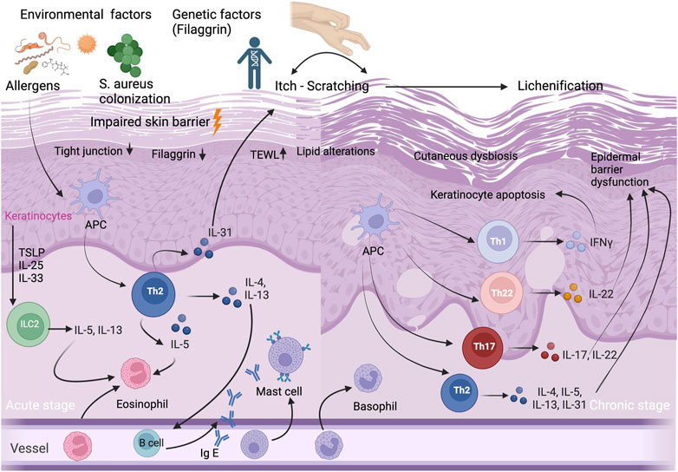
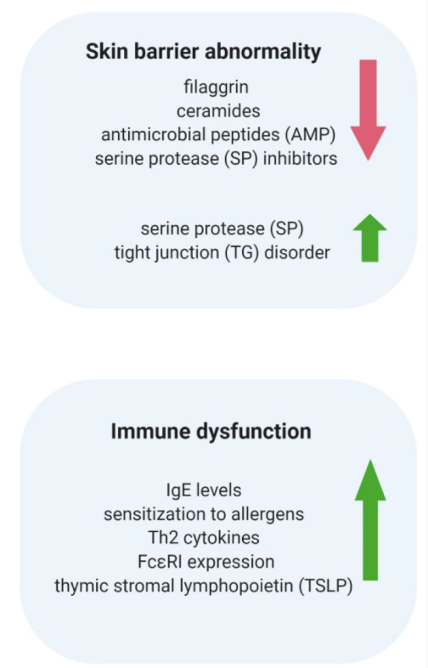
Topical Medications Will Not Alter the Course of Disease
Int. J. Mol. Sci. 2020, 21(8), 2867; https://doi.org/10.3390/ijms21082867
Notes:
Immunopathogenesis of AD involving both the innate and adaptive immune system.
Topical treatments Putting a band-aid on the problem instead of addressing the root cause

Slide 35
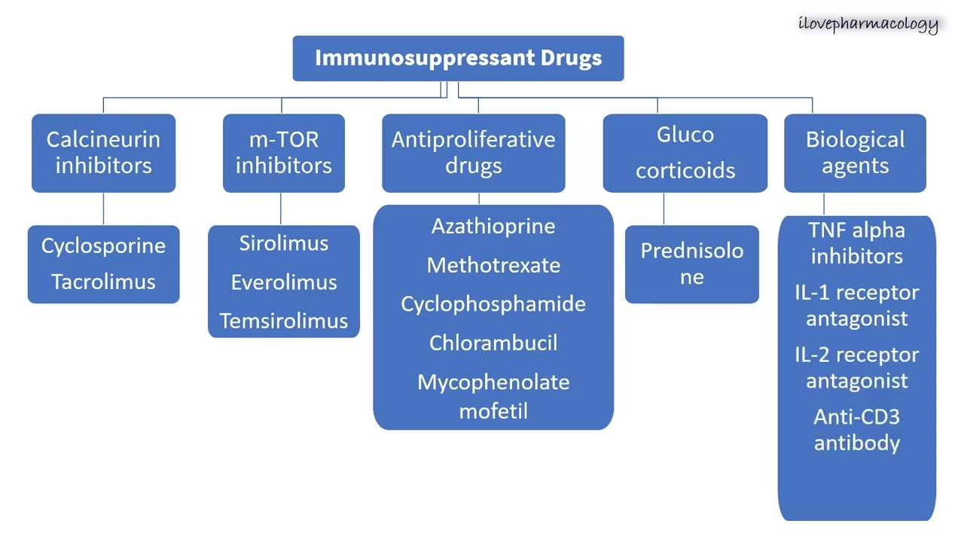
Other treatment options are immunosuppressive
Notes:
cyclosporine, Azathioprine, Methotrexate, Mycophenolate mofetil

Slide 36
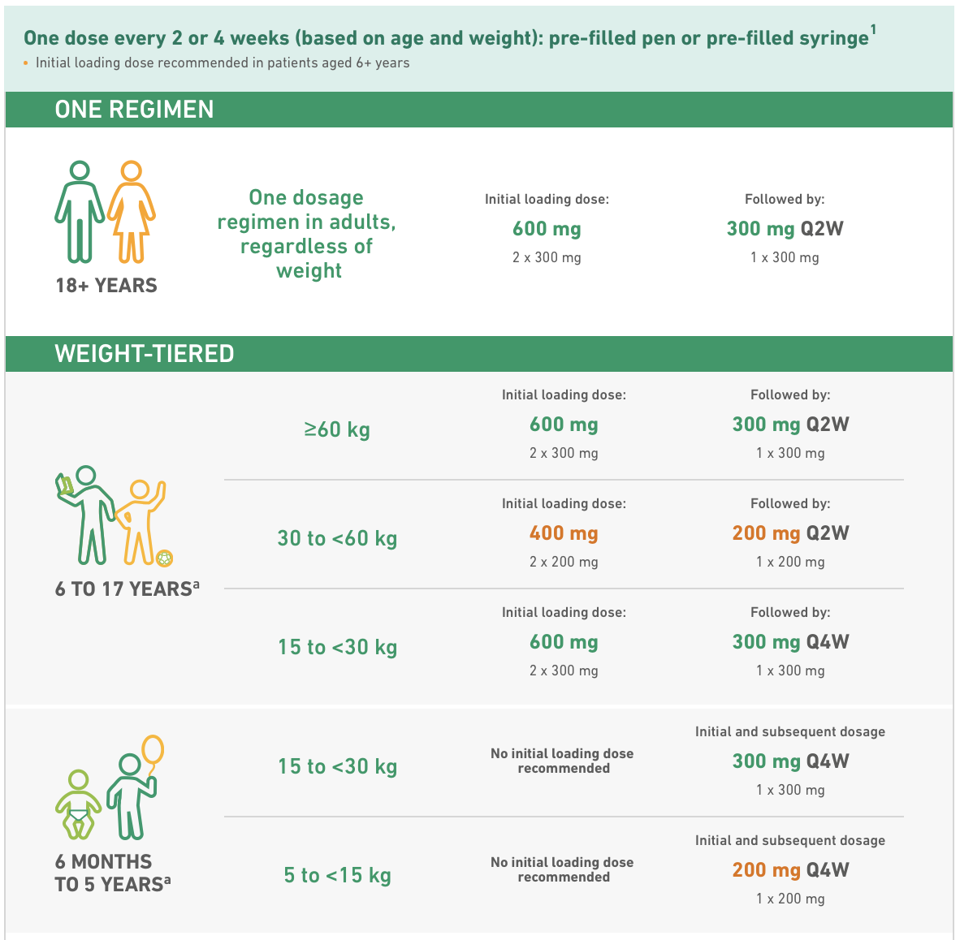
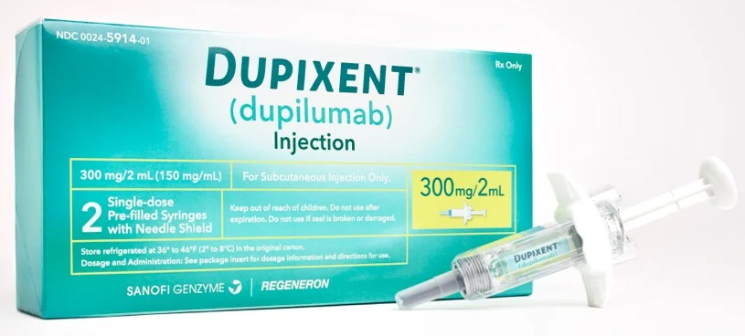
Dupixent also requires frequent injections!
Would you rather get SCIT for 3-5 years or Dupixent every 2 weeks for the rest of your life?
Notes:
Once the patient hits 30 kg, their dosage of dupixent is every 2 weeks.
There is not enough long-term data to understand if some patients with AD on Dupixent will have sustained benefits if they stop the drug. Since most patients on Dupixent tend to have more severe eczema, responders are often counselled to stay on the medication indefinitely.

Slide 37
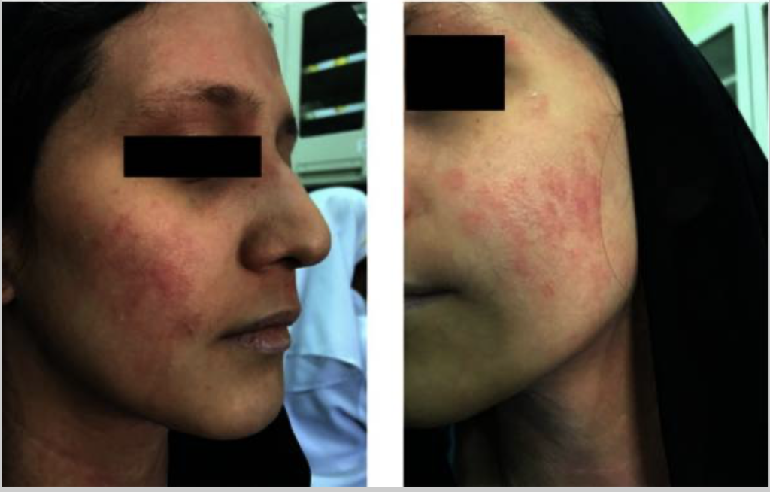
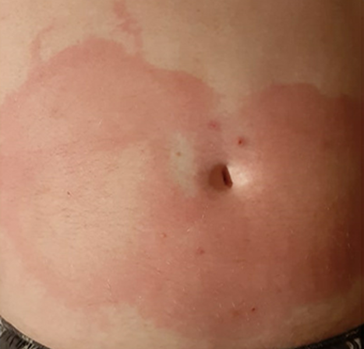
Not Everyone Can Tolerate Dupixent
Dupilumab-associated facial erythema has been described in up to 10% of patients and can lead to dupilumab discontinuation.
Serum sickness and serum sickness-like reactions have been reported with Dupixent.
Waldman RA et al. J Am Acad Dermatol. 2020;82(1): 230-232.
Notes:
Both serum sickness and serum sickness-like reactions have been reported with Dupixent.

Slide 38
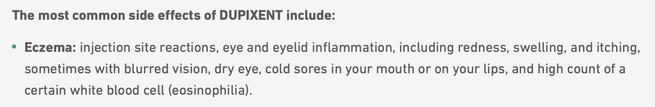
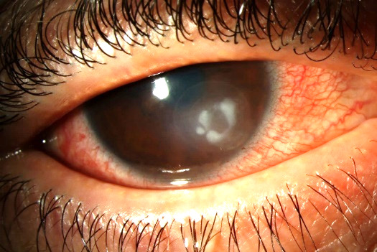

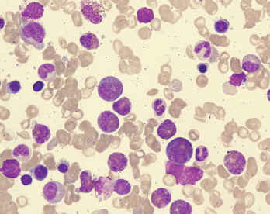
Dupixent Poses Serious Adverse Effects
Conto JE, Hogan JN, Lim SJ. Clinical Insights in Eyecare. 2024;2(2)
Notes:
Taken from the dupi website
21-year-old man developed dupilumab-associated ocular surface disease after start of dupilumab for the treatment of atopic dermatitis. Despite discontinuation of dupilumab, and aggressive management with topical and oral anti-inflammatory therapy, a corneal ulcer developed following dupilumab treatment.

Slide 39

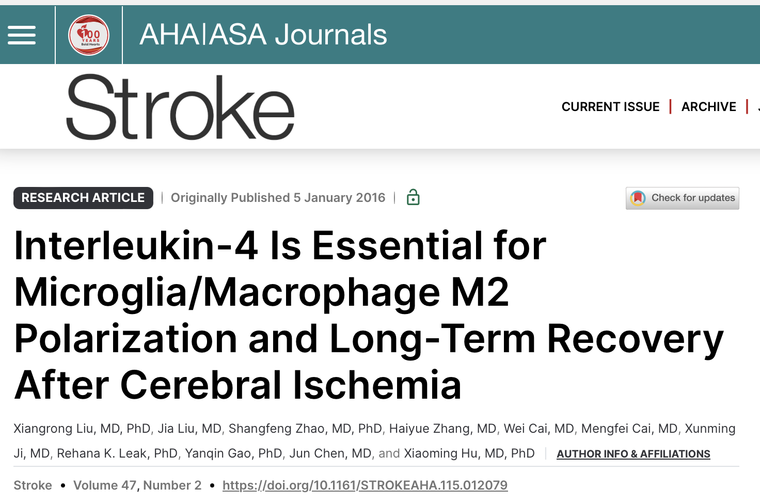
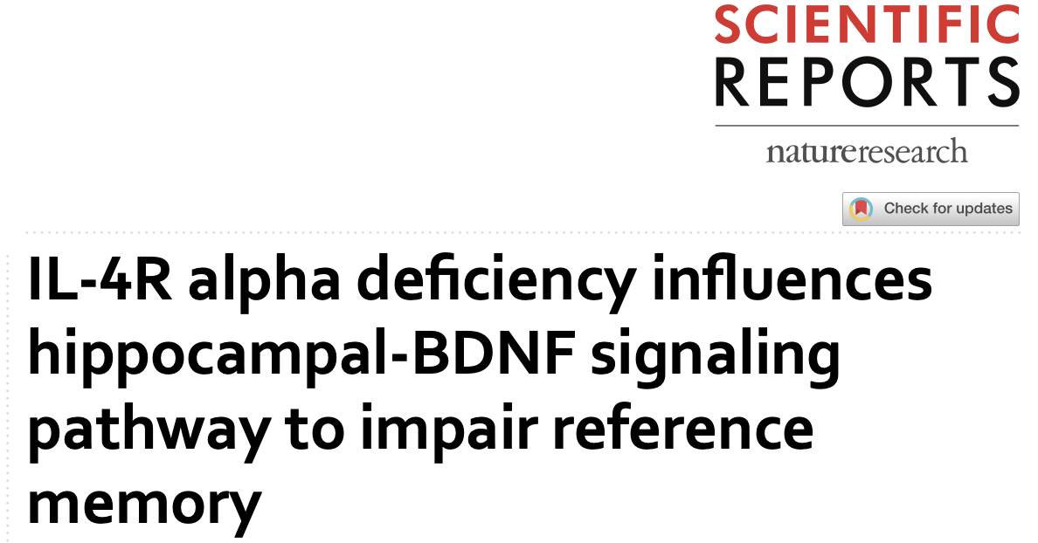
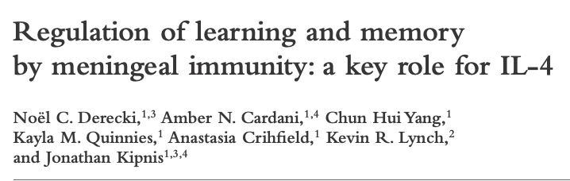
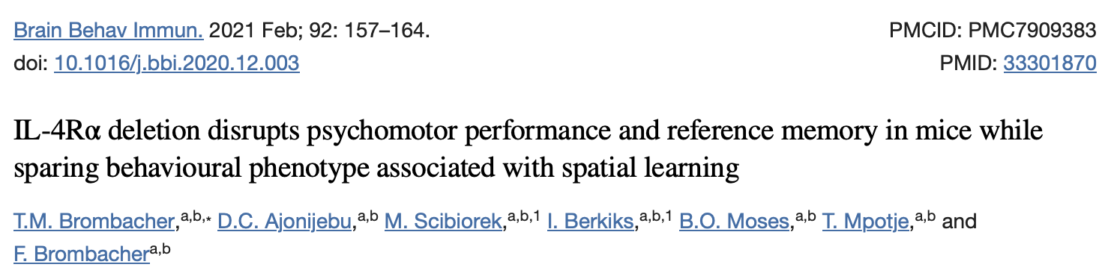
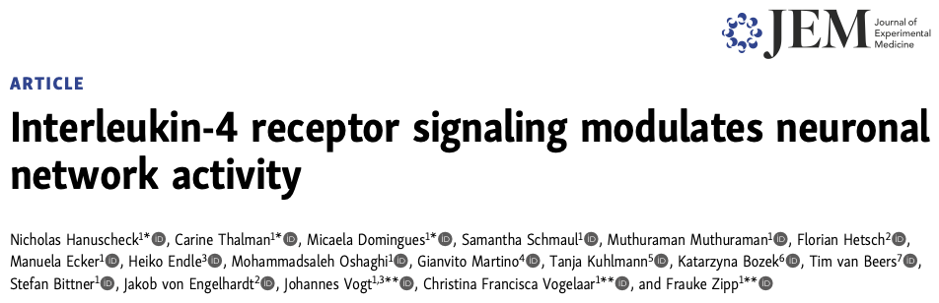
IL-4 Has Been Implicated in Learning and Memory – Are There Repercussions Associated with Blocking It?
Notes:
Something that isn’t talked about a lot, probably because pharmaceutical companies aren’t too keen on investing in this research
But IL-4 has been shown to be involved in synaptic modulation and neuronal network activity, suggesting that it plays a role in cognitive functions, particularly in learning and memory.
Can IL-4 inhibition with Dupixent negatively impact brain function? Something to think about, especially in the young children getting put on Dupi.

Slide 40
For Select Patients with Atopic Dermatitis, AIT Should be Considered as an Adjunctive Therapy
Decrease symptom severity and improve QoL.
Unlike symptomatic treatments that provide temporary relief, AIT addresses the root cause of atopic dermatitis.
Decrease reliance on other medications.
Treat or even prevent coexisting allergic conditions.

Slide 41
References
Cox L, Calderon MA. Allergen immunotherapy for atopic dermatitis: is there room for debate? J Allergy Clin Immunol Pract. (2016) 4(3):435–44. doi: 10.1016/j.jaip.2015.12.018
Ginsberg DN, Eichenfield LF. Debates in allergy medicine: specific immunotherapy in children with atopic dermatitis, the “con” view. World Allergy Organ J. (2016) 9(1):1–5. doi: 10.1186/s40413-016-0107-2
Guo, B.-C.; Wu, K.-H.; Chen, C.-Y.; Lin, W.-Y.; Chang, Y.-J.; Lin, M.-J.; Wu, H.-P. Advancements in Allergen Immunotherapy for the Treatment of Atopic Dermatitis. Int. J. Mol.Sci.2024,25,1316. https:// doi.org/10.3390/ijms25021316
Pessina, Benedetta et al. “Is There Room for Allergen Immunotherapy for the Treatment of Atopic Dermatitis in the Precision Medicine Era?” Frontiers in pediatrics 10 (2022): 1050560–1050560. Web.
Pharmacoeconomic Review Report: Dupilumab (Dupixent): (Sanofi-Aventis Canada Inc.): Indication: Moderate-to-severe atopic dermatitis (AD) [Internet]. Ottawa (ON): Canadian Agency for Drugs and Technologies in Health; 2018 Jul. Available from: https://www.ncbi.nlm.nih.gov/books/NBK539194/
Waldman RA, DeWane ME, Sloan B, Grant-Kels JM. Characterizing dupilumab facial redness: a multi-institution retrospective medical record review. J Am Acad Dermatol. 2020;82(1): 230-232.
Wang X, Boytsov NN, Gorritz M, Malatestinic WN, Goldblum OM, Wade RL. US health care utilization and costs in adult patients with atopic dermatitis by disease severity. J Manag Care Spec Pharm. 2022 Jan;28(1):69-77. doi: 10.18553/jmcp.2022.28.1.69. PMID: 34949118; PMCID: PMC10373046.
Wollenberg A, Barbarot S, Bieber T, Christen-Zaech S, Deleuran M, Fink- Wagner A, et al. Consensus-based European guidelines for treatment of atopic eczema (atopic dermatitis) in adults and children: part I. J Eur Acad Dermatol Venereol. (2018) 32(5):657–82. doi: 10.1111/jdv.14891
Yang G, Seok JK, Kang HC, Cho Y-Y, Lee HS, Lee JY. Skin Barrier Abnormalities and Immune Dysfunction in Atopic Dermatitis. International Journal of Molecular Sciences. 2020; 21(8):2867. https://doi.org/10.3390/ijms21082867
Notes:
https://pubmed.ncbi.nlm.nih.gov/26947461/ (JACI)

