Slide 1
Allergen Immunotherapy is indicated for the management of atopic dermatitis – Con
Shirley Jiang, MD
Stanford University
Notes:
Hedge- not that there is no role for it but that it can be an addition to other

Slide 2
Outline
Brief overview of the prevalence, burden, and risk factors for atopic dermatitis (AD)
Role of aeroallergen sensitization in AD
Evidence for the use of allergen immunotherapy (AIT) in AD, including data from the U.S.
Alternative treatment with biologic medications
Power of placebo in studies of AIT
Review of the the AAAAI/ACAAI Joint Task Force 2023 Practice Parameter on Atopic Dermatitis Update and Guidelines of Care for the Management of Atopic Dermatitis from the American Academy of Dermatology

Slide 3
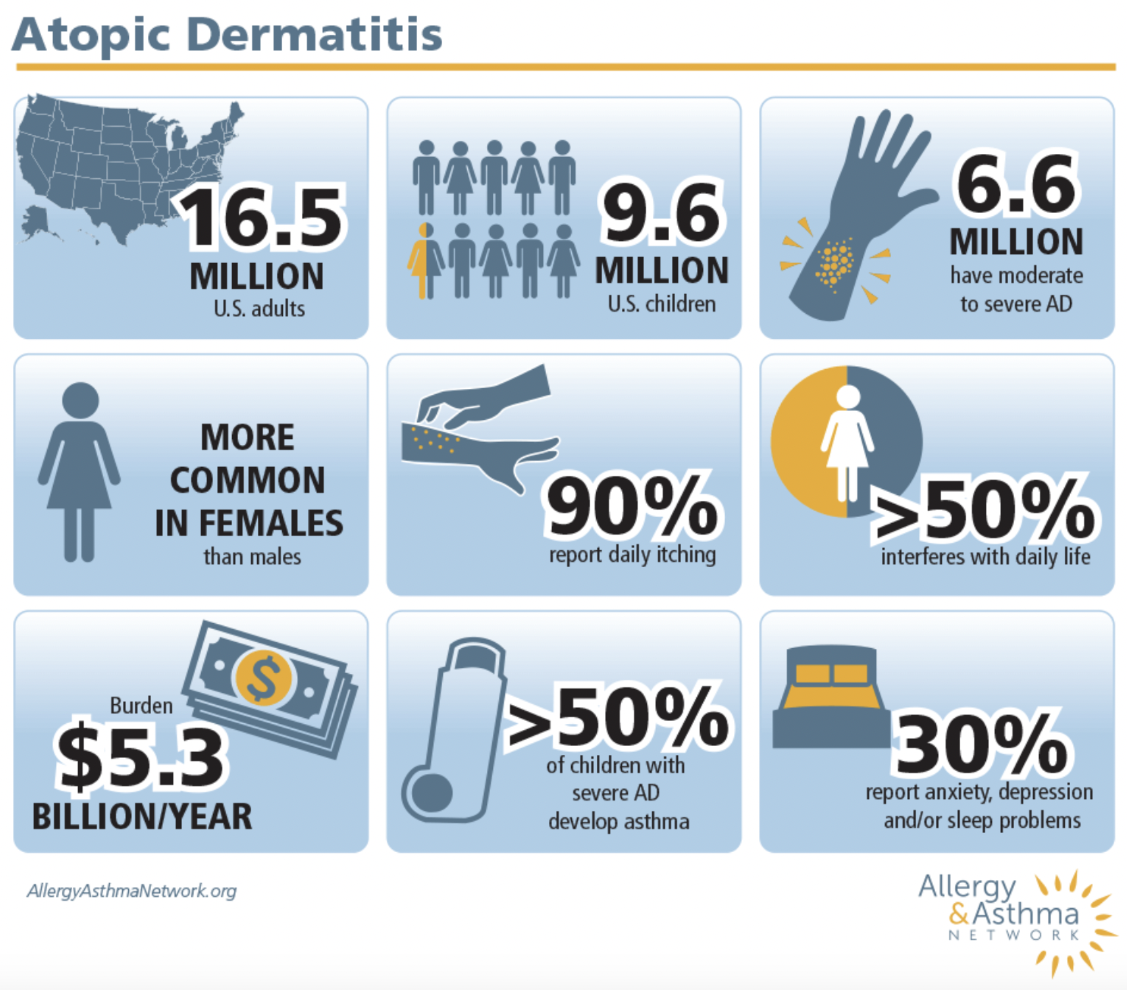
Brief review of Atopic dermatitis
https://allergyasthmanetwork.org/what-is-eczema/eczema-statistics/
Notes:
Atopic dermatitis is the most common inflammatory skin disease with a significant burden worldwide. In the US, 16.5 million of adults are affected and 9.5 million children.
About 1/5 of people have moderate-severe AD-> so the patients that are relevant in this talk make up a large proportion of the US population.
There is a significant burden associated with living with AD including daily itching, impairment of daily life, and psychosocial and sleep problems.
There is also a significant economic burden was 5.3 billion dollars in 2015, rising from 1 billion in 2004, which includes direct costs such as office visits and prescription medications, as well as indirect costs such as patient and/or caregiver lost workdays.
https://allergyasthmanetwork.org/what-is-eczema/eczema-statistics/
https://www.annallergy.org/article/S1081-1206(23)01455-2/fulltext

Slide 4
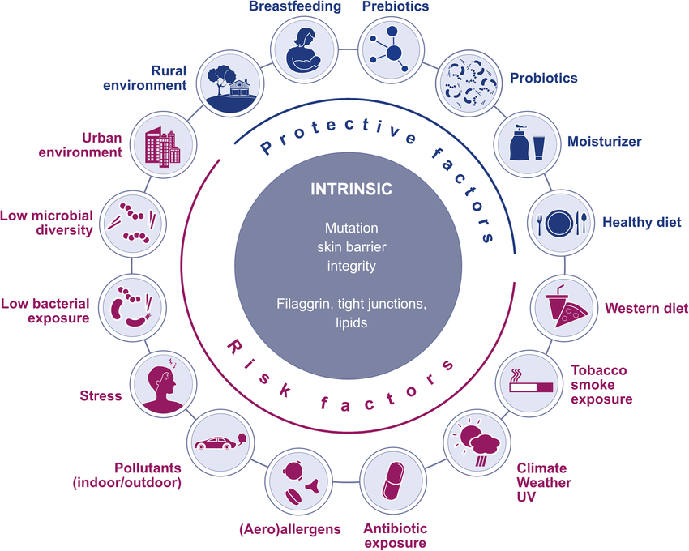
Risk factors for atopic dermatitis
Hülpüsch et al. Allergy 2021
Notes:
The cause is unknown, but we do think there is some genetic predisposition.
Environmental factors may also contribute such as urban vs rural living, air pollution, helminth infestation, number of siblings, living with animals, pet dogs in early life, similar factors that are thought to be contribute to the microbiome and risk of developing atopy.
Skin inflammation has been debated to be a result of an “outside-in” or “inside-out” hypothesis, whether it is initiated by barrier dysfunction or from immune dysregulation.
https://www.nature.com/articles/ng.3424
https://allergyasthmanetwork.org/what-is-eczema/eczema-statistics/

Slide 5
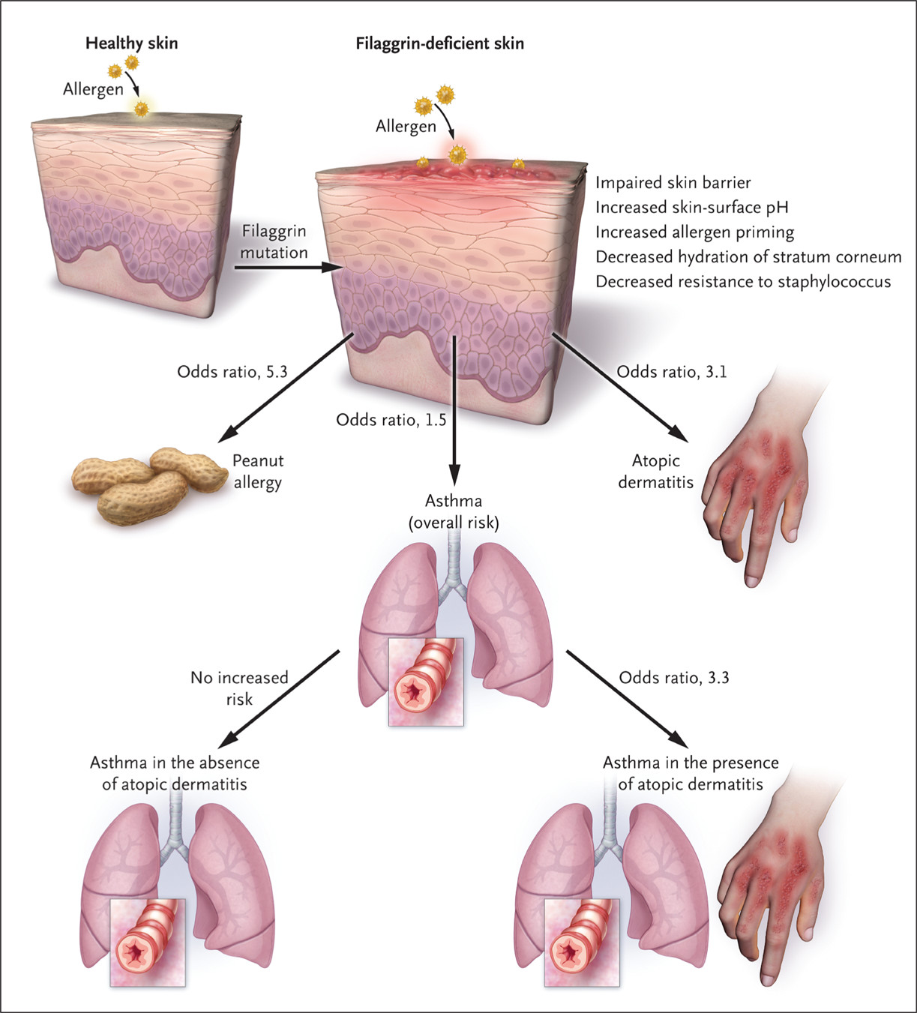
Irvine et al. NEJM 2011
Notes:
Illustrates that mutations in filaggrin can lead to the increased prevalence of AD but also other atopic conditions such as food allergy and asthma in the presence of AD.
https://www.nejm.org/doi/full/10.1056/NEJMra1011040

Slide 6
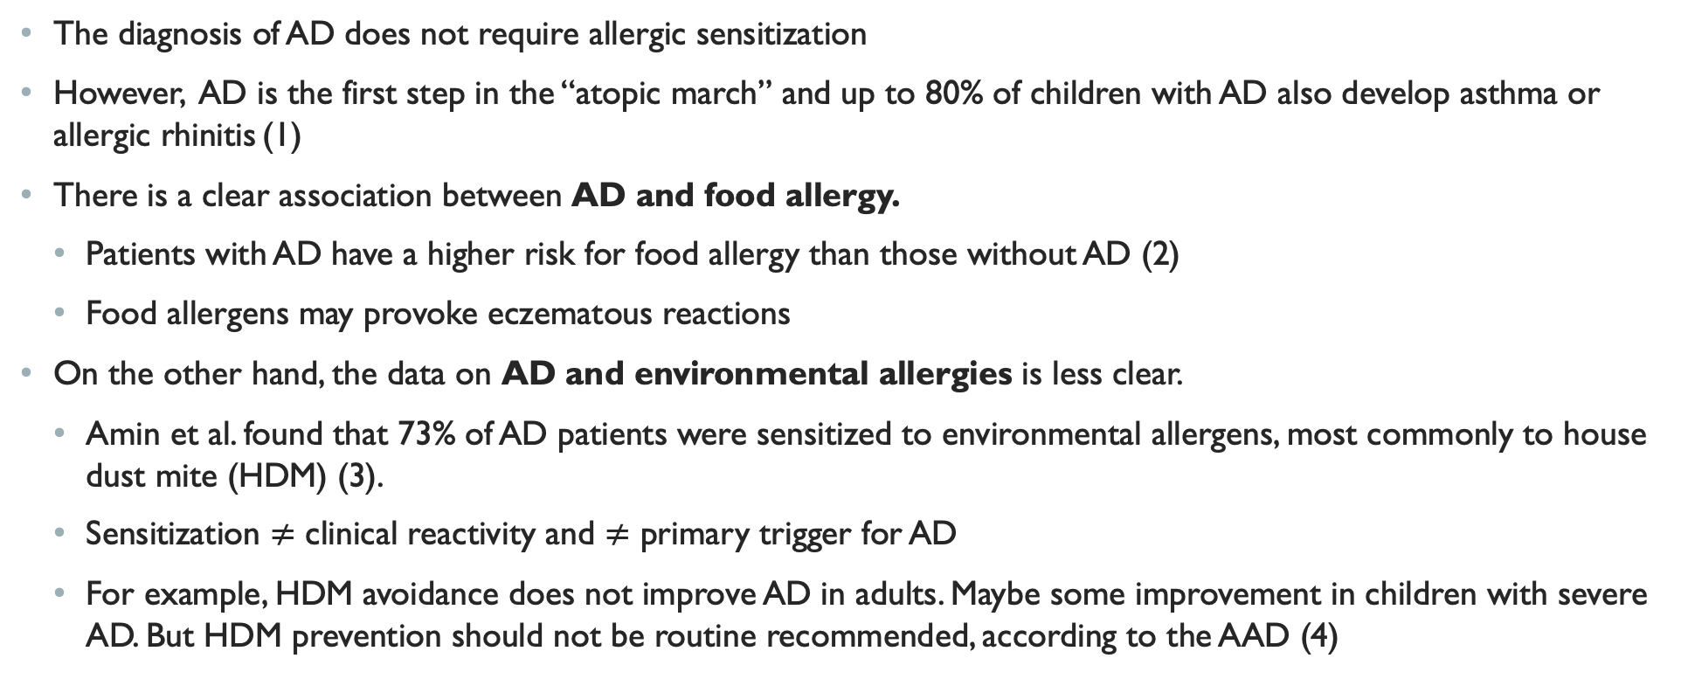
Role of allergic sensitization in atopic dermatitis
The diagnosis of AD does not require allergic sensitization
However, AD is the first step in the “atopic march” and up to 80% of children with AD also develop asthma or allergic rhinitis (1)
There is a clear association between AD and food allergy.
Patients with AD have a higher risk for food allergy than those without AD (2)
Food allergens may provoke eczematous reactions
On the other hand, the data on AD and environmental allergies is less clear.
Amin et al. found that 73% of AD patients were sensitized to environmental allergens, most commonly to house dust mite (HDM) (3).
Sensitization $≠$ clinical reactivity and $≠$ primary trigger for AD
For example, HDM avoidance does not improve AD in adults. Maybe some improvement in children with severe AD. But HDM prevention should not be routine recommended, according to the AAD (4)
1. Eichenfield et al. Pediatrics 2003.
2. Chu et al. Ann Allergy Asthma Immunol 2024.
3. Amin et al. Cytokine 2023.
4. Sidbury et al. J Am Acad Dermatol 2014
Notes:
The exact role of environmental allergens in the pathogenesis and exacerbation of AD remains controversial.
The pathophysiology of AD does not depend on environmental allergy exposure and the link is less clear. Avoidance does not necessarily help.
Reducing exposure to environmental allergens, such as Dermatophagoides pteronyssinus and Dermatophagoides farinae, does not consistently improve symptoms of atopic dermatitis (AD).
The American Academy of Dermatology (AAD) guidelines indicate that while house dust mite (HDM) sensitization is common in AD patients, the evidence supporting the routine use of HDM avoidance measures is limited. Normal cleaning measures, such as washing bedding weekly and frequent vacuuming, only provide small decreases in HDM allergen levels. Although HDM covers for pillows and mattresses may reduce allergen levels, studies have not consistently shown improvement in AD severity, particularly in adults. One study did show improvement in children, especially those most severely affected.^{[1]}
A study by Shah et al. found that hypersensitivity to Dermatophagoides pteronyssinus might be clinically relevant in approximately one-third of adult AD patients. However, this does not imply that allergen avoidance will universally improve AD symptoms in all sensitized individuals.^{[2]}
In summary, while allergen avoidance measures may be considered in specific cases, particularly for patients with severe AD and confirmed HDM sensitization, the overall evidence does not support a broad recommendation for these interventions to improve AD symptoms.
https://pubmed.ncbi.nlm.nih.gov/12612244/
https://www.annallergy.org/article/S1081-1206(23)01455-2/fulltext
https://pubmed.ncbi.nlm.nih.gov/25264237/

Slide 7
The evidence: Systematic review and meta-analysis
Yepes-Nunez et al (1) conducted a systematic review and meta-analysis to evaluate the benefits and harms of AIT for the indication of AD for the AAAAI/ACAAI Joint Task Force 2023 Practice Parameter on AD Update, which included:
23 RCTs comparing AIT (11 subcutaneous immunotherapy [SCIT], 12 sublingual immunotherapy [SLIT]) to no AIT (placebo or standard care)
1957 adult and pediatric patients
13 countries across Asia, Europe, North America, and South America
Used Cochrane methods for data extraction and GRADE approach to determine quality of evidence
Intention-to-treat analysis
1. Yepes-Nunez et al. JACI 2023
Notes:
While there is some benefit seen with AIT, I would argue it is not worth the burden of adding AIT to treat AD.
This guideline's linked systematic review of 23 RCTs (11 subcutaneous immunotherapy [SCIT] and 12 sublingual immunotherapy [SLIT]) included 1957 adult and pediatric patients (median of study mean ages, 19 years; range of means, 4-34 years).
Methods: Raters independently screened, extracted data, and assessed risk of bias in duplicate. We synthesized intervention effects using frequentist and Bayesian random-effects models. The GRADE approach determined the quality of evidence.

Slide 8
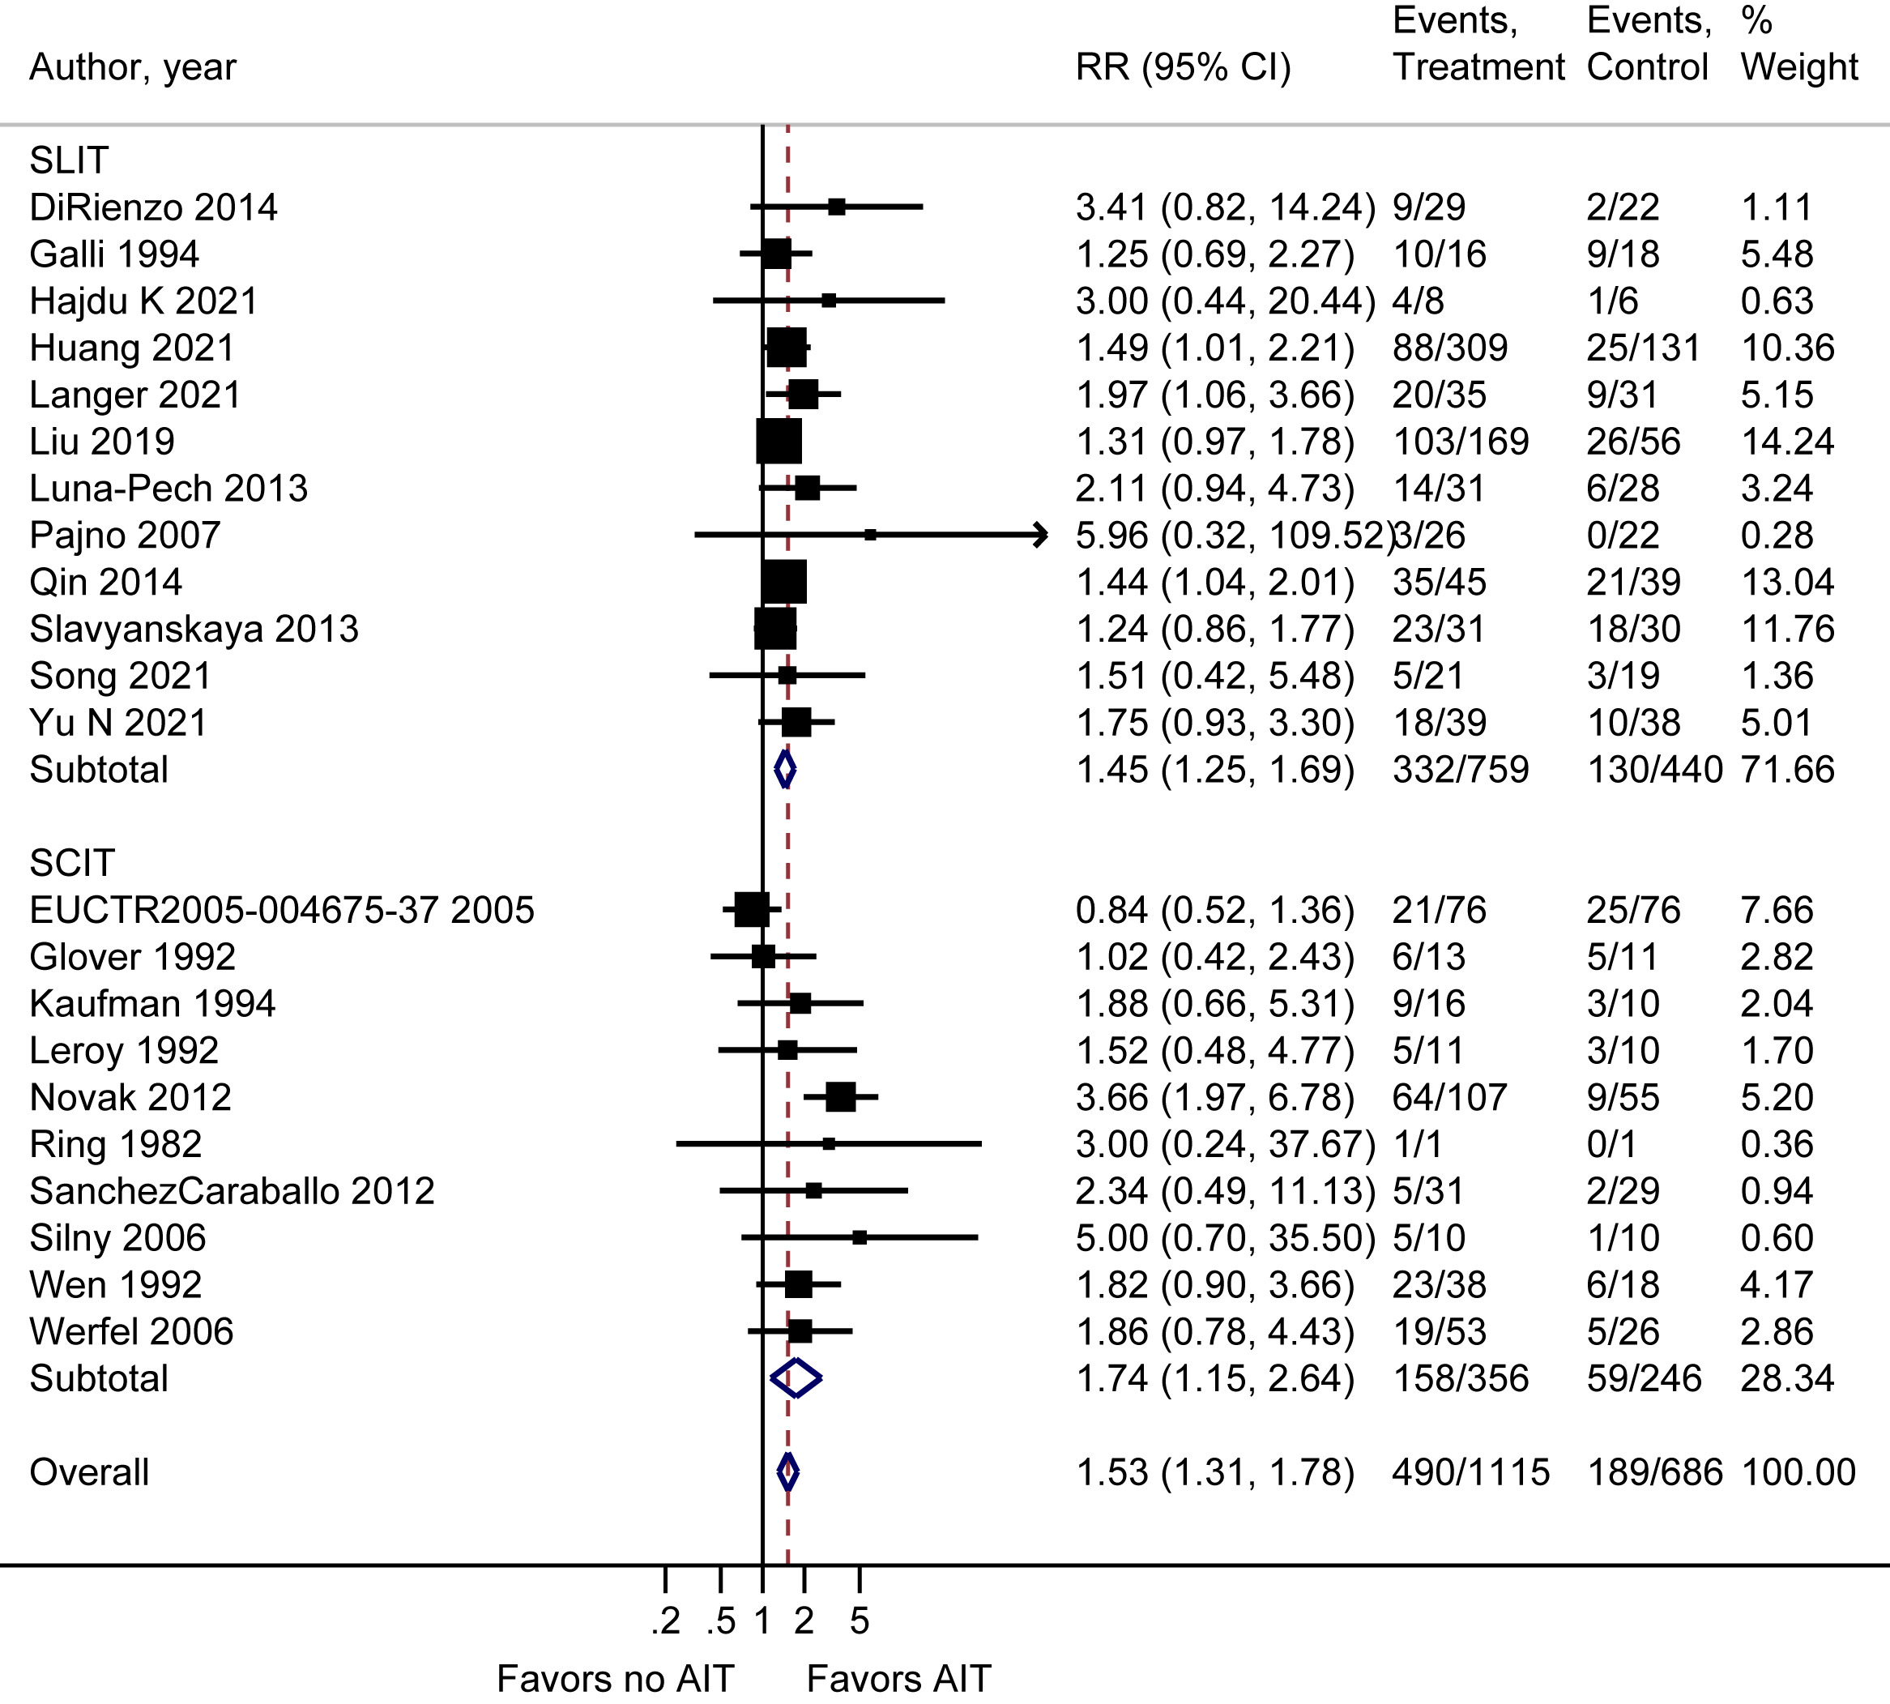
AIT improved clinician-reported AD severity by 50% or more compared to no AIT (40% vs 26%, RR 1.53 [95% CI, 1.31-1.78], moderate certainty)
Notes:
The first thing they looked at was the impact of AIT on AD (eczema) severity. They found a probable effect of improvement of AD by 50% from baseline with moderate certainty. 40% improvement in AIT vs 26% in no AIT. RR 1.53.
There is similar effect of SCIT and SLIT.
So, here we see that there may be some improvement with the use of AIT, however I will argue that this does not justify their use.

Slide 9
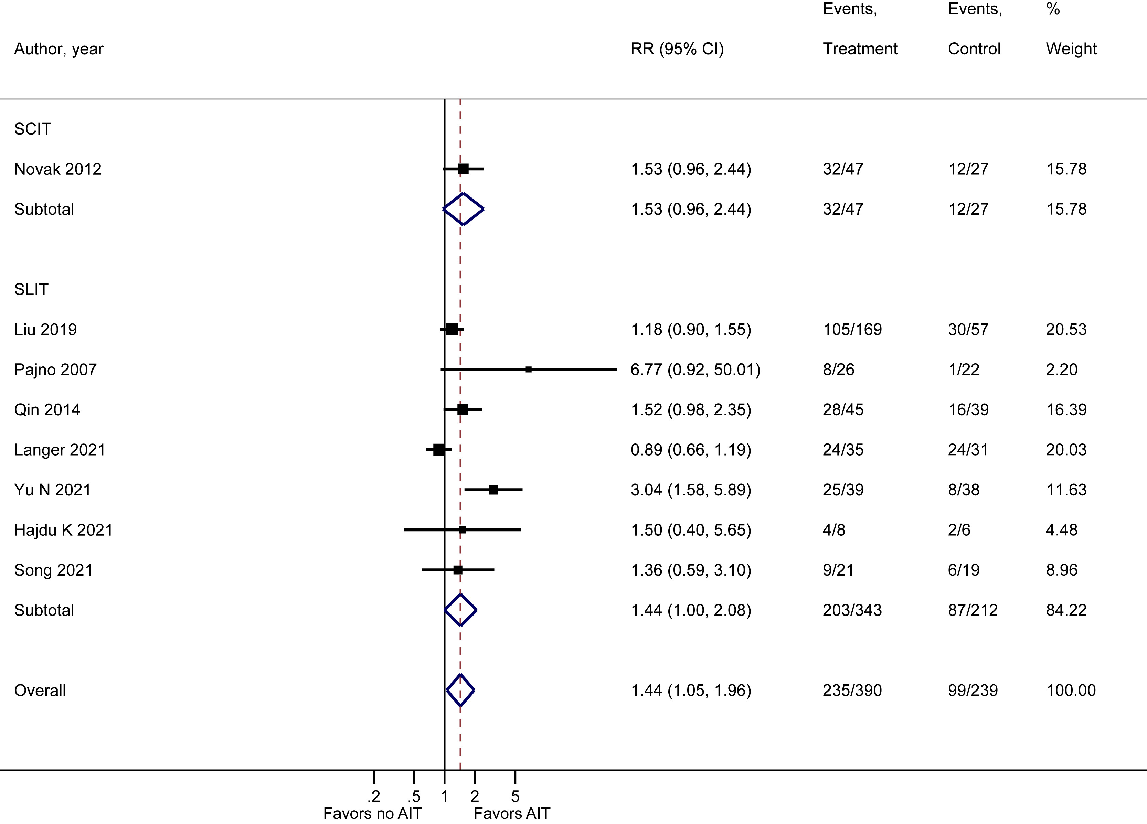
AIT improved DLQI by 4 or more points compared to no AIT (56% vs 39%, RR 1.44 [95% CI, 1.03-2.01], moderate certainty)
Notes:
Next, they examined the impact of AIT on AD (eczema)-related QoL. 8 RCT’s addressed impact of AIT vs no AIT on health related QoL, measured by DLQI and a minimally important difference of 4. AIT probably improved DLQI by 4 or more points compared to no AIT with moderate certainty. 56% vs 39%, RR 1.44.
Note that only one study was included for SCIT.

Slide 10
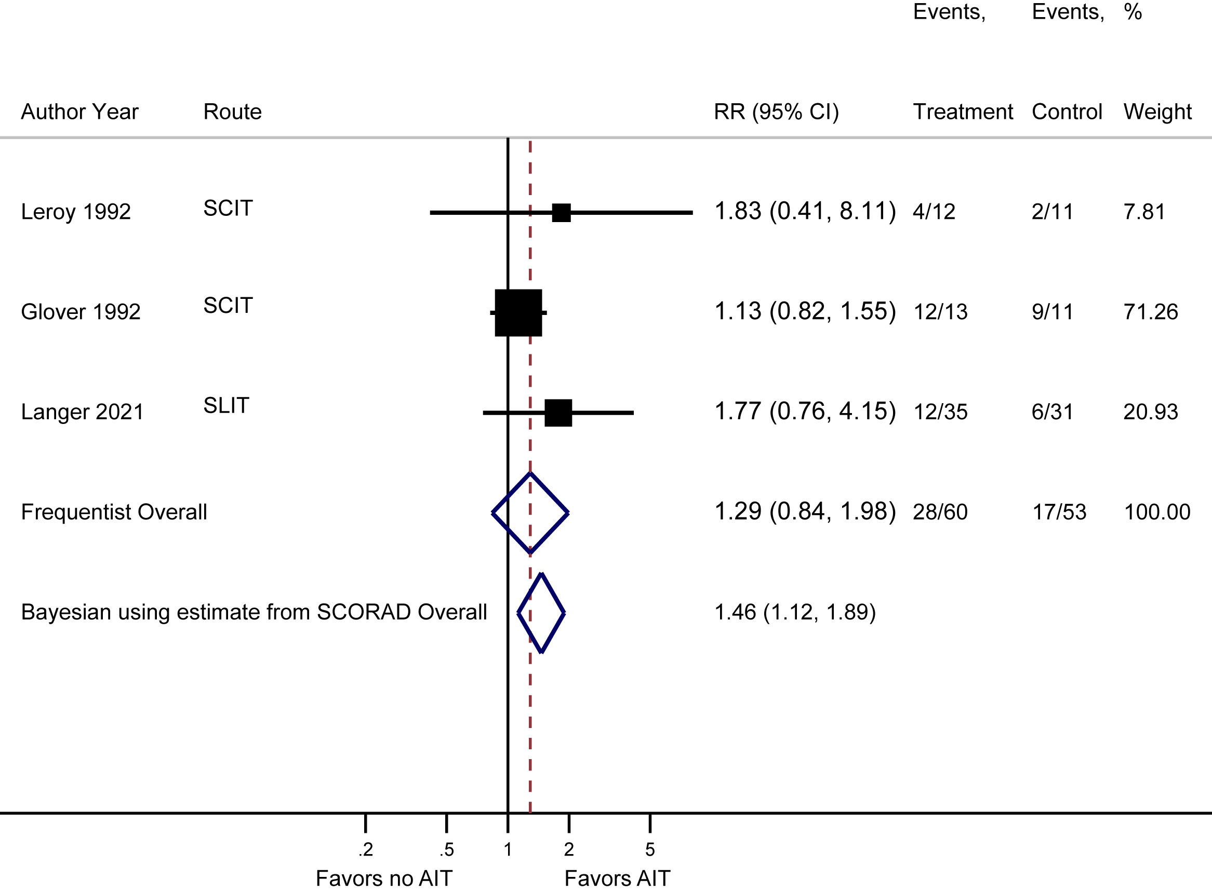
AIT reduced itch by 50% from baseline compared to no AIT (25% vs 19%, RR 1.29 [95% CI, 0.84-1.98], low certainty)
Notes:
Three RCTs that examined itch. AIT may reduce itch by 50% from baseline compared to no AIT, but the evidence is uncertain (25% vs 19%, RR 1.29).
Sleep:
The effect of AIT compared to no AIT on sleep loss in patients with AD is very uncertain (very low-certainty evidence).
Flares:
The effect of AIT, compared to no AIT, was very uncertain.

Slide 11
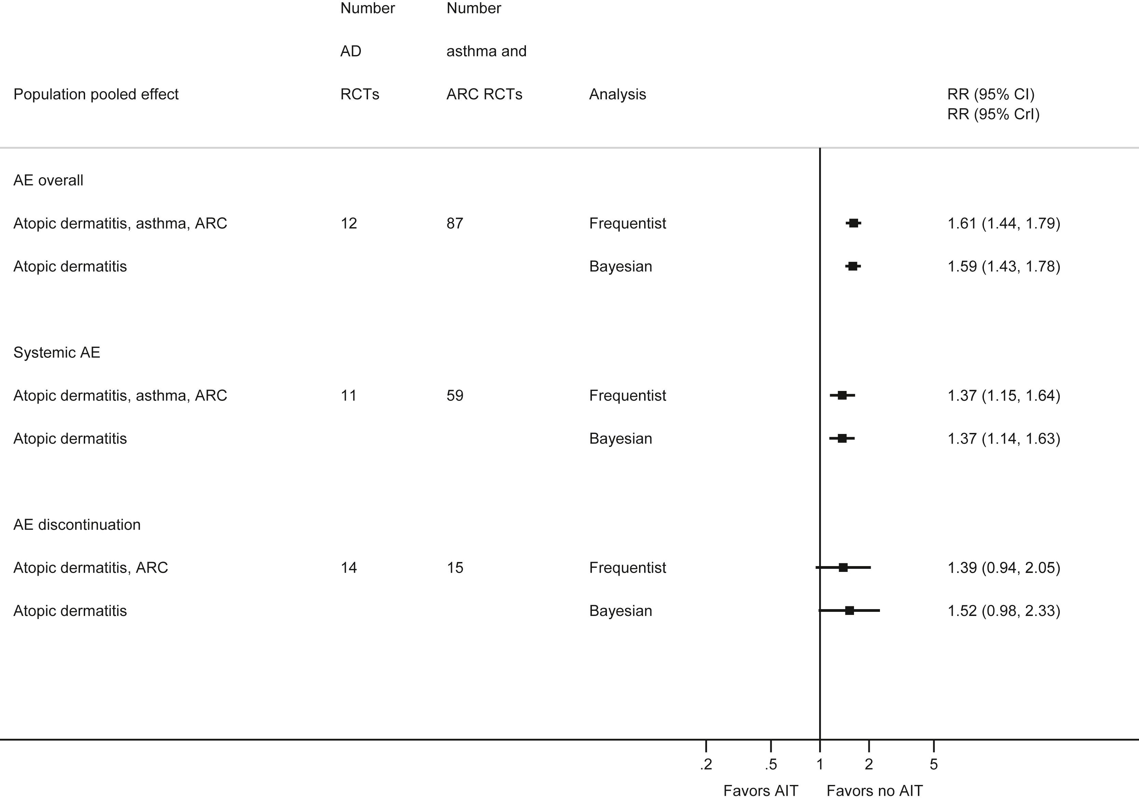
AIT increased local adverse events (RR 1.65 [95% CI, 1.48-1.64], high certainty)-> 66% of SCIT, 13% of SLIT
AIT increased systemic reactions (RR 1.37 [95% CI, 1.15-1.64], moderate certainty)-> 10% of SCIT, 0.14% SLIT
AIT increased adverse effects severe enough to cause discontinuation (RR 1.39 [95% CI, 0.94-2.05], moderate certainty)
Notes:
For adverse events, they aggregated data from studies including AIT for asthma and ARC and used frequentist and Bayesian frameworks. Frequentist framework uses traditional statistical methods such as random-effects models to calculate pooled estimates of treatment effects, whereas Bayesian framework combines prior information or beliefs about treatment effect.
They found that with high certainty that AIT increased local adverse events.
AIT increased systemic reactions.
And, AIT increased adverse effects severe enough to cause discontinuation with moderate certainty.

Slide 12
Bottom line
Although there is some moderate certainty of AIT improving AD severity and QoL, there is an important increase in adverse events, particularly with SCIT.
We do not know the impact of AIT on long term AD control, flares, itch, and sleep quality, and patient-reported AD severity.
The studies were mainly on HDM. Only 4 (17%) RCTs addressed pollens or did not specify the allergens used.
SLIT studies were done with SLIT drops, whereas many U.S. allergists are familiar with SLIT tablets
AIT took months to improve AD.
Did not address the time commitment and inconvenience of committing to SLIT daily or SCIT weekly-monthly
Did not differentiate baseline severity of AD
What about infants who have not developed aeroallergen sensitization?

Slide 13
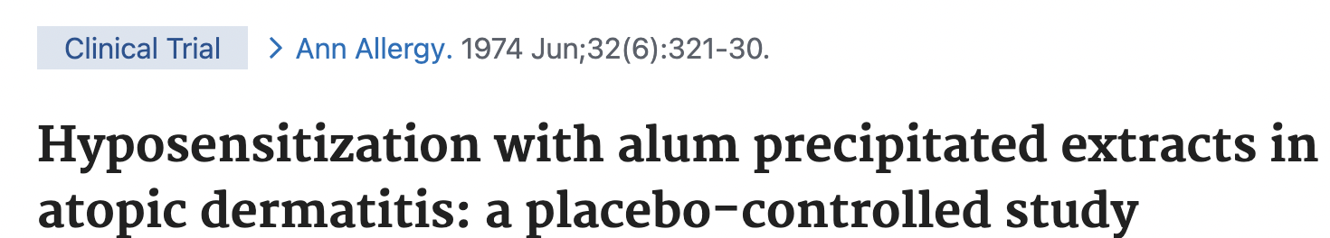
SCIT for treatment of atopic dermatitis in the united states
There is one study…
Kaufman and Roth reported a quasi-double-blind placebo-controlled study in 1974:
52 patients with AD.
Half the patients dropped out before completing the study.
13/16 patients in the treatment group and 4/10 in the placebo group improved over a 24-month study period.
Limitations included randomization, inadequate blinding, and the high patient drop-out.
Notes:
We know that allergen immunotherapy outcomes can be different abroad, particularly in Europe, particularly data on SLIT.
In fact, in Yepes-Nunez’s study, only of the RCT’s included was from the United States which was by Kaufman and Roth in 1974.
Let’s take a better a look at typically used immunotherapy SCIT used in the US and see if there are any benefits for AD.

Slide 14
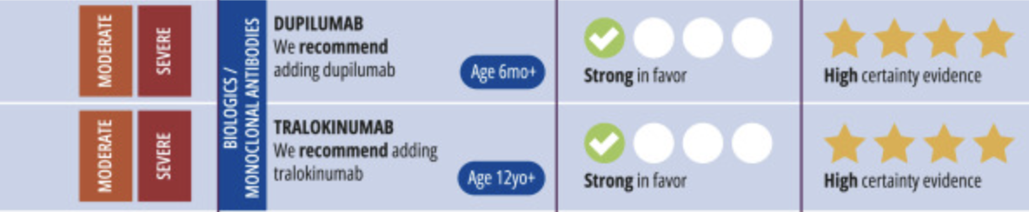

AIT vs. biologic for treatment of AD
Benefits of Dupixent over AIT, although there are no head-to-head studies
There is a large treatment effect with greater certainty
Initially there are less frequent injections
Option for self injection
Can be used down to 6 months of age, whereas AIT is typically not indicated until later
Chu et al. Ann Allergy Asthma Immunol 2024
Notes:
Although there are no head-to-head studies between AIT and biologics use for atopic dermatits, the evidence and clinical experience with using a biologic, particularly with dupilumab is clear. Not only is there a favorable safety profile, but it also works very effectively with strong certainty of evidence.
There is larger treatment effect with greater certainty
Initially less frequent injections
Option for self injection
We can use dupilumab down to 6 months of age, whereas AIT is typically not indicated for younger children.
In the practice parameters, they even have conditional favor of using AIT for moderate-severe eczema, but they place guardrails around this recommendation because they want allergists to select AIT for AD if other conditions can benefit such as ARC and asthma, and not solely out of the use for AD.

Slide 15
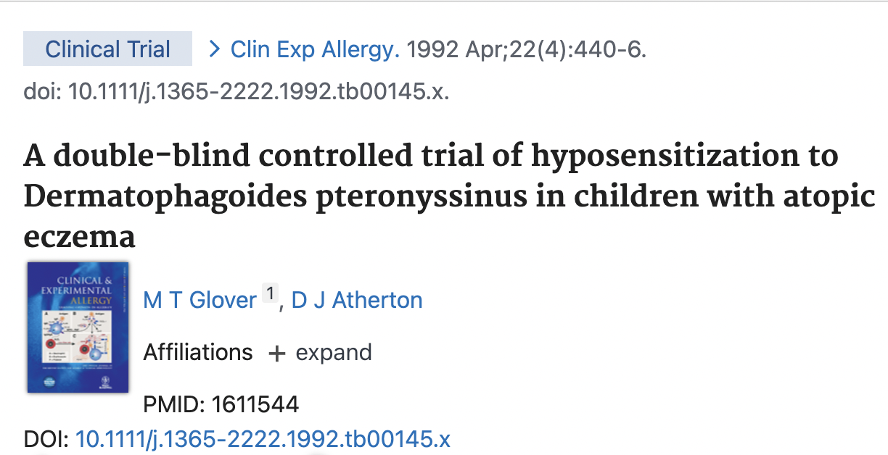
Power of Placebo effect
Glover and Atherton reported on 24 children with AD and sensitization to HDM in the UK that underwent a double-blind placebo-controlled trial of SCIT:
Study 1: Patients were randomized to HDM SCIT or placebo injections for 6 months
Study 2: To assess long term maintenance treatment in the 13 patients in the treatment arm, they were offered 6 more months of monthly injections randomized to treatment or placebo. 7/13 accepted.

Slide 16
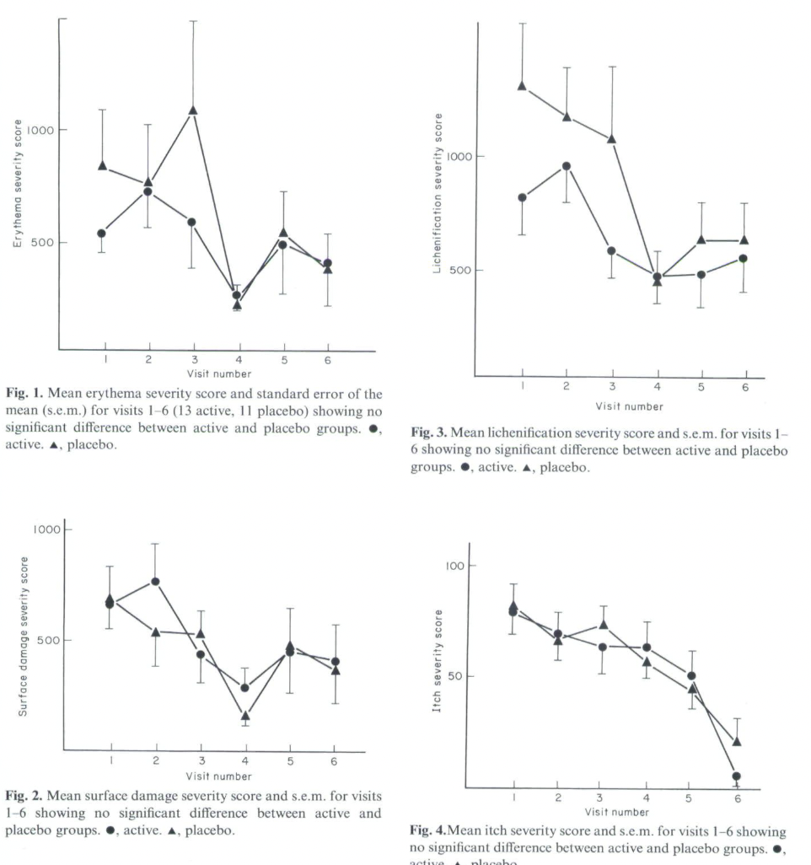
Study 1
Erythema
Lichenification
Surface damage
Itch
Notes:
Both treatment and placebo groups showed significant improvement but no statistical difference in erythema, surface damage, lichenification, or itch by the end of 6 months (visit 6).

Slide 17
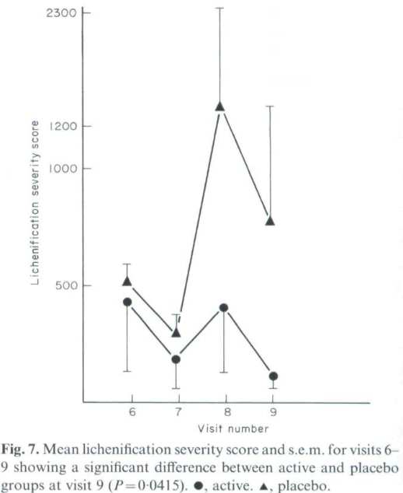
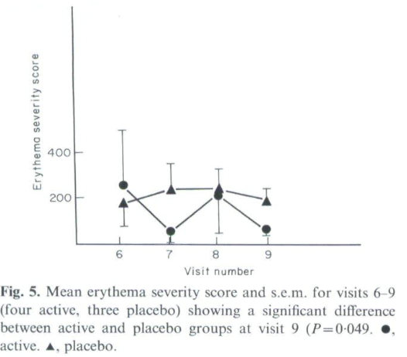
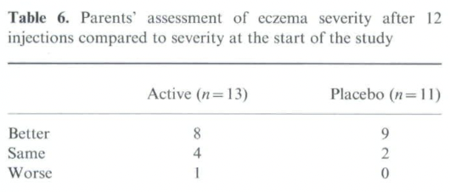
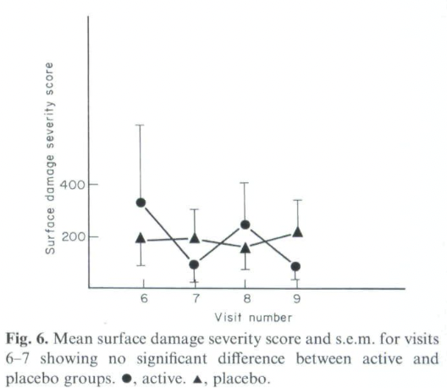
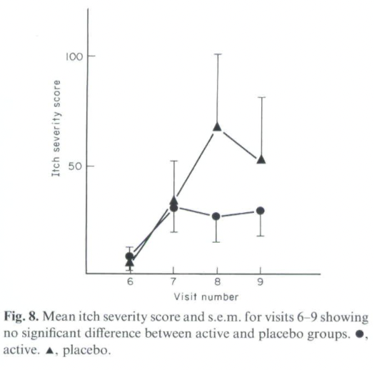
Study 2
Erythema
Lichenification
Surface damage
Itch
Notes:
7 patients received who agreed to Study 2, 4 received SCIT with dust mite and 3 received placebo. There was a statistical significant difference at the last visit for erythema and lichenification but not surface damage or itch.
Interestingly, after 12 months when you ask parents if their child’s eczema was better, same, or worse after treatment, many who were receiving placebo felt that it was better, and there was no statistical significant difference.
There are a couple things to highlight here:
that the patient/family perspective in perceiving improvement is an important metric.
It took 12 months to have some difference seen in erythema and lichenification, but not all metrics.
There was a substantial placebo effect, so studies we examine have to be carefully crafted to look a placebo arm that specifically uses an indistinguishable alternative to SCIT, unlike some of the studies included in the systematic review.
----
There was no difference in total IgE, dust mite IgE and SPT at the end of the study.

Slide 18
Other Concerns about treating ad with ait
There are differences in allergen immunotherapy formulation by practice, and different schedules of delivering immunotherapy (i.e. weekly vs monthly SCIT, cluster and rush SCIT) that may lead to a wide range of treatment outcomes
We don’t know much about patient preferences
Could the improvement in AD be due to increased office visits with AIT?
Notes:
Patient preferences: impact on daily life, treatment burden. Eczema-associated QoL is not the only important QoL metric.

Slide 19
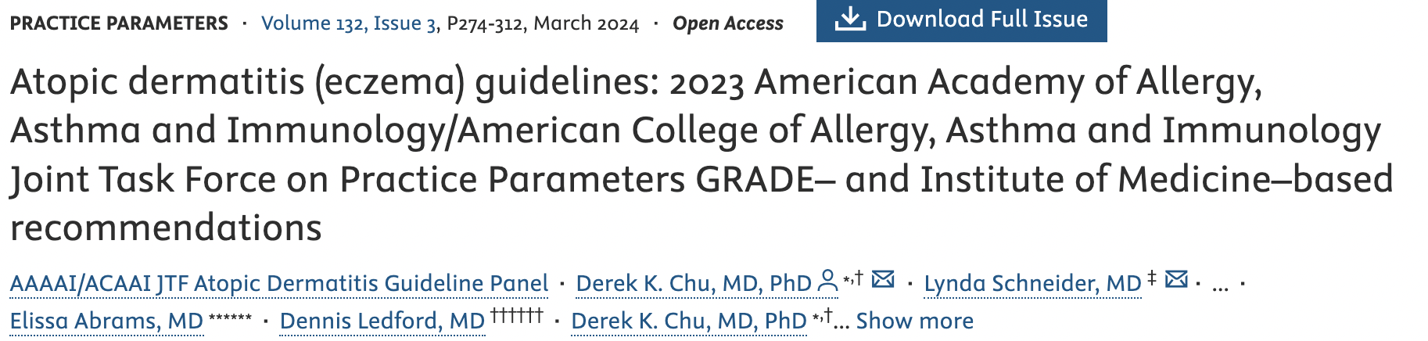
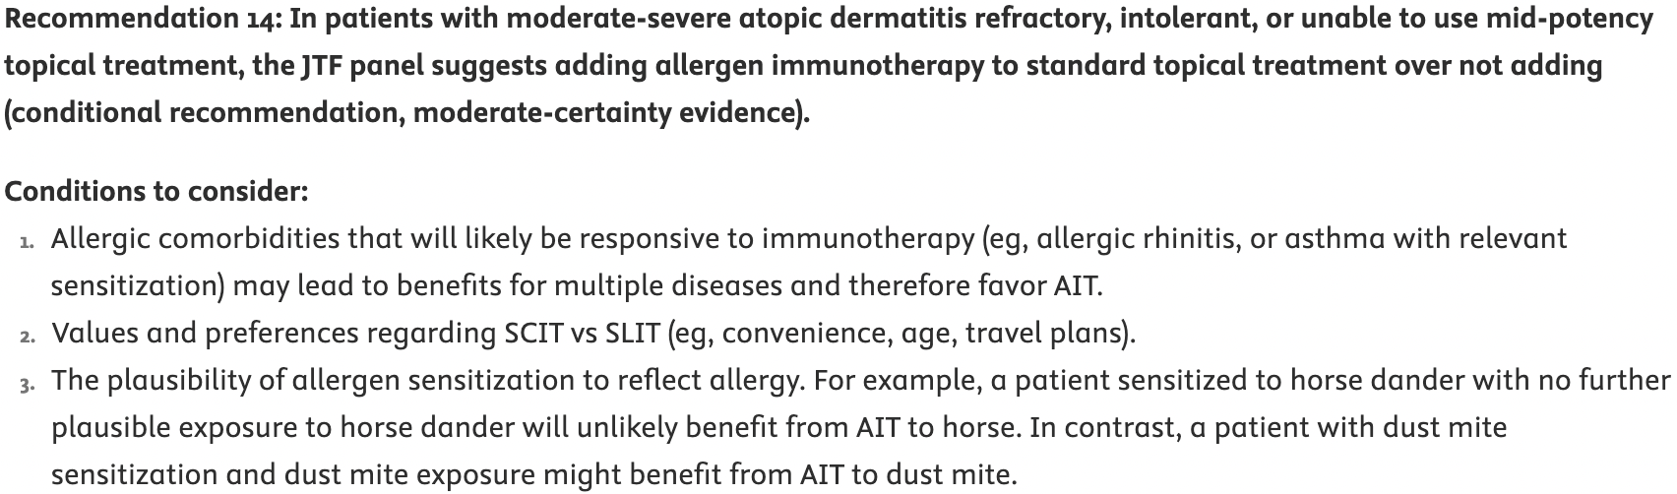
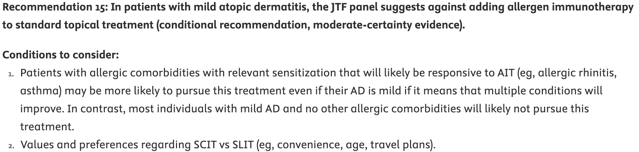
Expert Opinion

Slide 20
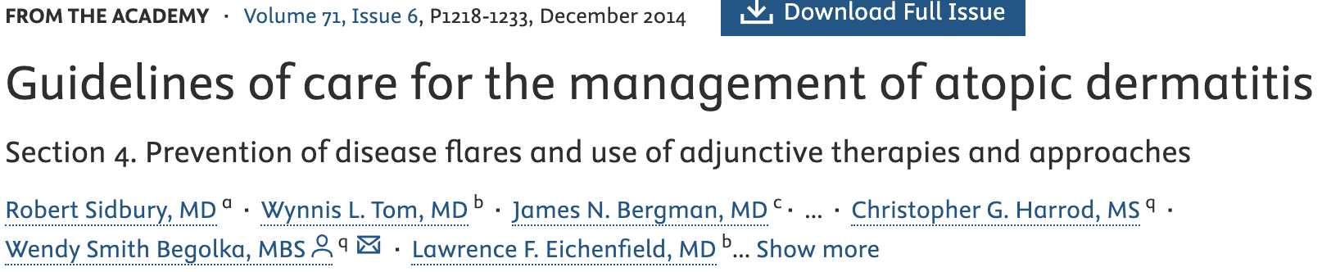
Expert Opinion
Strength of recommendation:
B. Recommendation based on inconsistent or limited-quality patient-oriented evidence
Level of evidence:
II. Limited-quality patient-oriented evidence
Table II Recommendation for prevention of flares of atopic dermatitis
Table VI Recommendations for other adjunctive and complementary interventions for the treatment of atopic dermatitis
Notes:
In the general AD population, sublingual immunotherapy and injection immunotherapy are not recommended for the treatment of AD because of the small number of studies and conflicting conclusions. AAD
Strength of Recommendation Taxonomy (SORT)
I. Good-quality patient-oriented evidence (ie, evidence measuring outcomes that matter to patients: morbidity, mortality, symptom improvement, cost reduction, and quality of life).
II. Limited-quality patient-oriented evidence.
III. Other evidence, including consensus guidelines, opinion, case studies, or disease-oriented evidence (ie, evidence measuring intermediate, physiologic, or surrogate end points that may or may not reflect improvements in patient outcomes).
Clinical recommendations were developed based on the best available evidence tabled in the guideline. These are ranked as follows:
A. Recommendation based on consistent and good-quality patient-oriented evidence.
B. Recommendation based on inconsistent or limited-quality patient-oriented evidence.
C. Recommendation based on consensus, opinion, case studies, or disease-oriented evidence.

Slide 21
Conclusion
There is some but limited evidence for the use of AIT for the indication of AD, predominantly for patients with HDM sensitization
Exercise caution with extrapolating studies done abroad due to differences in sensitization profiles and practices such as the predominant use of SLIT drops in available RCT studies
Studies have limited reporting of patient experiences around burden of treatment and acceptability of the time to efficacy and adverse events
Comparative efficacy to current standard of treatment (i.e. biologics) for moderate-severe AD, mostly anecdotally, but there are no head-to-head studies
Most importantly as providers, we should provide patients with the informed decision that maximizes their benefit to risk ratio when presenting treatments for AD
Notes:
The studies that inform our guidelines to use AIT in moderate-severe AD, particularly with patients with other atopic conditions cannot necessarily be extrapolated to practice of AIT in the US.
Sometimes when there are other treatments we know work well, it is difficult to spend the time to explain the complexities of using AIT for AD when you are presenting a few different options.

Slide 22
Thank you!

Slide 23
Rebuttal
Notes:
AIT as an adjunct rather than in place. – Sure, it’s a positive but is it only marginal benefit only?
Dupixent – lead to live vaccine response.

Slide 24
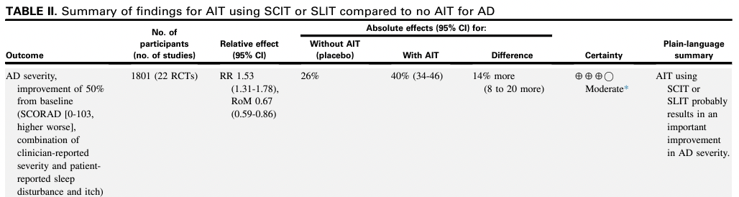
Reduces severity of atopic dermatitis
Modest difference with a range of 8-20%.
Risk of bias present due to patients not always being blinded.
Yepes-Nunez et al. JACI 2023
Notes:
Again, these studies are for HDM and not useful for interpretation of sensitization and immunotherapy to anything else.

Slide 25
Reduces severity of atopic dermatitis
Inconsistent data
Bae et al (1) performed a systematic review and meta-analysis in 2013:
Subgroup analysis that showed that SCIT improved AD, but SLIT did not
AIT did not improve AD in children
Tam et al (2) performed a Cochrane systematic review and meta-analysis in 2016:
While AIT improved SCORAD, it did not improve SCORAD part C (patient/parent-reported itch and sleep disturbance)
1. Bae et al. J Allergy Clin Immunol 2013.
2. Tam et al. Cochrane Database Syst Rev. 2016

Slide 26
Reduces severity of atopic dermatitis
Newest data (1)
Yu et al., 2021 (2) performed an RCT on 96 HDM sensitized patients
Included children and adults (ages 4-60)
AIT improved SCORAD and Visual Analogue Scale (VAS) after 12 months, however, this study was unblinded
High drop out rate (20%)
Langer et al., 2022 (3) performed a double-blind, placebo-controlled study on 91 HDM sensitized patients with SCORAD >=15
Included children and adults (ages 3-62)
No difference in EASI or DLQI scores, VAS for symptoms, and pruritis after 18 months
High drop out rate (27%)
1. Pessina et al. Front Pediatr. 2022
2. Yu et al. Postepy DermatolAlergol. 2021
3. Langer et al. J Allergy Clin Immunol Pract. 2022

Slide 27
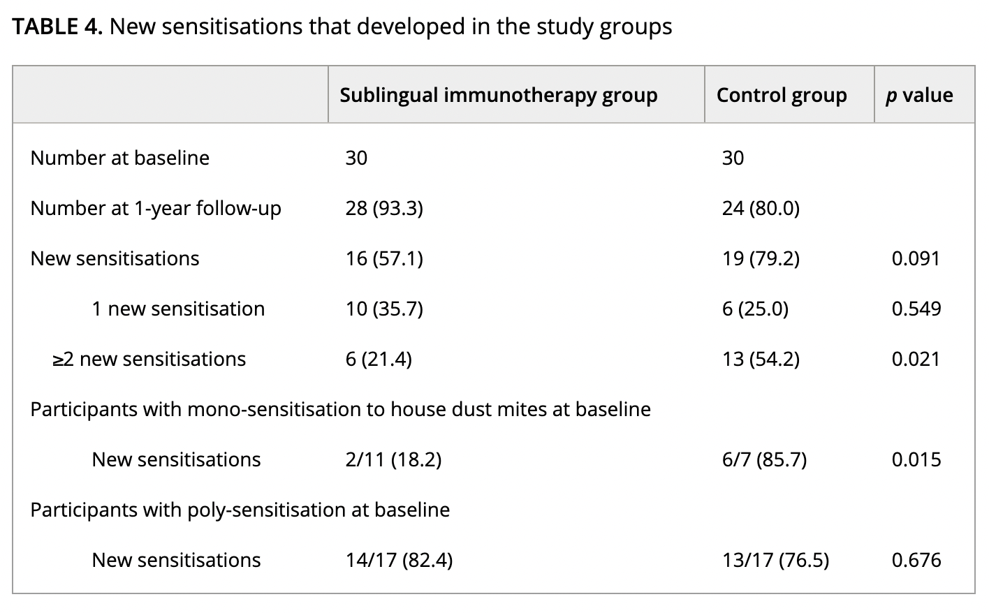
Prevention of new sensitization
Kim et al. reported that pediatric patients that underwent HDM SLIT had a reduction in 2 or more new sensitizations after 12 months
0/17 who received SLIT developed AR vs 3/17 who did not receive SLIT did develop AR
None of the patients developed new asthma
Concerns:
Number of patients is limited, and we don’t have long term data
Does the degree of sensitization prevention from SLIT offset the burden and side effects of treatment?
Kim et al. Acta Paediatrica 2022
Notes:
31% had local reactions that were were not severe.

Slide 28

Other concerns about sensitization
Sensitization $≠$ clinical reactivity and $≠$ primary trigger for AD
Moderate-severe eczema – testing can lead to false positives
Notes:
For example, pollen sensitization but perennial eczema.

Slide 29
Safety profile
Although SCIT and SLIT can increase the risk for severe adverse events such as systemic reactions, and we have experience with them for indications in allergic rhinitis and allergic asthma, the real question is whether the benefits will outweigh the risks and burden of treatment
We have alternatives that have good safety profiles that are likely more efficacious!

